Slide 1
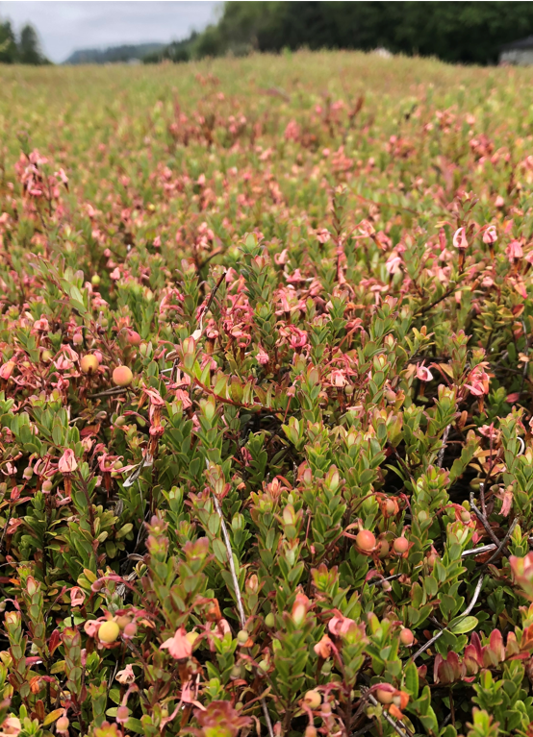

US Pesticides and WA Research Update (maybe)
Sam Tochen
Ag. Scientist-WA
Ocean Spray Cranberries
2022 PNW Cranberry Congress

Slide 2
What’s on deck
WSU cranberry extension update
Pesticide update
Brief tipworm trial update (time permitting)

Slide 3


WSU extension position update
Final search committee request has been submitted
Submitted notice of vacancy and waiting for approval to advertise position.
Late spring/summer?
?
Notes:
you may have seen the description in the latest pccrf newsletter

Slide 4
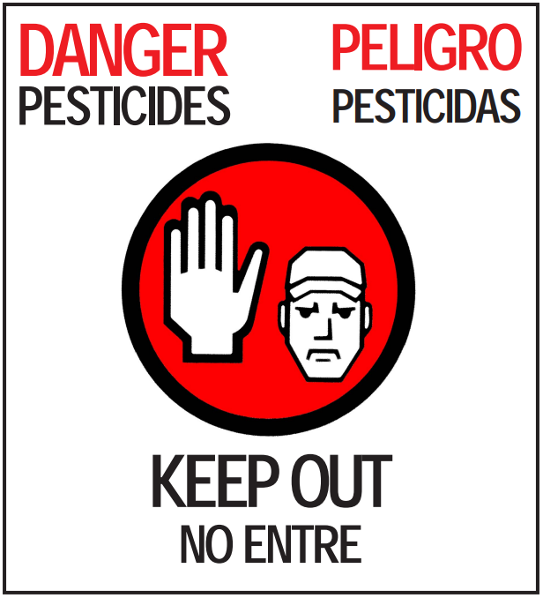
US Pesticide Updates
pay attention to this section

Slide 5
Quick disclaimer and reminder
For all products, read the label
  Make sure labeled for your region
  Cranberry needs to be listed on the physical label you possess
Check with your handler re: further restrictions

Slide 6
What’s out?

Slide 7
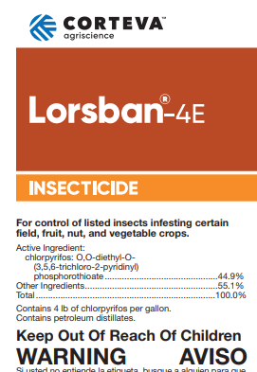
Lorsban (and any other chlorpyrifos products)
EPA revoked all MRL tolerances on food crops
NO USE ALLOWED AFTER 2/28/2022
  Supersedes any existing phase-outs at state level (OR, WA)
Notes:
Few exceptions for use, not sure worth mentioning

Slide 8
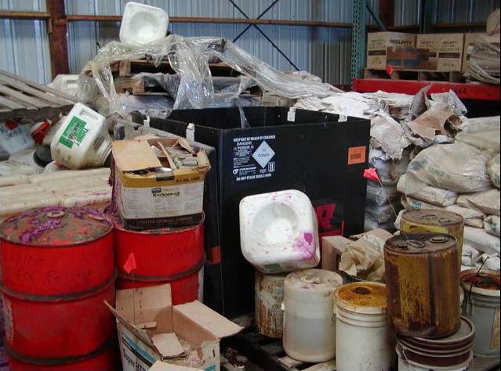

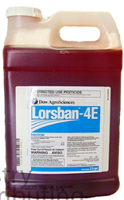
Pesticide waste programs
ODA and WSDA provide free disposal of pesticides
Credit: UF/IFAS Pesticide Information Office

Slide 9
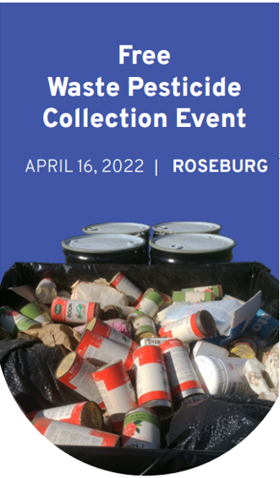

ODA
Provided through the Pesticide Stewardship Partnership (PSP) Program
  Disposal of pesticides only (includes surfactants and adjuvants)
  No fertilizers, solvents or other non-pesticidal materials
Nearest collection event April 16th
  Douglas County Fairgrounds, 2110 Frear St., Roseburg
Must register by April 1st to participate
  Go to: https://oda.direct/PSP

Slide 10

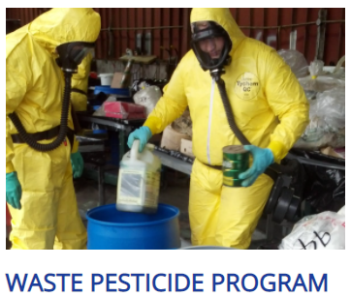
WSDA
Provided through WSDA’s Technical Services and Education Program
  Same deal as Oregon, only pesticides
Next collection event for cranberry growing regions will be in June (dates TBD*)
Must contact WSDA 1 month beforehand
  wastepesticide@agr.wa.gov
  (360) 902-2056
  https://agr.wa.gov/services/education-and-training/tsep/waste-pesticide-program
Note: WSDA will pick-up chemicals from your farm** at no charge
Notes:
*If no interest expressed, pick up will not happen
**preference for Grayland area, but in general

Slide 11
What’s in?

Slide 12
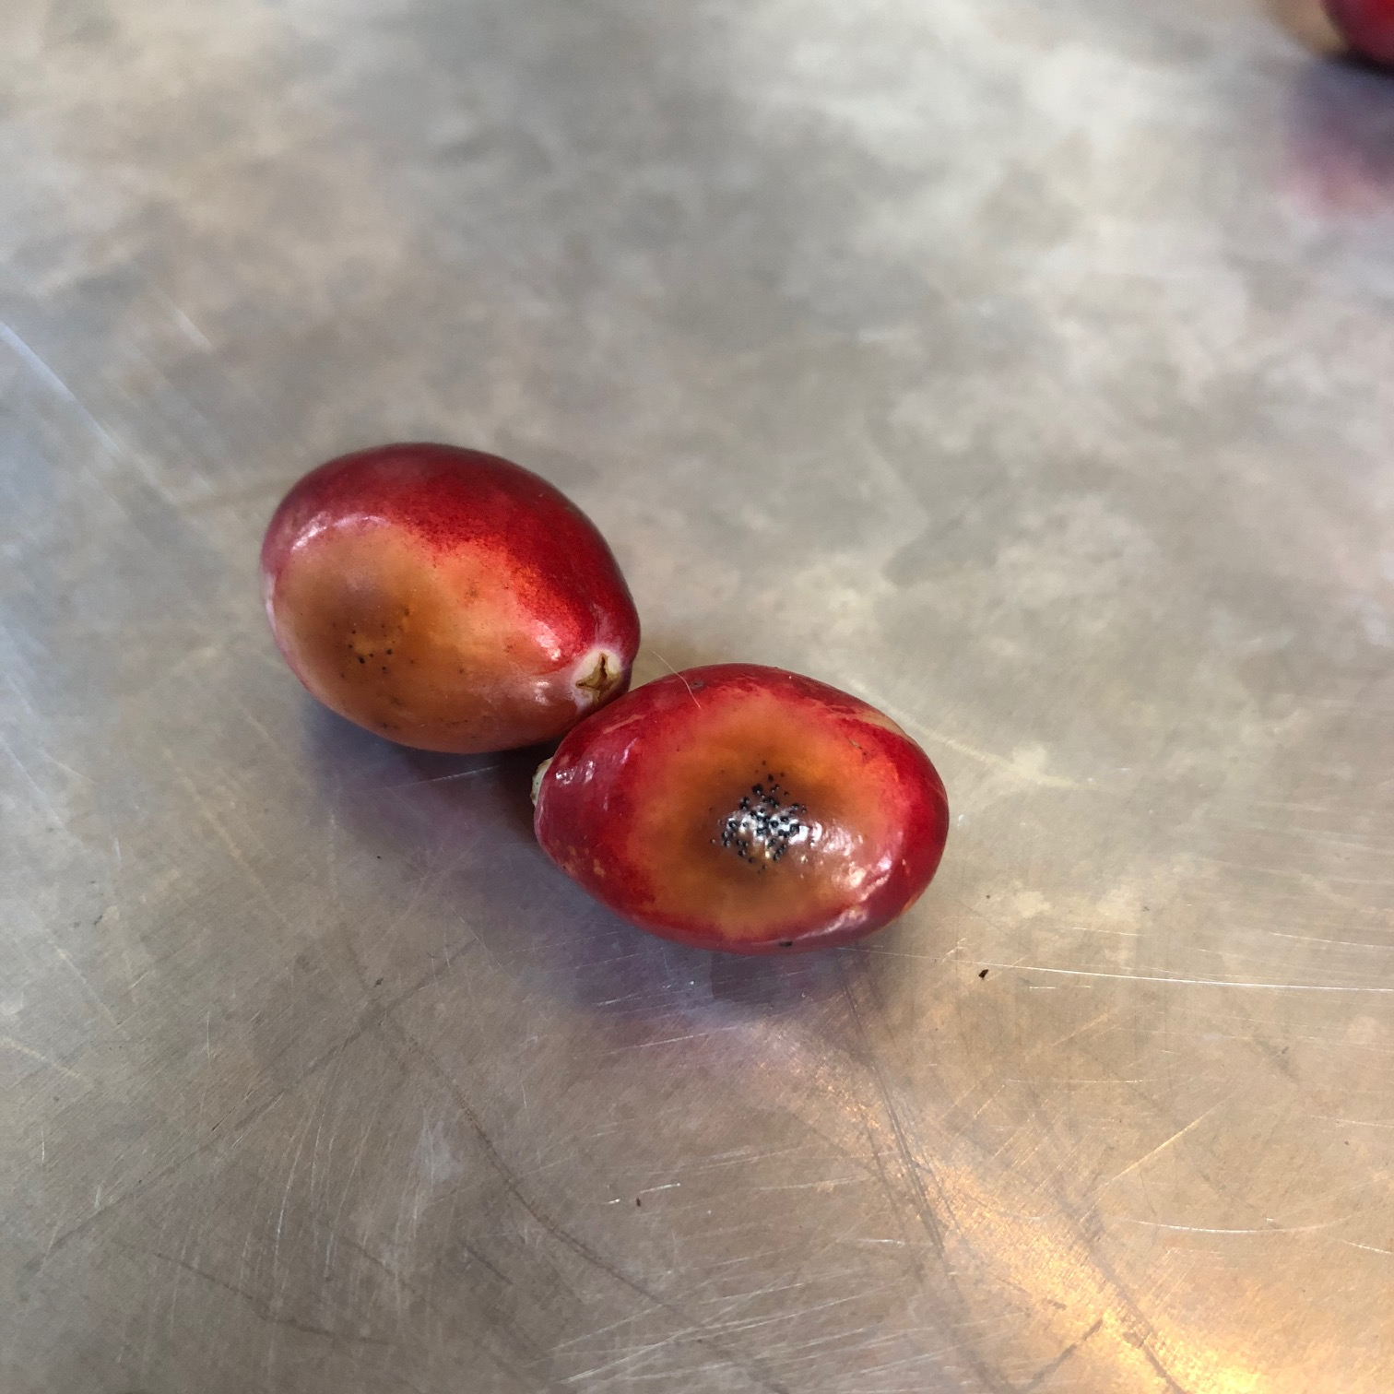
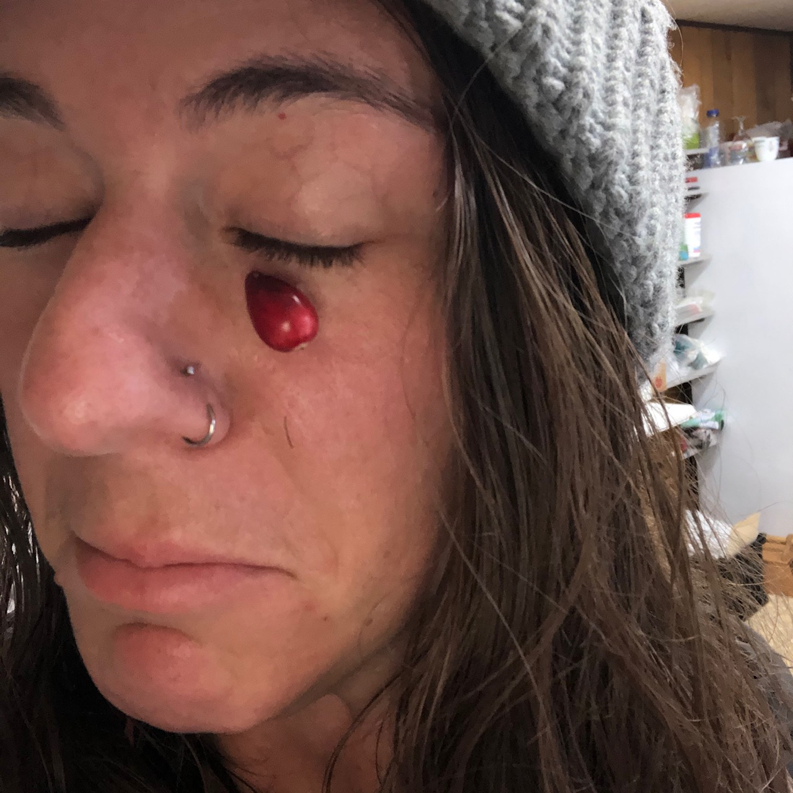
(not) Fungicides
Still nothing new of note
  FRAC 7 and some biologicals coming down the pipeline

Slide 13
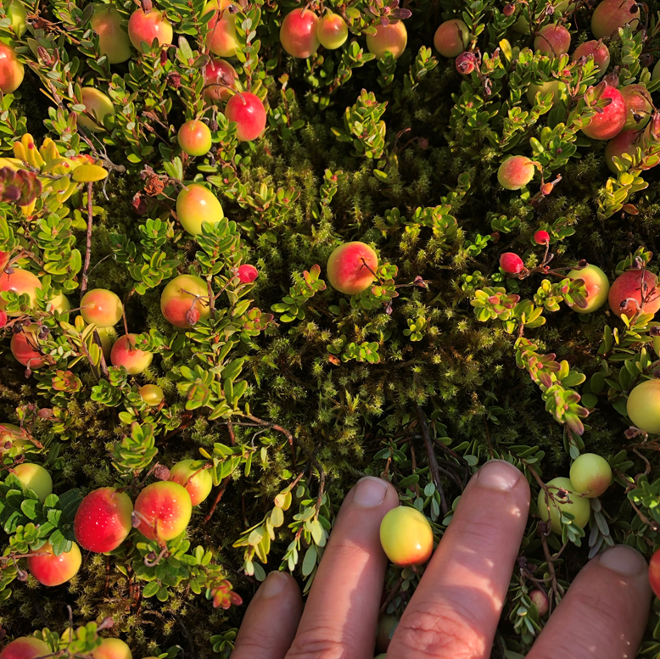
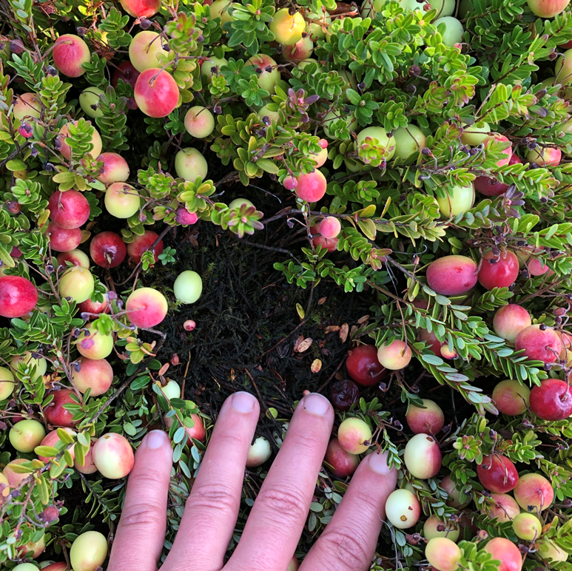
Herbicides
No updates on that one pre-emergent with amazing moss control
so impressive, it threw off the color correction

Slide 14
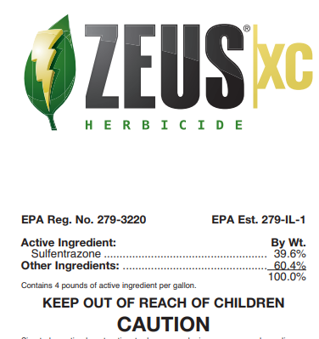
Zeus XC 24(c) SLN label update
Recall, MA and NJ have SLNs for Zeus XC (a.i. sulfentrazone) on haircap moss and allows chemigation
ODA received the application, and it’s currently under review
  may have in time for applications this season
WSDA still waiting on application package ☹
  should have by next week, but 60-day review process
  may not have before dormancy breaks

Slide 15
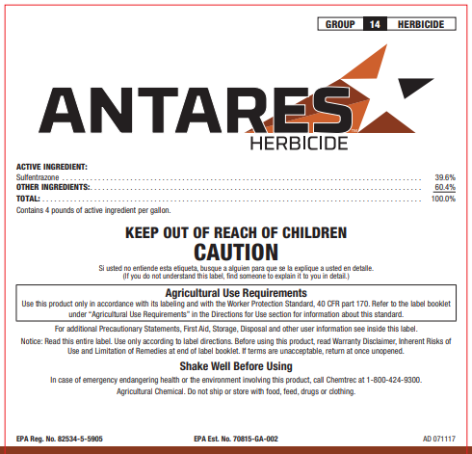
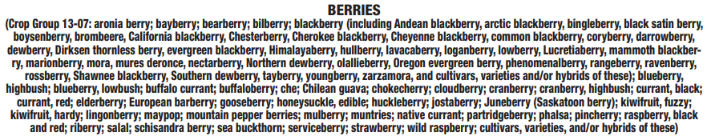
That other sulfentrazone option
Source through distributor, difficult to acquire (ymmv)
physical label must have cranberry listed
broadcast application
4-12 fl oz/acre rate
Dormant applications only

Slide 16
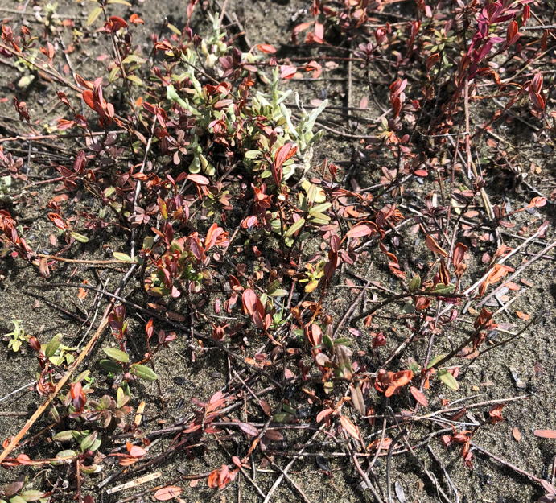
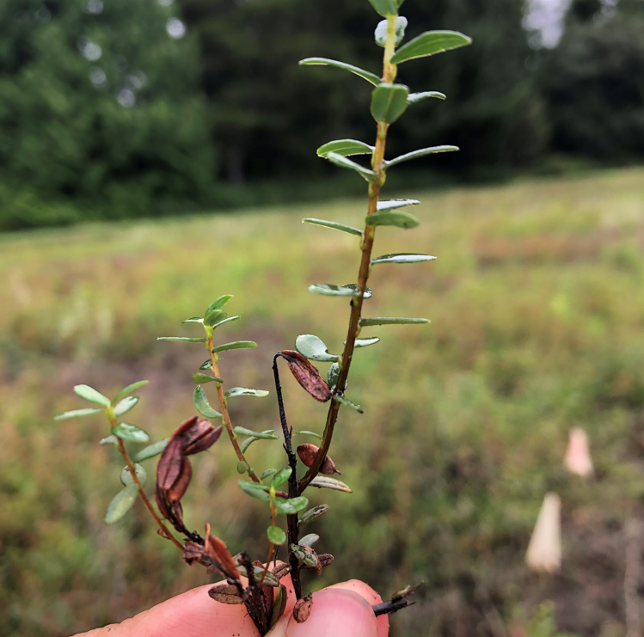
Dormant apps are a must
May
Aug
you will damage *new* growth
vines should recover if healthy

Slide 17
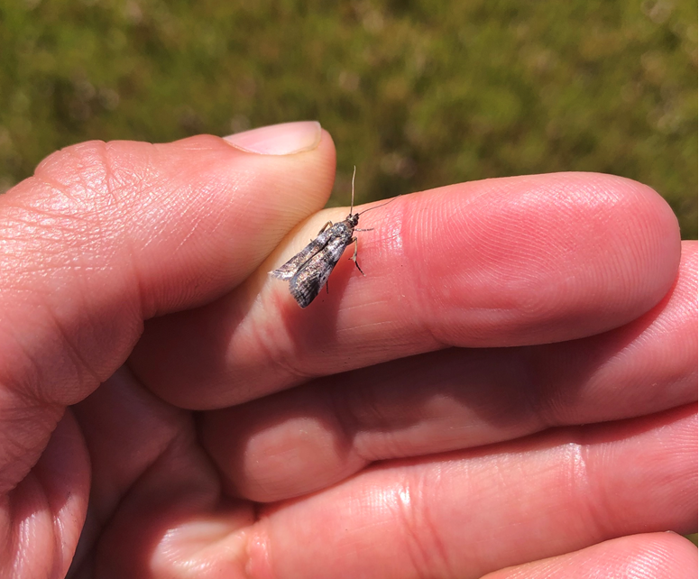
Insecticides
Fanfare (a.i. bifenthrin)
  Yep, that one pyrethroid you’ve been waiting for (hold your applause)
Otherwise, not much on the insecticide front from last year
Notes:
the highest point at this part

Slide 18
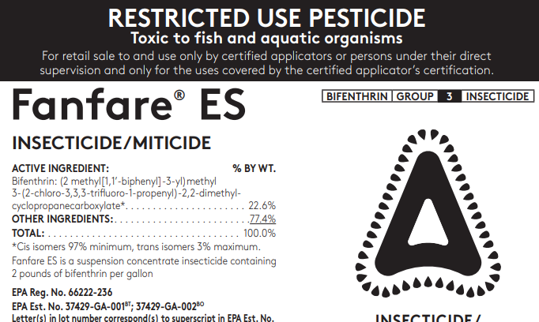
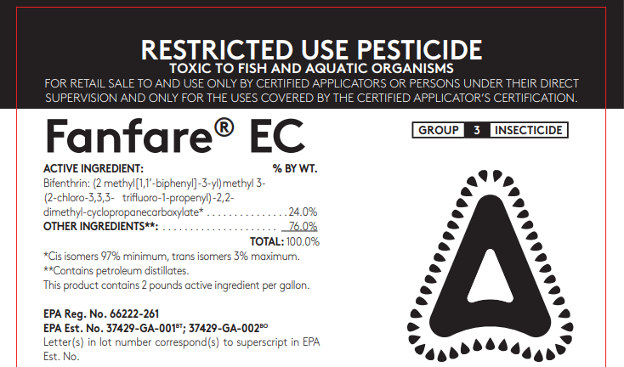
Fanfare
Three formulations in total, ONLY ES and EC registered on west coast
You must have the matching supplemental label for the formulation you purchase
Note: This is a Restricted Use Pesticide, you need a pesticide applicator’s license to buy and apply!

Slide 19
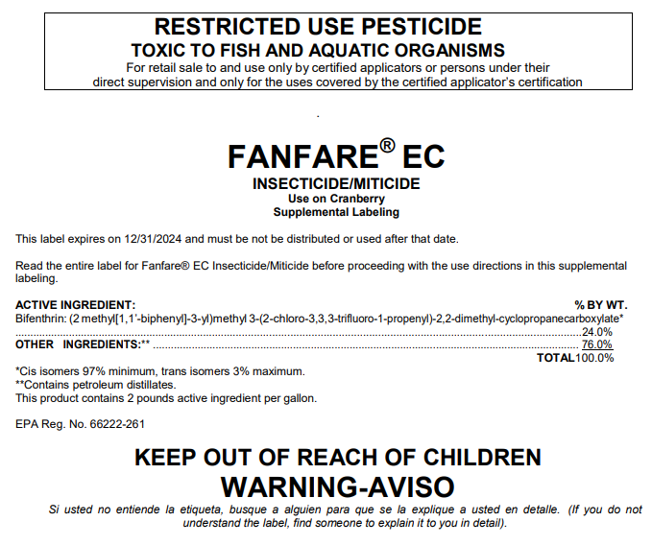
Supplemental label looks like this (will be 2 pages in total)
Linked on OCGA website or you can reach out to me if you can’t track it down
Notes:
Needed for apps through 2024
Bonus: Wilbur Ellis actually has some in stock, east coasters have none

Slide 20
Fanfare cont.
a.i. Bifenthrin (IRAC 3)
  Same class as Danitol; if you’re spraying both back-to-back, that’s not rotating chemistries
Again, Restricted Use Pesticide
  Extremely toxic to aquatic organisms
Highly toxic to pollinators
Broadspectrum
Chemigation allowed
Rate: 6.4 fl oz/acre, 3 applications max
REI: 12 hours; PHI: 30 days
CHECK WITH YOUR HANDLER, OSC will have additional restrictions

Slide 21
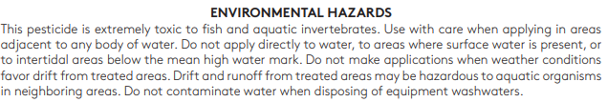
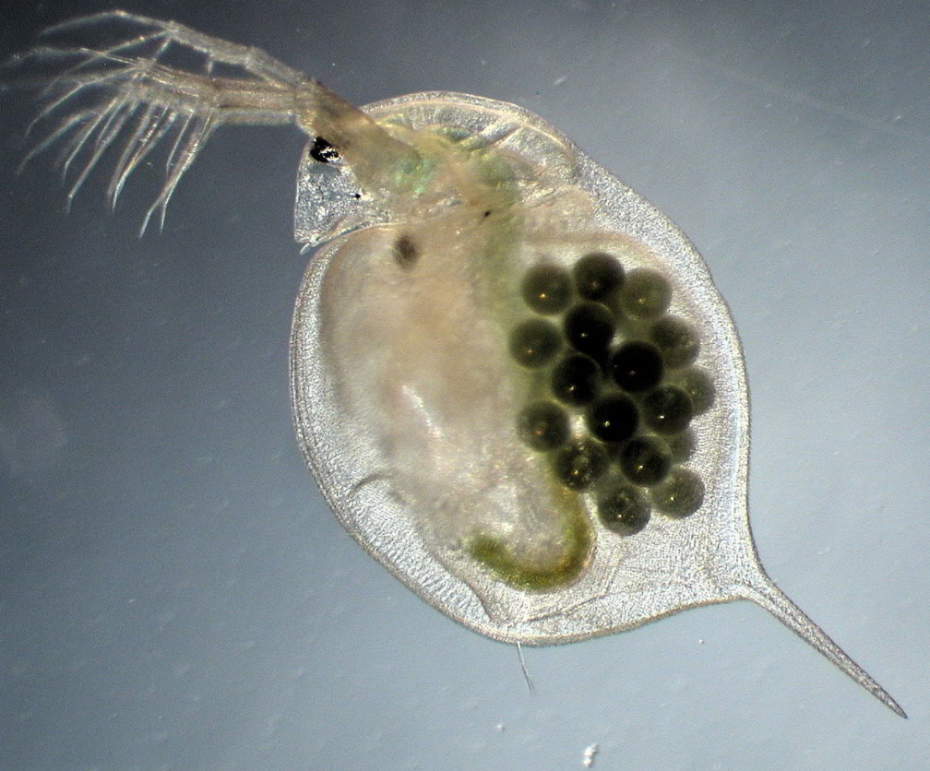
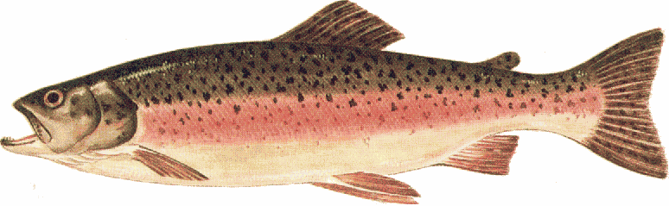
From the label
So what?
c/o: Dieter Ebert
Rainbow trout (Oncorhynchus mykiss) 96 hr LC50 (mg/L=ppm)
Fanfare | bifenthrin | 0.00019 mg/L
Danitol | fenpropathrin | 0.00075 mg/L
Lorsban | chlorpyrifos | 0.003 mg/L
Bravo | chlorothalonil | 0.008 mg/L
Diazinon | diazinon | 2.3 mg/L
Water flea (Daphnia magna) 48 hr EC50 (mg/L=ppm)
Diazinon | diazinon | 0.0004 mg/L
Lorsban | chlorpyrifos | 0.00068 mg/L
Fanfare | bifenthrin | 0.00195 mg/L
Bravo | chlorothalonil | 0.0342 mg/L
Danitol | fenpropathrin | 0.080 mg/L
please note, Danitol is not much better!

Slide 22
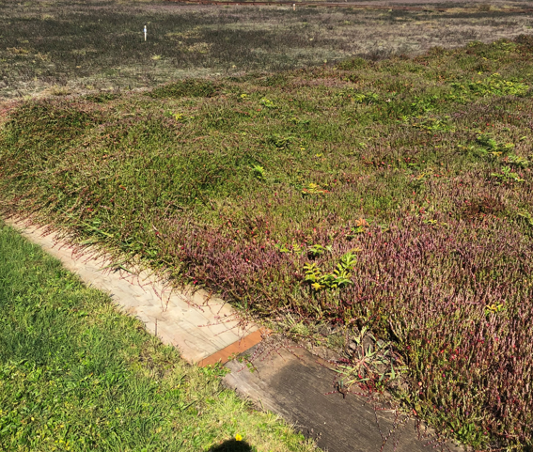
Now what?
Fanfare is cheap, use is likely to be high
Industry rec: hold water 3 days post-Fanfare application*
Washington growers: watch your cribbing!
Similar to Danitol, pre-bloom application would be target window
*I’d lump Danitol with this too
Notes:
follow similar pre-cautions that we had for Lorsban/Diazinon/etc

Slide 23
Upcoming OR and WA meetings
Oregon: in-person meeting April (tbd)
Washington: virtual meeting April 13th or 14th (poll at end for input)
  more pesticide credits anticipated

Slide 24
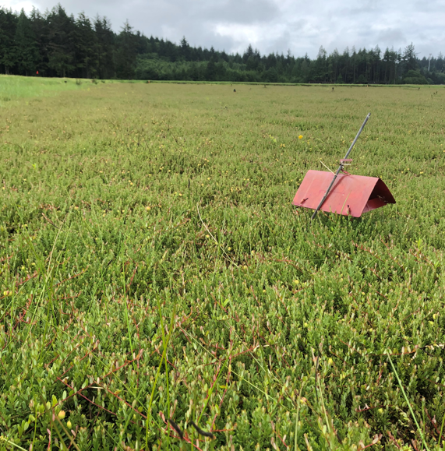
Questions?

