Slide 1


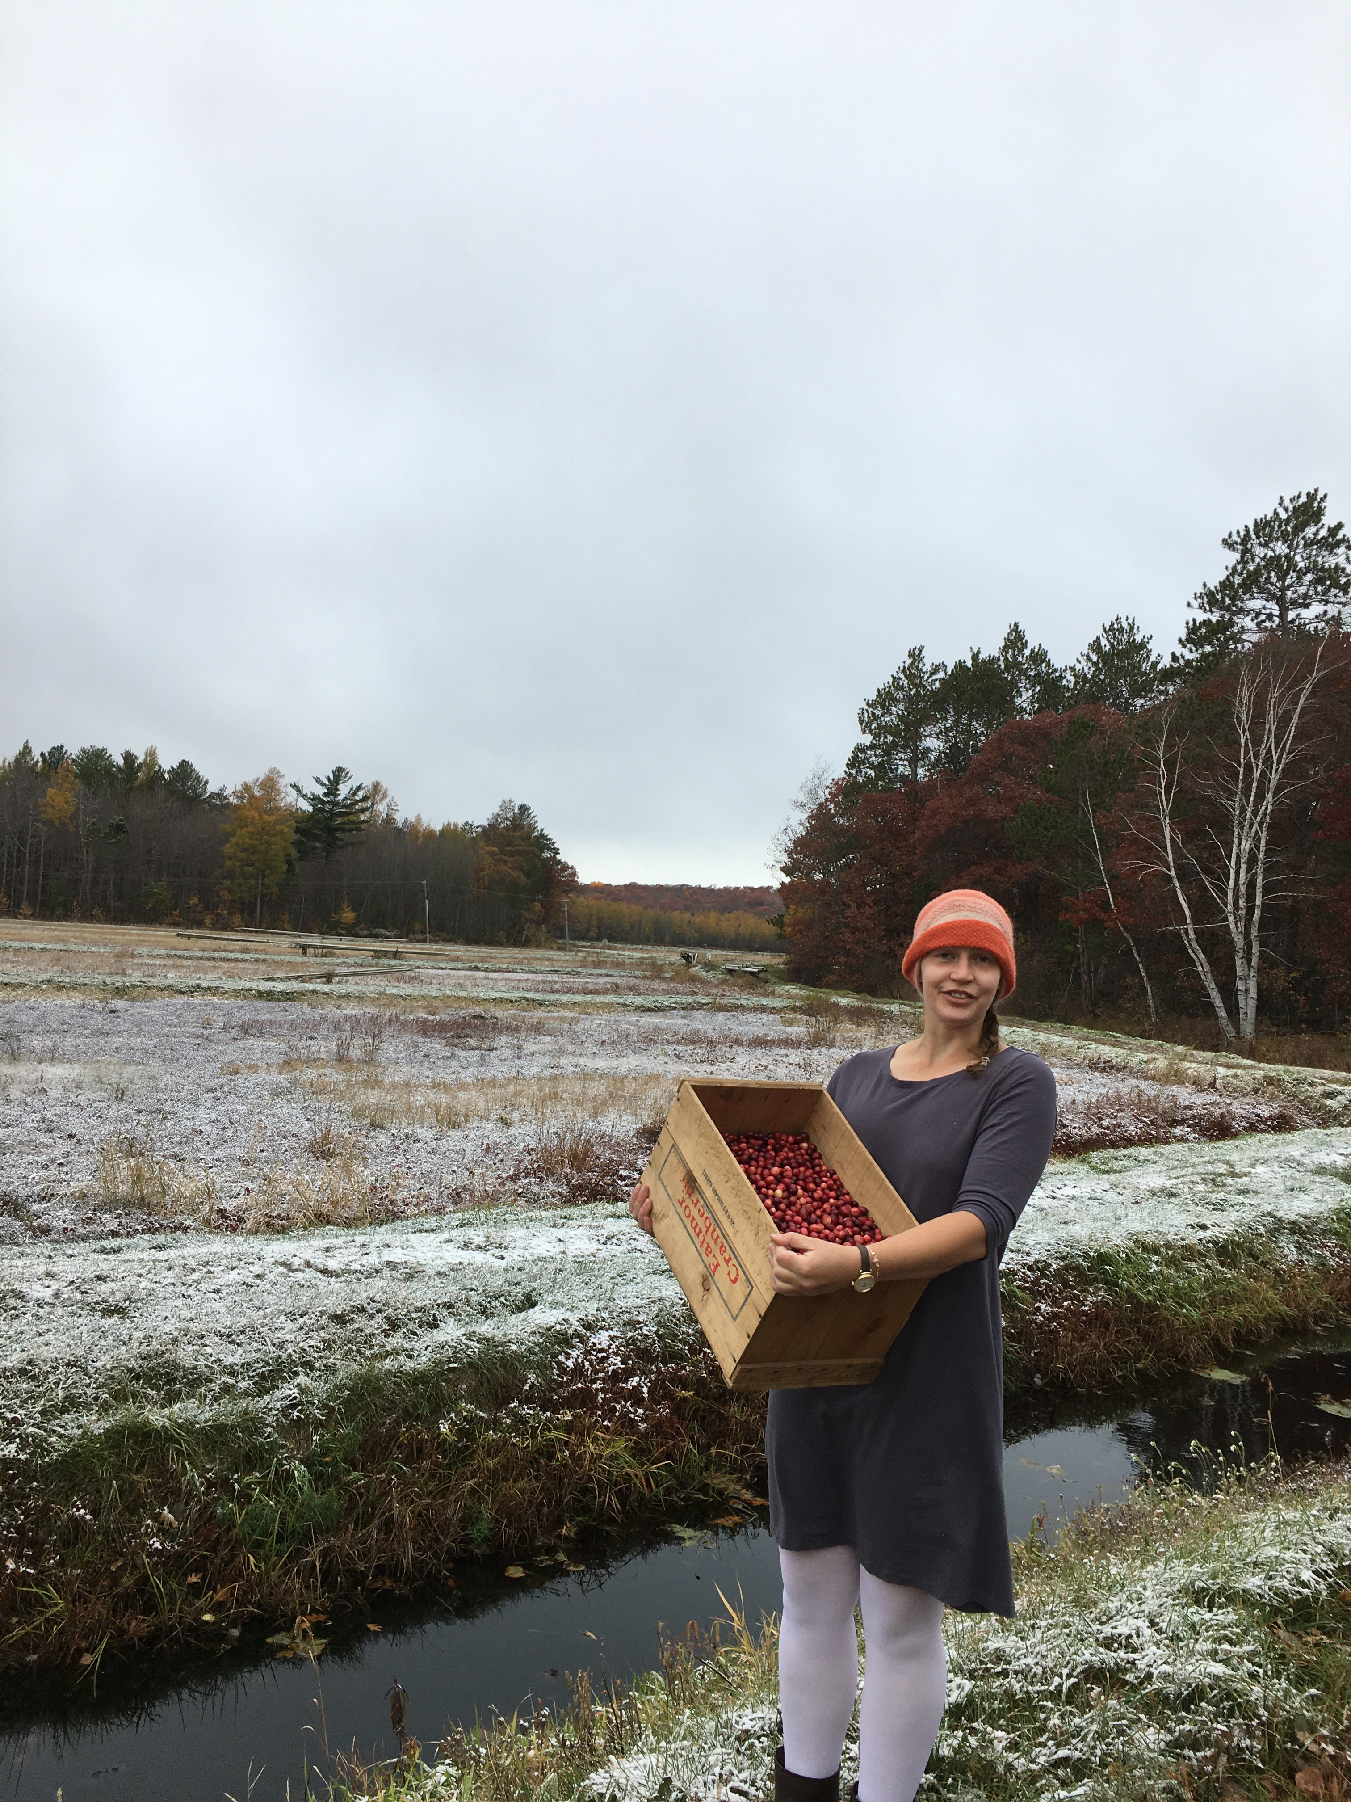
2022 Pacific Northwest
Cranberry Congress
Nutrient Management
Allison Jonjak
Cranberry Outreach Specialist
allison.jonjak@wisc.edu

Slide 2
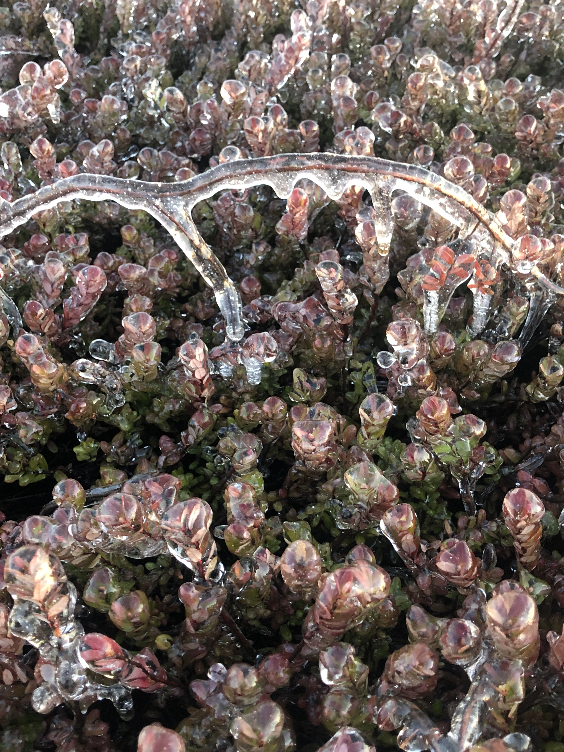

Quick Introduction
UW Madison Division of Extension since 2020
Virtual Brown Bags, Video Interviews, Cranberry Crop Management Journal;
Nutrient Management and Pesticide Applicator Trainings;
Research Round Table;
Researcher Cooperation, Sherlock Holmes Field Visits;
Pesticide Screening Trials
Cranberry Outreach

Slide 3
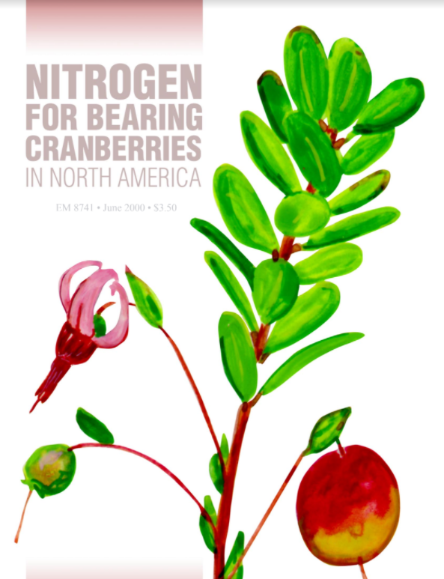
Nutrient Management
Timing of applications
Recommendations by cultivar
Extension presentation, vs original research
Updating you on developed practices since 2000
Cranberry Outreach

Slide 4
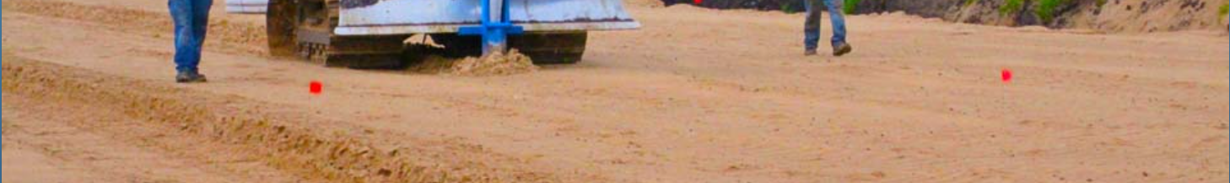
Note On Soil Types
Wisconsin is 75% sanded organic
Up to 12” of sand lift on renovated beds, often including tile drainage
Pacific NorthWest is primarily organic
Never make a management change without visually checking your leaf color & upright length
Consider organic matter contribution to available N
Consider to what degree watering-in is necessary
Cranberry Outreach

Slide 5

Timing of Applications
3 week window
  Beginning when you first see berries (variety by variety)
May not see growth response after 1st application. Make 2nd application and watch for response, adjust up or down based on response and crop potential
App for bud set still being debated: does it boost next crop? At cost to hardiness?
Cranberry Outreach

Slide 6
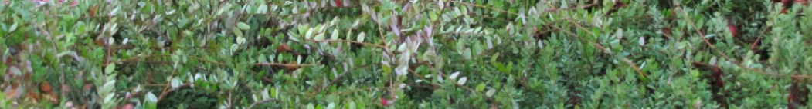
Timing & Composition of Applications
Watching tissue testing, many growers are not seeing P deficiency. Making decisions based on N tissue test, crop projection, visual plant inspection
  Common blends:
    14-8-14 (followed by 0-0-50 and 0-0-62 mix in fall)
    14-14-14
    8-8-24
Avoid Overgrowth
You cannot go back and apply less.
Cranberry Outreach

Slide 7
Visual Inspection Reminders
  Establish personal convention
    check for berries you can see at ditch-edge when standing on dike
    check leaf color and upright height at same time of day, same sun direction
  Nitrogen is mobile within plant, so old leaves will show N stress (yellowing) when new leaves are still green
  Experiment with polarized sunglass lenses
  Eyes on growth above this year’s crop, hold a firm line on the last app of the season, watching yellow tinge
Cranberry Outreach

Slide 8
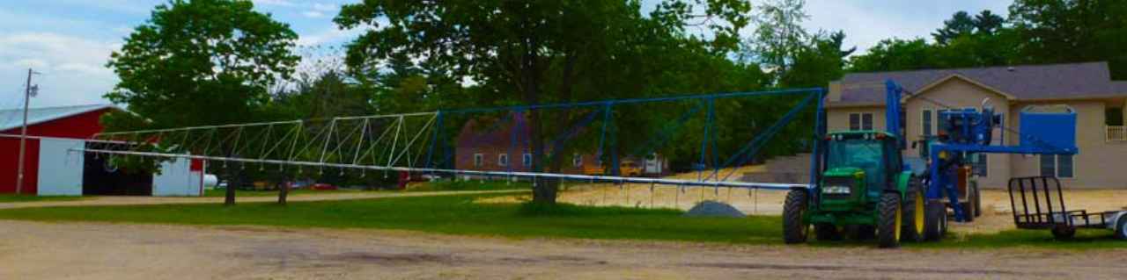
Timing of Applications
Atucha lab’s upcoming pub on 2019, 2020, 2021 research
  Exploring post harvest N to encourage root recovery after ie winter damage
  Stay tuned
Cranberry Outreach

Slide 9
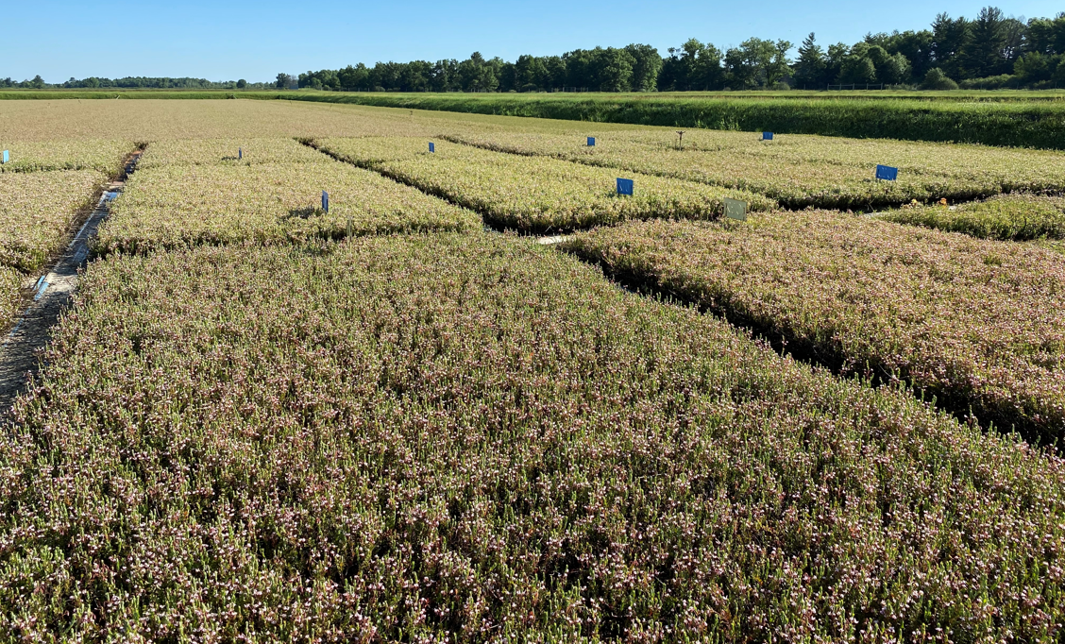
Timing By Variety
Earliest varieties are receiving first apps sooner than mid and late-season
Some growers start earlier varieties with larger dose than mid-season
ie 50# app of 8-8-24 as a Crimson Queen’s first dose and a 25# app as a Ben Lear’s
then tapering off in reverse order
Each variety benefits from individual management. Some growers have boom out 3+ days/week during this period
Cranberry Outreach

Slide 10
Nutrition Need by Variety
Updating expectations from “20-60 lbN” per year —in Stevens from 2000 research
Crimson Kings and Midnights are reaching peak yields with 65 to 70 lbN per year
N is being removed from system in fruits at higher rates in newer varieties
Cranberry Outreach

Slide 11
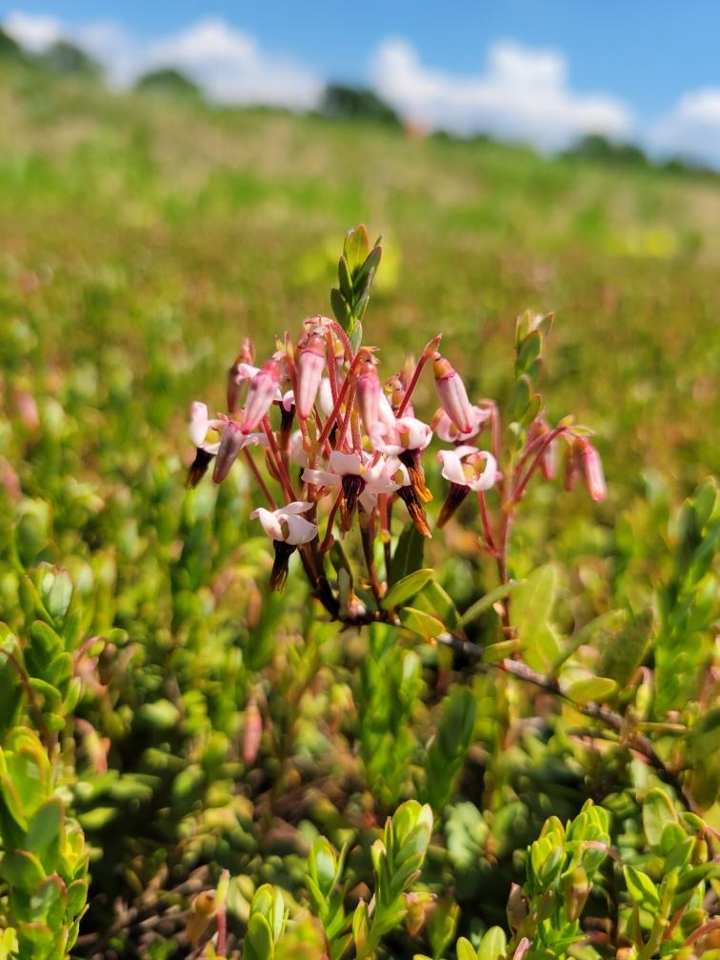
Nutrition Need by Variety
Updating expectations from “20-60 lbN” per year —in Stevens from 2000 research
Crimson Kings and Midnights are reaching peak yields with 65 to 70 lbN per year
N is being removed from system in fruits at higher rates in newer varieties
Cranberry Outreach

Slide 12
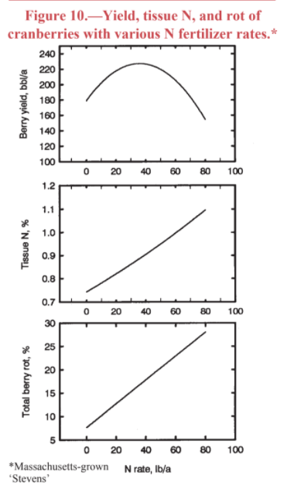
The Cost of Overapplying
Reduced yield
Upright overgrowth (~3 years need to recover)
Incrased rot
Multiple applications of small doses allow you to find the best place on this curve
Cranberry Outreach

Slide 13
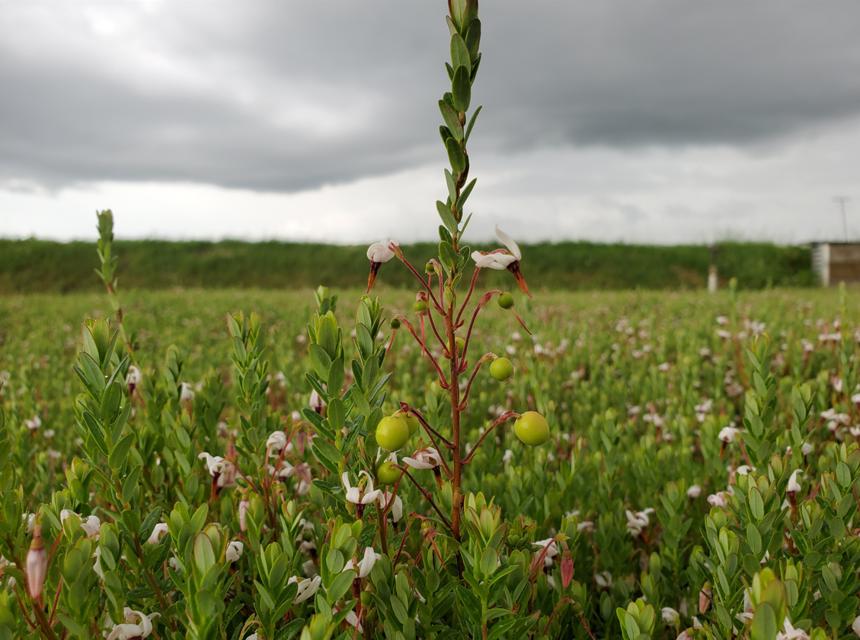

Thoughts, questions?
What else do you wonder?
More you’d like to see?
Allison Jonjak
Cranberry Outreach Specialist
allison.jonjak@wisc.edu

Slide 14

Extension’s Commitment
The University of Wisconsin-Madison Division of Extension provides affirmative action and equal opportunity in education, programming and employment for all qualified persons regardless of race, color, gender, creed, disability, religion, national origin, ancestry, age, sexual orientation, pregnancy, marital or parental, arrest or conviction record or veteran status.
Extension’s Commitment

