Slide 1
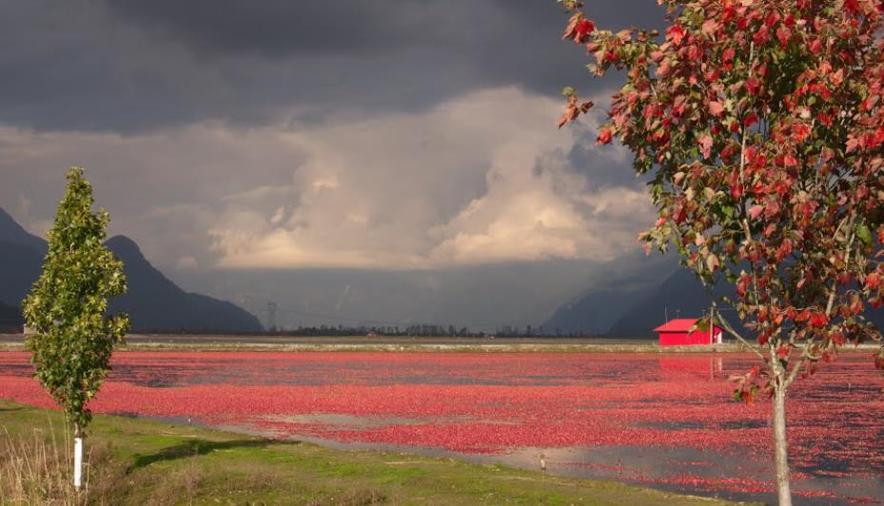

Agricultural Land Commission

Slide 2
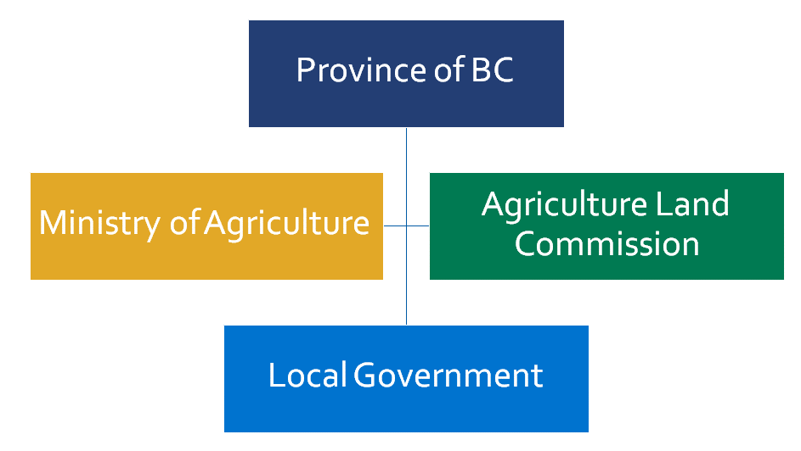
Government Role in Agriculture
ALC

Slide 3
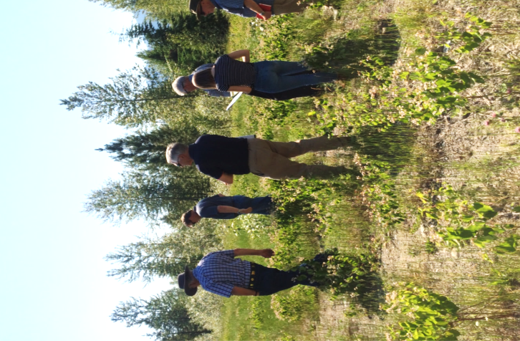
Agricultural Land COMMISSION
Independent administrative tribunal
Carries out mandate set out in ALC Act
Preserve agricultural land
Encourage farming in collaboration with other communities of interest
Encourage Gov’t laws and policies to enable & accommodate farm use
Administer the ALC Act & its Regulations

Slide 4
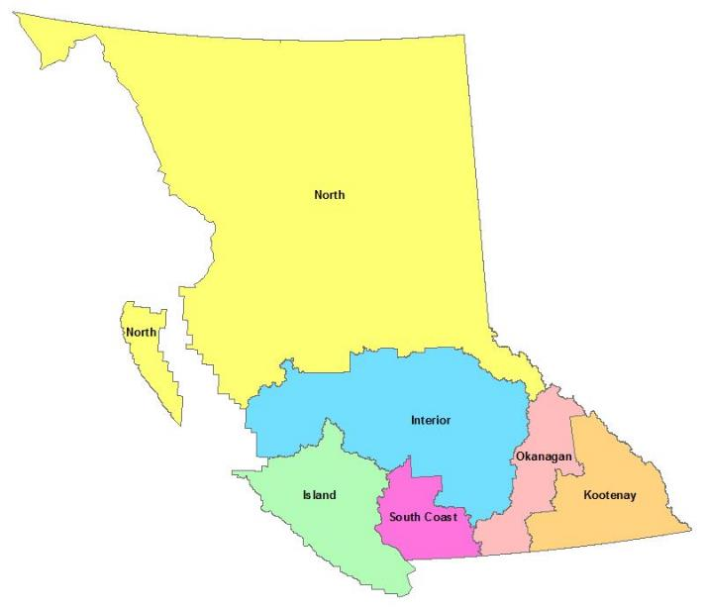
North Panel
Topic Specific Panels, as needed
Interior Panel
Okanagan
Panel
Island
Panel
Kootenay
Panel
S. Coast
Panel
Effective March 12, 2020
Panels & Administrative Regions

Slide 5
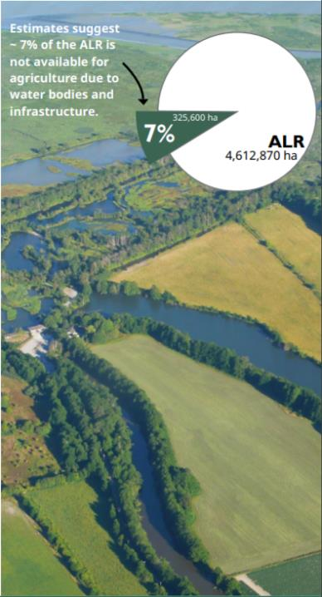
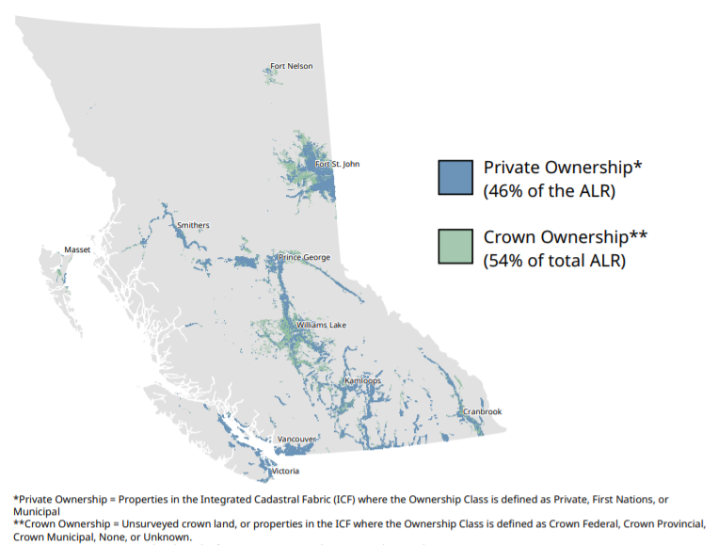
ALR: Private vs Crown Ownership
ALC

Slide 6
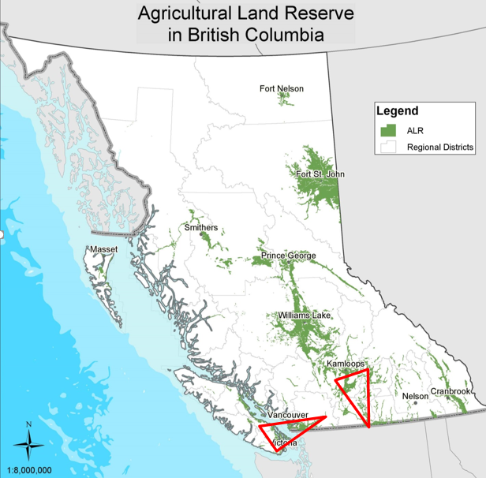
Population & Agriculture
These 2 areas contain:
2.7% of BC’s Land Area
81% of BC’s Population
83% of BC’s Annual Farm Gate Receipts
ALC

Slide 7
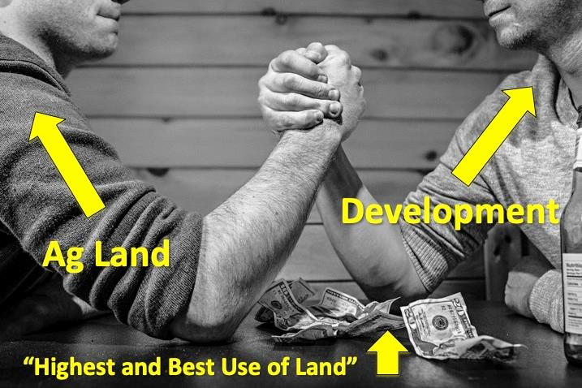
Why?
7

Slide 8
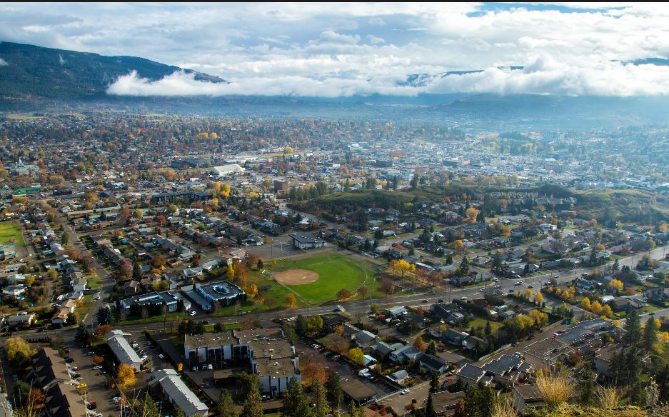

Slide 9
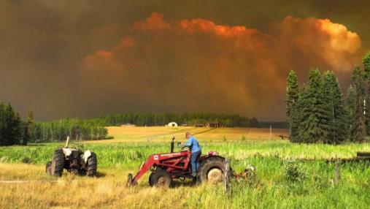
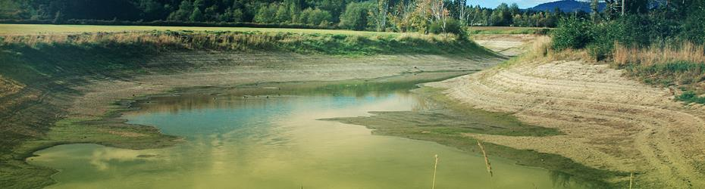
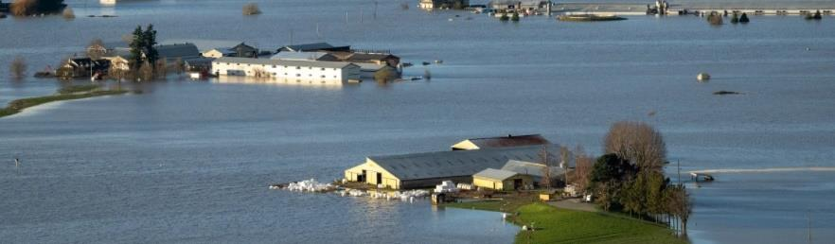
Climate Pressures

Slide 10

Role of the Local Governments
Local governments, regional and municipal, are partners in agricultural land preservation
ALC & local governments have concurrent jurisdiction
Regulate land use and issue permits for lands in the ALR consistent with the ALCA and its regulations
First step in the Application Process to the ALC
ALC

Slide 11
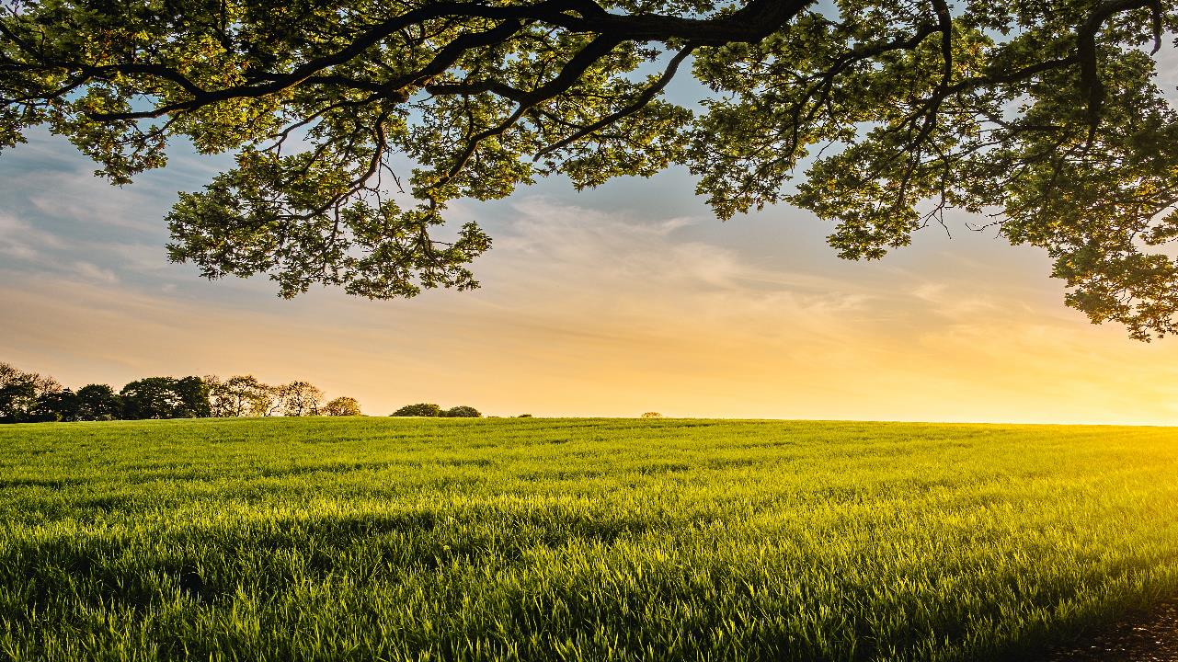
Hot topics

Slide 12
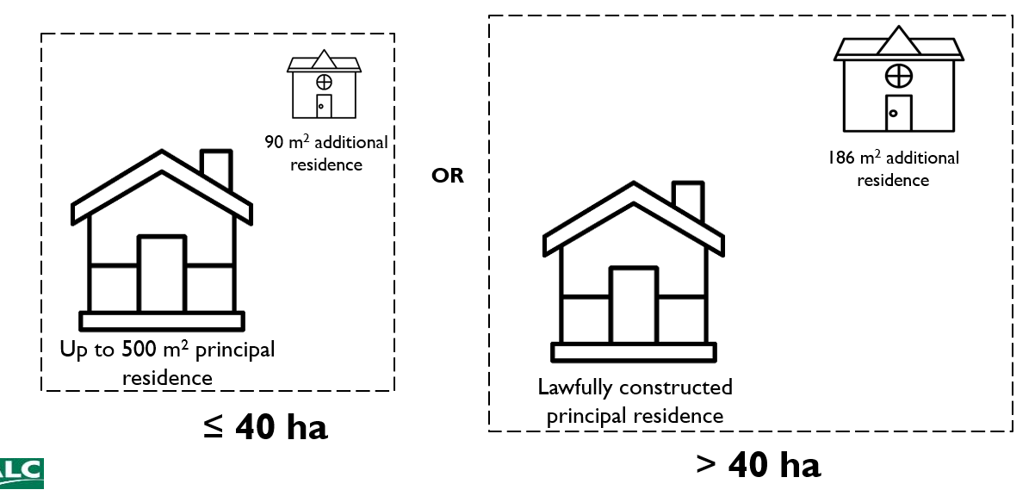
Housing – New Regulations
ALC

Slide 13
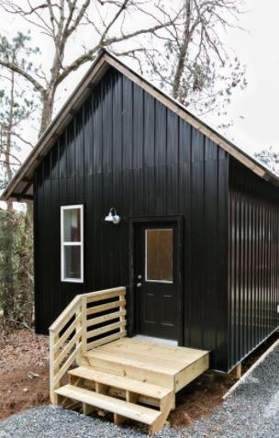
Ministry Of AGRICULTURE policy intent
Small secondary / accessory residence.
For farmers and non-farmers.
May be used for many purposes – e.g., rental (long or short term), family, farm help, etc.
Local governments able to further regulate / restrict based on community need.
Ministry News Release: https://news.gov.bc.ca/releases/2021AFF0043-001352

Slide 14
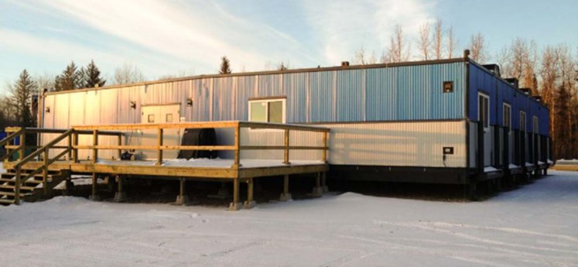
Temporary Farm Labour accommodation
Streamlined approval process for Temporary Farm Labour Accommodation consistent with the Minister’s Bylaw standards provided:
Parcel has Farm Class
Farm operation is at least 4 ha
Accommodation is moveable
Siting doesn’t impact arable land
Financial security & registration of a covenant to ensure removal

Slide 15
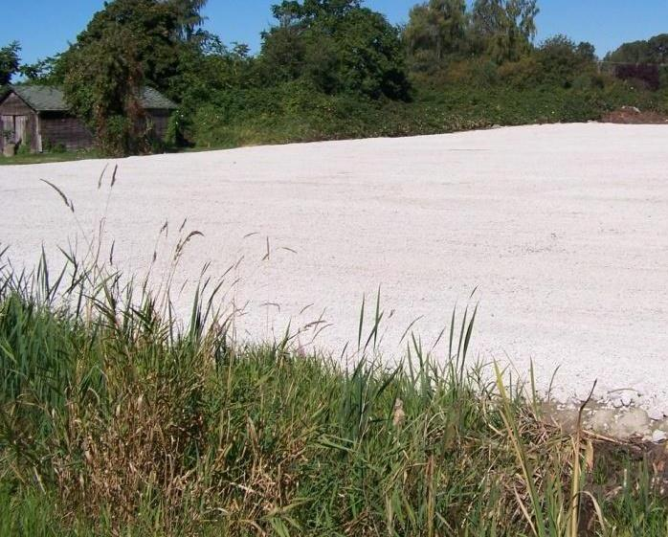
Soil and Fill Regulation Changes
"fill" means any material brought onto agricultural land other than materials exempted by regulation;

Slide 16
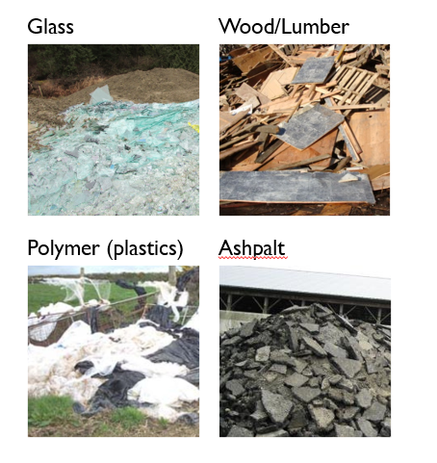
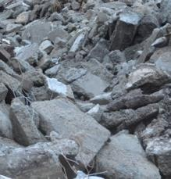
Prohibited Fill
Placement of construction or demolition waste, including masonry rubble, concrete, cement, rebar, drywall and wood waste is prohibited in the ALR
ALC must reject an applications that involves the placement of prohibited fill
Cement
ALC

Slide 17
Permitted Fill Placement or Soil Removal
Permitted Soil or Fill Use Activities
1. 1,000 m² area for a Principal Residence
3. Cranberry berms (2 m high x 10 m base)
4. Flood plain dikes, irrigation, livestock watering
5. Maintain existing farm road (50 m³/100 m road)
6. 100 m³/ha or less (sand top dressing)
7. Soil amendments
8. Conduct soil research or testing
9. 500 m³ of aggregate per single parcel
2. 1,000 m² area for a Farm structure

Slide 18
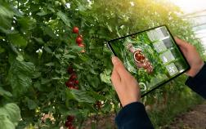
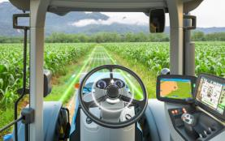
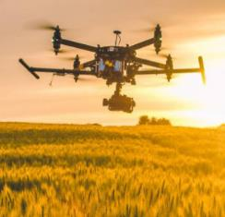
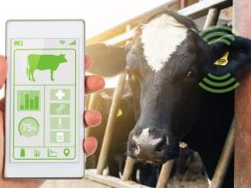
AGRI-TECH IN THE ALR
Agritech refers to the use of technological innovations in agriculture to increase yield, quality, efficiency, and profitability.
Technology used in Agritech:
Smart farming
Drones and Satellites
IoT Sensors
Blockchain
Vertical farming
Automation

Slide 19
Vertical Farming regulation – effective August 31, 2022
New Definition
“controlled environment structure” means a structure that provides a controlled environment intended to intensify crop production, including, without limitation, (a) a vertical farming system, (b) a rotating tray system, or (c) any other structure that minimizes the use of land, controls the use of light, air, water or nutrients or relies in whole or in part on automation but not including a greenhouse, mushroom barn or cannabis production facility
New Division - Farm Uses That May Be Prohibited
Controlled environment structures
3.1 The use of agricultural land to construct, maintain or operate a controlled environment structure is designated as a farm use.

Slide 20
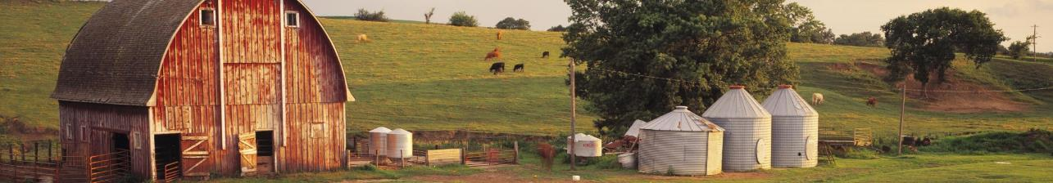
Vision for the Future of Agriculture
Stable and protected agricultural land base (ALR is just one tool)
Improved access to farmland;
Supported agricultural sector – skills, innovation, incentives & diversity
Greater food security/incentives – expansion in local food production
Greater alignment between Provincial, regional and local regulatory regimes
ALC
20

Slide 21
“…once in your life you need a doctor, a lawyer, a preacher but every day, three times a day you need a farmer.” Brenda Schoepp
Thank you

