Slide 1
Prohexadione Calcium for Canopy Management in Cranberries
Phase 1 (2021) results
Charitha A. Jayasinghege
charitha.jayasinghege@agr.gc.ca
Pacific Northwest Cranberry Congress (2022)

Slide 2
Important
Prohexadione calcium (Apogee®/Kudos®) is not labelled for use in cranberries. We have used this product for research purposes only.
DO NOT use this product in cranberries!

Slide 3
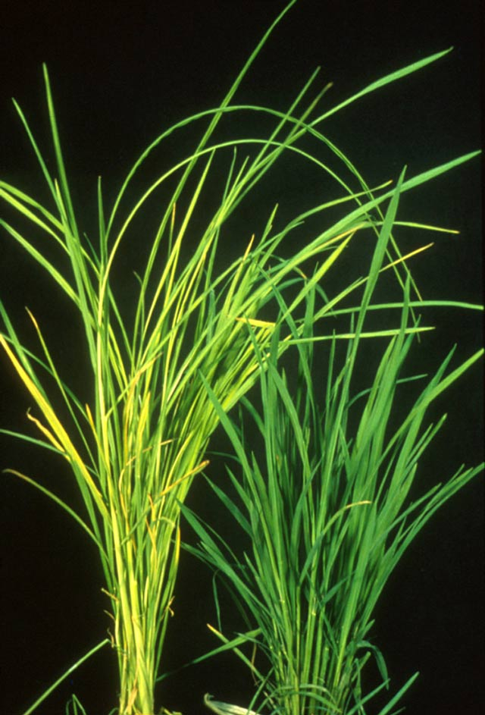
Gibberellin (GA) stimulates stem elongation
Fungal infection
High level of GA
Foolish seedlings
Normal seedlings
Tamura S. (1991) Gibberellins; Image: http://www.knowledgebank.irri.org/

Slide 4
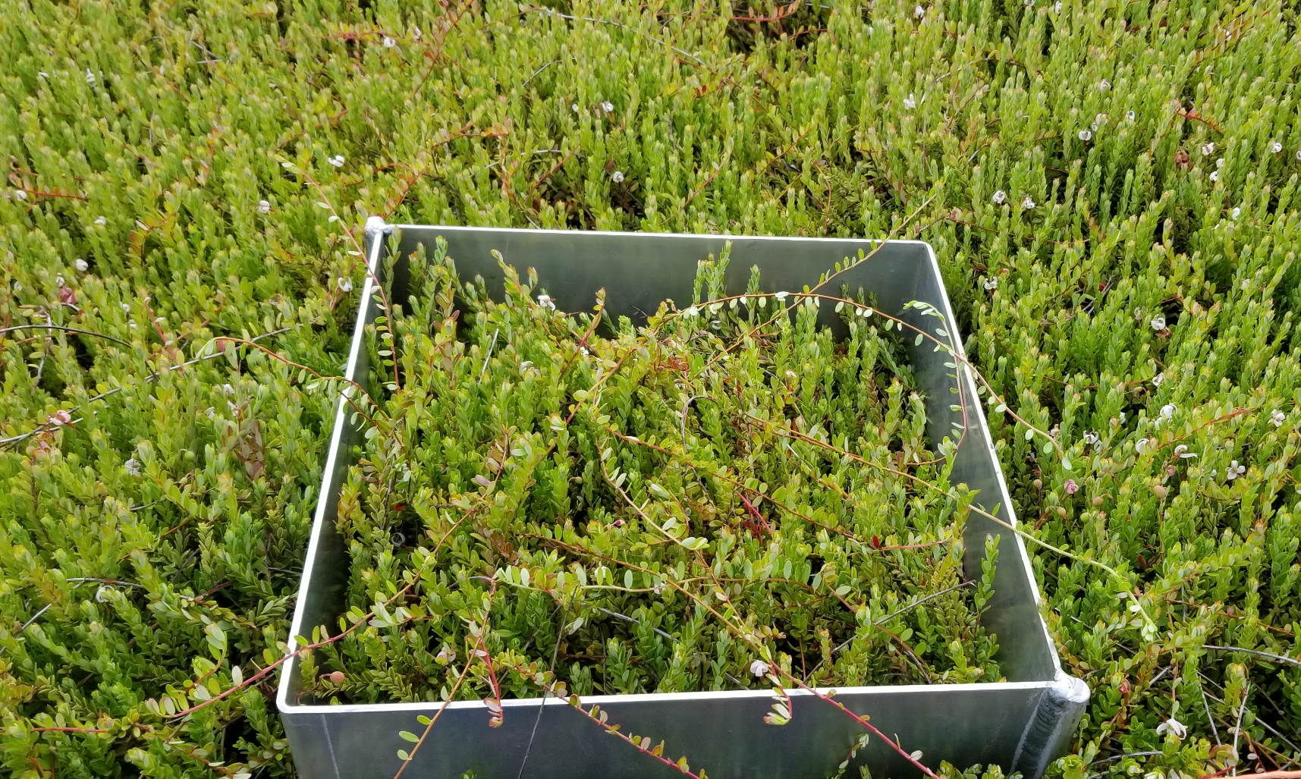
Excessive vegetative growth in cranberries
Potential contributing factors
Genetics
Climate
Organic matter rich soil

Slide 5
Why excessive vegetative growth is not good?
High resource allocation for vegetative growth
Low fruit yield
Thicker canopy
No good root system
Resource imbalance
Vine death causing cranberry field decline
Someya, T. (2019), University of British Columbia

Slide 6
GA inhibitors for canopy management
Many GA inhibitors are available
Most are not suitable due to
Environmental concerns
Health concerns
Suboptimal activity
Prohexadione calcium (Pro-Ca)
GA biosynthesis inhibitor
(Used in apples, cherries and strawberries)

Slide 7
Pro-Ca efficacy evaluation in cranberries
Study was done in 2021 at the Cranberry Research Farm, Delta, BC
Variety: Stevens
RCBD design with 4 replications
Apogee® growth regulator was used
Three different concentrations of Apogee (Low, Medium, High)
Treatments were started at bud elongation stage
Two (2x) or three applications (3x) with two-week intervals in between

Slide 8
Apogee (Pro-Ca) reduces runner density
~ 46% reduction
~ 41% reduction

Slide 9
Apogee (Pro-Ca) reduces runner length
~ 30% reduction
~ 44% reduction

Slide 10
Apogee (Pro-Ca) had no effect on upright growth
Upright height was not affected by Pro-Ca treatment
Upright density may change in the later years

Slide 11
High concentrations can be phytotoxic

Slide 12
Fruit qualities were not affected by Pro-Ca
Treatment | Anthocyanin (mg/100 g fresh fruits)* | TSS (˚Brix) | TA (%)± | Fruit rot (fruits/30 cm2)
Water control | 35.5±5.4 | 8.8±0.1 | 2.70±0.03 | 1.1±0.8
2X_Low | 45.3±3.8 | 8.8±0.1 | 2.55±0.02 | 2.0±0.7
2X_Medium | 50.1±2.9 | 9.0±0.1 | 2.72±0.04 | 0.6±0.6
2X_High | 50.4±2.5 | 9.2±0.1 | 2.63±0.03 | 0.6±0.4
3X_Low | 45.4±5.5 | 9.0±0.2 | 2.66±0.04 | 0.3±0.1
3X_Medium | 52.3±3.2 | 9.3±0.3 | 2.60±0.06 | 0.5±0.2
3X_High | 47.8±8.0 | 9.4±0.1 | 2.48±0.08 | 0.5±0.4

Slide 13
Summary
The gibberellin biosynthesis inhibitor Pro-Ca effectively inhibits runner growth in cranberries
Two applications of Apogee (Pro-Ca) at “low” rate is sufficient to reduce runner length and density by ~ 30 and 45% respectively
Higher Apogee concentrations are not beneficial and may reduce yield
Apogee treatment has no clear impact on upright height or fruit qualities

Slide 14
Next steps
Study-1 (To evaluate impacts of last year treatments)
No Pro-Ca activity from last year treatments is expected
Inhibition of runner growth may affect canopy runner/upright growth and yield

Slide 15
Next steps
Study-2 (newly proposed)
To repeat the “low” treatment to confirm 2021 data
To evaluate the possibility of lowering the treatment concentration further
To evaluate the potentials of expanding the treatment intervals to 3 weeks
To evaluate the efficacy of adding a third treatment in the late summer to early fall

Slide 16

Acknowledgments
Collaborators: Miranda Elsby (Ocean Spray), Markus Clodius (AAFC), Rishi Burlakoti (AAFC)
Technical support: Carine Bineng (AAFC), Brigit Christie (SFU)
Funding and research plots: BC Cranberry Marketing Commission

Slide 17
Question for pesticide credits
Please select the correct answer. Prohexadione calcium (Pro-Ca) inhibits the biosynthesis of,
(A) Auxin
(B) Gibberellin
(C) Ethylene

