Slide 1
Cranberry Institute – UPDATE
William “Bill” Frantz
Executive Director

Slide 2











CRANBERRY INSTITUTE SUPPORTING MEMBERS
January 2018

Slide 3
To Present, Promote, and Further the strength, resilience and reputation of the cranberry industry by initiating and coordinating essential industry activities and communications that benefit the industry as a whole.
Health Benefit and Production Research
Pesticide & Regulatory Interface
Health Care Provider Education
Public Affairs
Mission

Slide 4
2021 Review
Health Research
  In partnership with CMC, brought 2 cranberry health projects forward for funding consideration
  Both projects were fully funded
Pesticide Update

Slide 5
Health Research
Process for Research Funding Consideration
Year 1
Year 2
Year 3
Q1
Q2
Q3
Q4
Q1
Q??
SAB mtg
-areas of research
-type of research
-budget
-CMC, other
-Draft RFP
-Target researchers
-Distribute RFP
-Evaluate proposals
-SAB, scientists
-HAC mtg.
-PIs present @ CI/CMC
-Joint session
-Funding decision
-Communication of decision
-Product and placebo dev’t
-Lab/personnel scale up
-Contracts dev’t
-Study begins
-Journal publication
-Communication of study

Slide 6
Areas of Health Research
Cancer
UTI
Cognition
Antibiotic Resistance
Mental Health
Heart/Cardiovascular
Health
Immune System
Dental Health
Gut Health
Women’s Health
Men’s Health
Anti-viral Activity
Anti-aging

Slide 7
Areas of Health Research
Cancer
UTI
Cognition
Antibiotic Resistance
Mental Health
Heart/Cardiovascular
Health
Immune System
Dental Health
Gut Health
Women’s Health
Men’s Health
Anti-viral Activity
Anti-aging

Slide 8
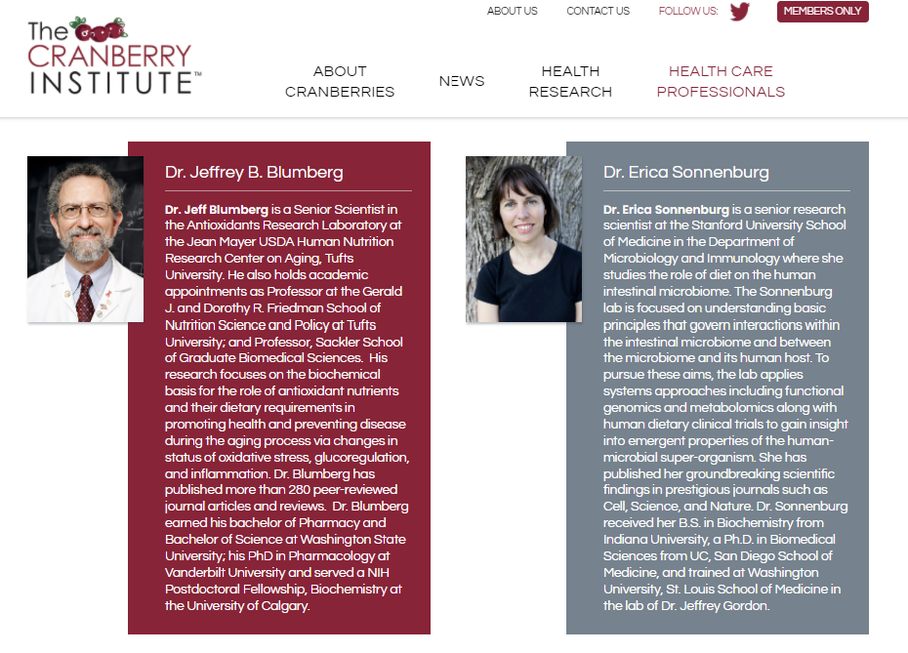
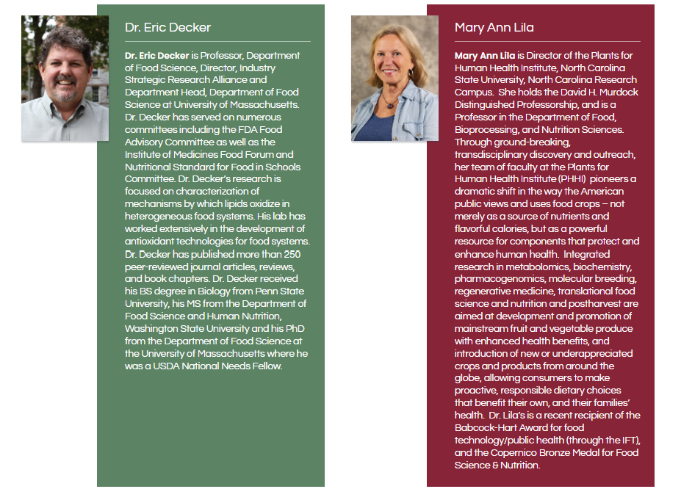

Scientific Advisory Board - Health

Slide 9

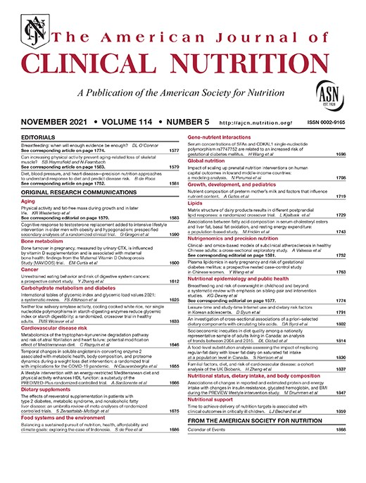
Dr. Ana Rodriquez Mateo’s Research
Submitted for Publication
Funded
Daily consumption of cranberry improves endothelial function in 45 healthy adult males: a double blind randomized controlled trial
Manuscript submitted to the Food and Function
This study examined the impact of daily cranberry consumption on the vascular system and how those effects are related to the cranberry polyphenol metabolites in healthy men.
The study concluded that acute and daily consumption of whole cranberry powder for 1 month improves vascular function in healthy men and this benefit is linked with specific metabolite profiles in plasma. During this one month study, the consumption of whole cranberry powder led to a significant improvement in flow-mediated dilation (FMD) as compared with the control group.
The amount of cranberry used in this study is equivalent to 100g fresh cranberries, a quantity that could realistically be consumed daily, which strengthens the relevance and media interest of this study.

Slide 10

Dr. David Vauzour’s Research
Submitted for Publication January 2022
Funded
Chronic consumption of Cranberries for 12 weeks improves episodic memory and regional brain perfusion in healthy older adults: A randomized, placebo-controlled, parallel-groups study
Manuscript submitted to Frontiers in Nutrition
This study investigated cranberries’ impact on cognitive function in older adults. Polyphenol-rich fruits have been recognized for their protection against age-related neurodegeneration, but cranberries specifically had not yet been studied.
Cranberry supplementation, equivalent to 1 small bowl of cranberries, for 12 weeks significantly improved visual episodic memory and neural functioning in participants ages 50 to 80 years. Participants also had a significant decrease in LDL cholesterol during the study period.
This creates an important foundation for future research in this area related to neurological disease.
Notes:
Study Purpose:
Investigate the impact of cranberries on the gut-brain axis, specifically cognitive performance, gut microbiota speciation and metabolism and changes in cerebrovascular functions in healthy older adults with no memory complaint or dementia.
The study was a 12-week randomized placebo-controlled trial among 60 older adults aged 50 to 80 years that used freeze-dried cranberry powder and assessed the impact of daily cranberry consumption on cognition, brain function and biomarkers of neuronal signaling.

Slide 11

Dr. Nathalie Tufenkji Research
Funded in 2021 by CMC
Funded
Antibiotic Potentiation by Cranberry Bioactives Against Drug Resistant Uropathogenic E. coli
Expected Completion September 2022
The purpose of this study is to evaluate how the cranberry bioactives found in a commercial cranberry juice may increase the effectiveness of eight antibiotics against 30 drug-resistant and partially resistant uropathogenic E. coli isolates (UPEC) that cause urinary tract infections. Previous studies have shown evidence of this complementary relationship between cranberry proanthocyanidins and different antibiotic classes against opportunistic pathogens.
This study will further the understanding of antibiotic-supporting activity of cranberry bioactives against drug resistant and partially resistant UTI-causing bacteria. With the spread of antibiotic resistance, it is important to find strategies to improve the effectiveness of available antibiotics.
Notes:
https://docs.google.com/document/d/1wXWM_MGpe-XE5x6fuyWZEqdRL8hWGVFqARqKiM12EJw/edit

Slide 12
Dr. Ana Rodriquez Mateo Research
Funded in 2021 by CMC
Funded
Modulation of the gut-brain axis by cranberries: impact on university students’ mental health -The CRANMOOD study
Expected Completion December 2022
This 12-week study will investigate if cranberry consumption can improve gut microbiome diversity and composition, leading to a decrease in stress levels, anxiety and depression symptoms, and improvement in cognitive function.
Findings will help to understand the benefits of cranberry consumption for the prevention and treatment of mood disorders.
Notes:
A 12-week parallel double-blind randomized controlled trial (a strong study design) will investigate if cranberry consumption can improve gut microbiome diversity and composition, leading to a decrease in stress levels, anxiety and depression symptoms, and improvement in cognitive function.
https://docs.google.com/document/d/1d2kSY-R8G6grDFcF-fmtoSqfFa6YQhUxw4OKH0qFSQA/edit

Slide 13
2021 Review
Pesticide/Hort Update
  Held 3 virtual cranberry farm tours for pesticide registrants (BASF, Syngenta, ISK)
    Hosting another 3-4 virtual tours in 2022
  Held virtual cranberry farm tour for EPA staff (>200) and IR-4 staff (20)
  Obtained IR-4 priority project for cranberry
  Industry hort research
  Pesticide charts
  Responded (submittals to Federal docket) on numerous pesticide issues (chlorpyrifos, ESA biological evaluations…)

