Slide 1

The CI Role in Industry Pesticides
Katherine Ghantous
February 2022

Slide 2
Topics
The path to new pesticides
Registration review process
Tracking international MLRs

Slide 3
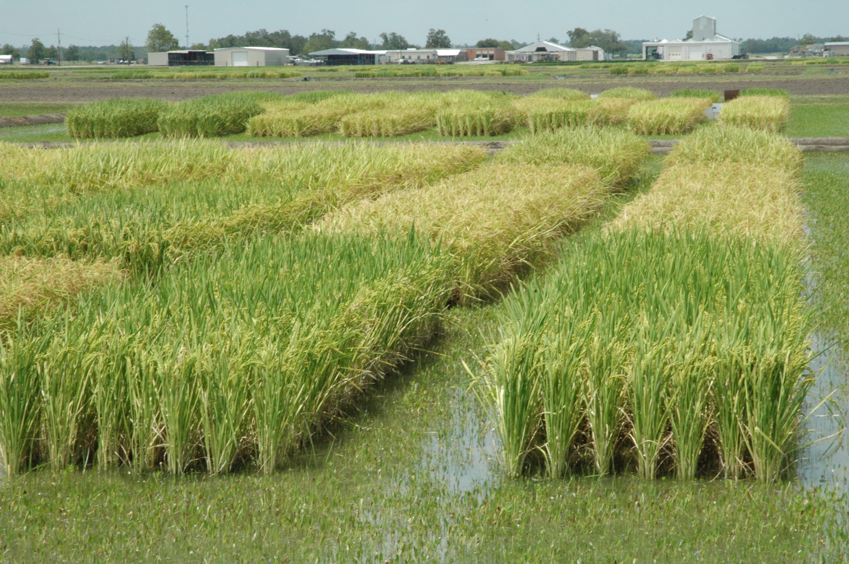
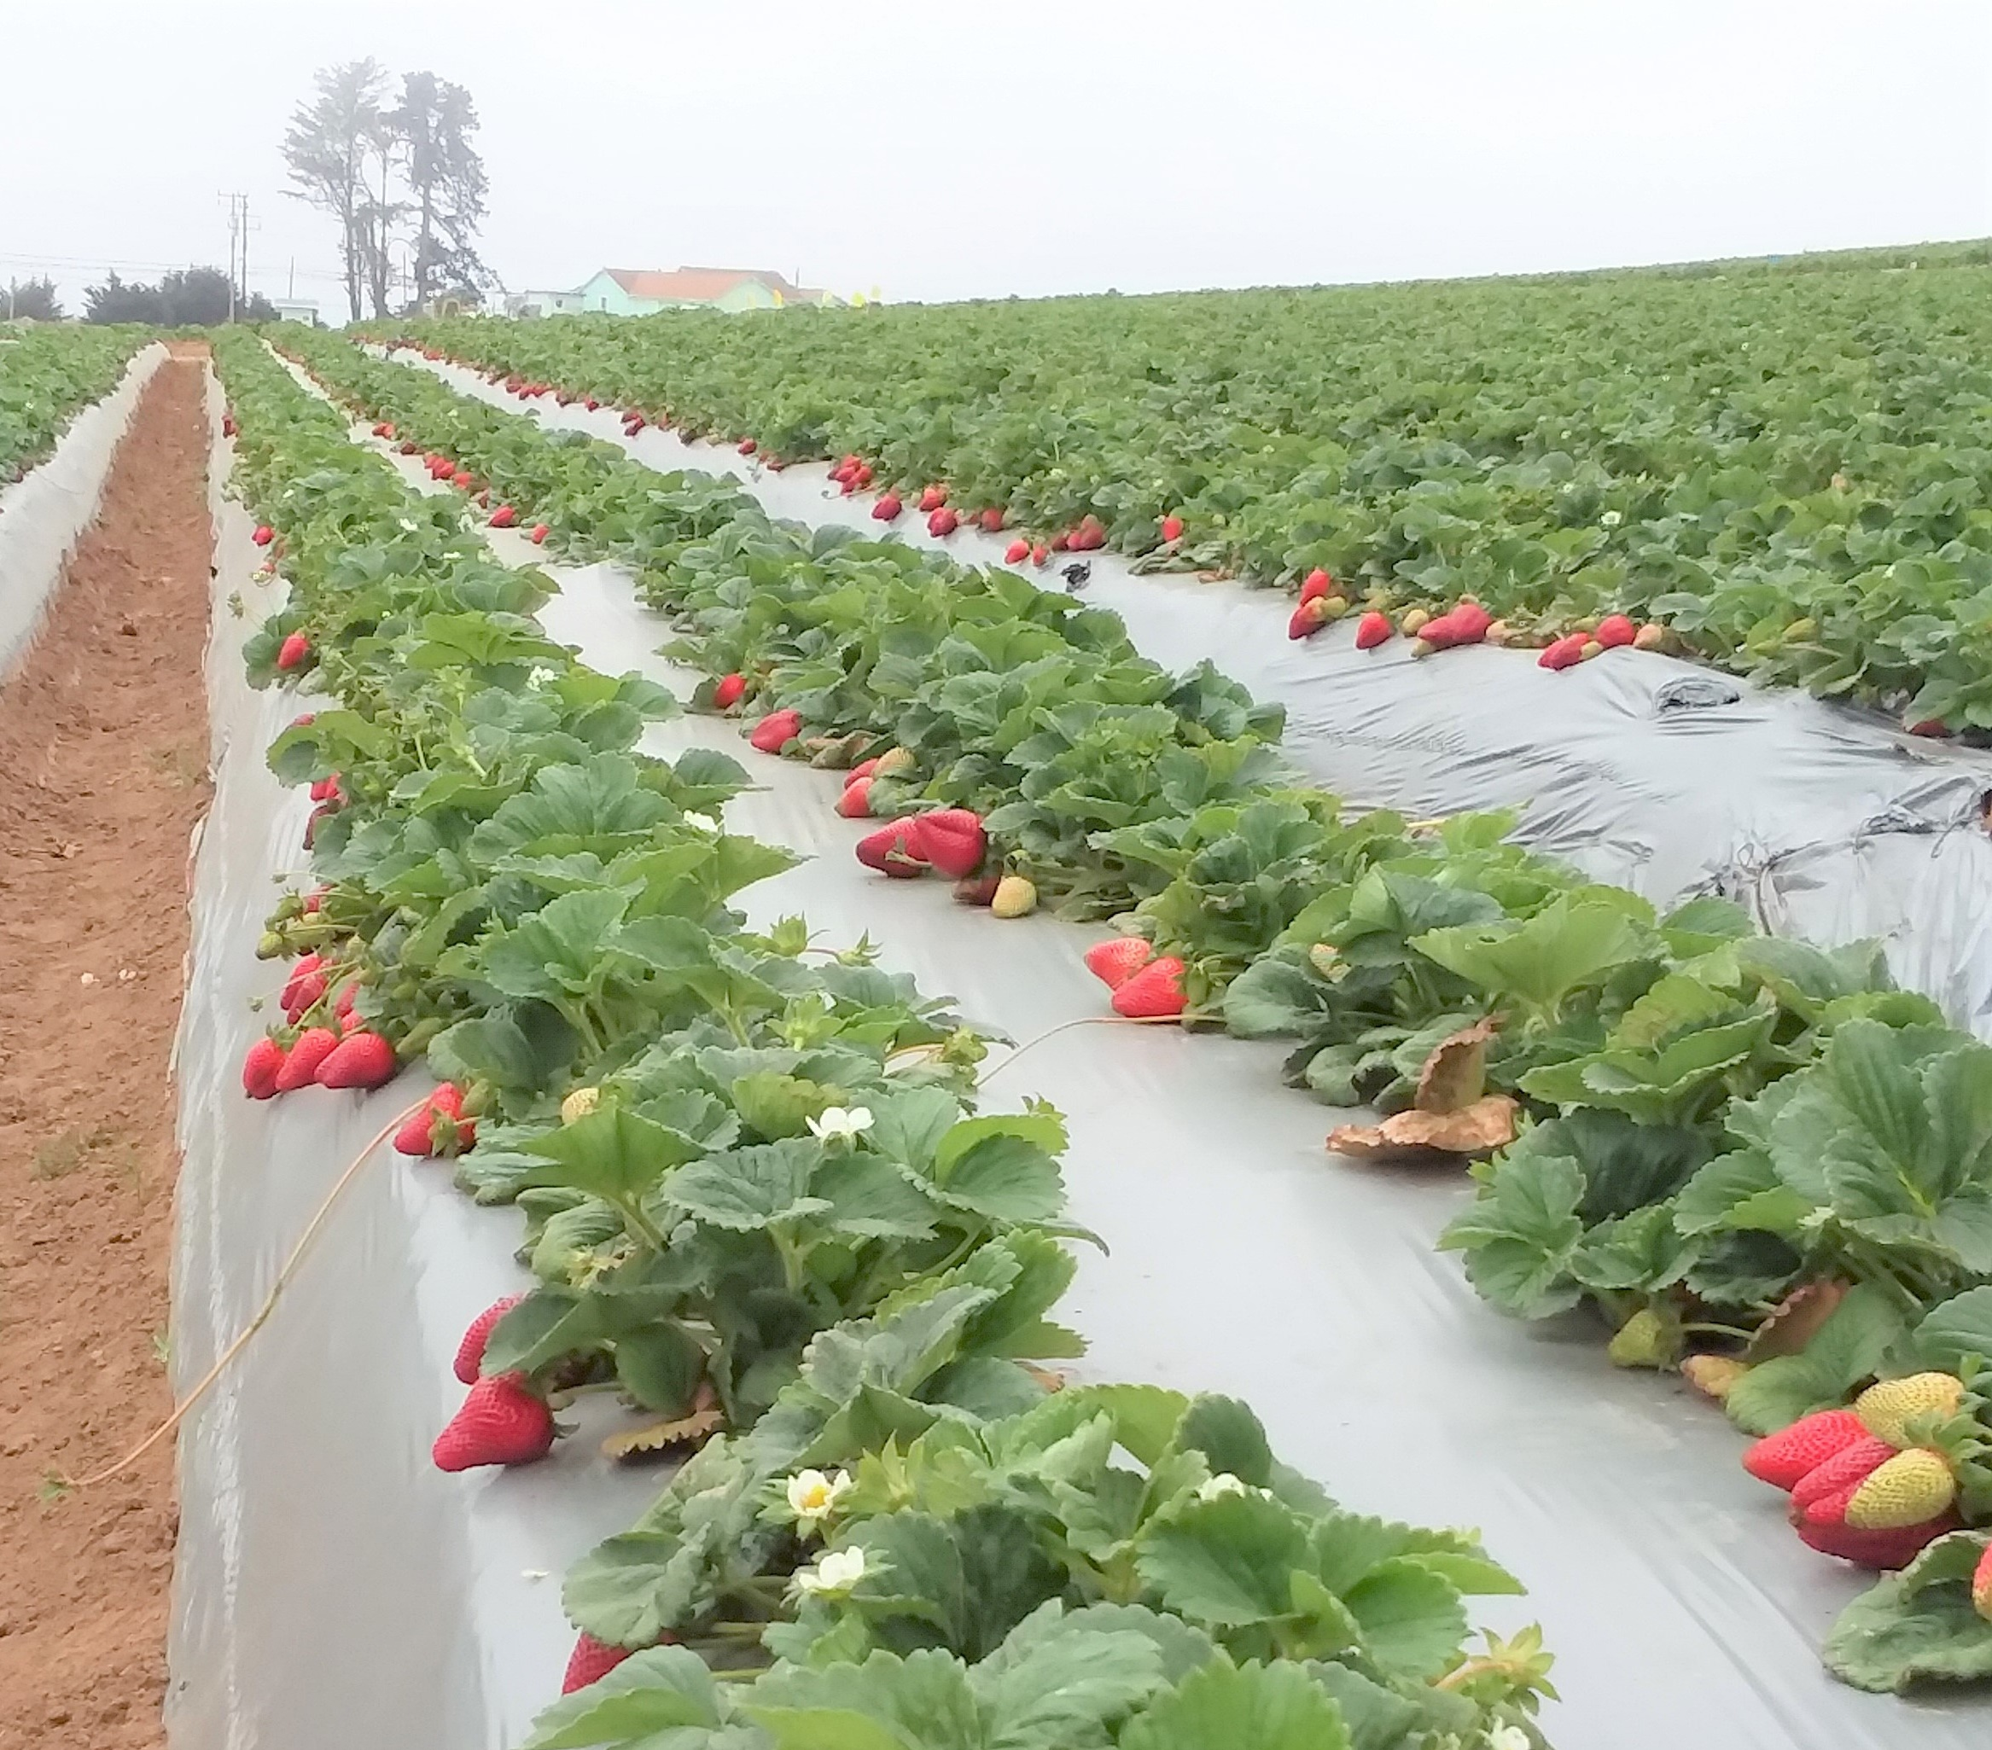
Scientists identify products to test
  Pesticides used in other crops
    Already have food uses
    Spectrum of pest control has overlap with cranberry pests
    Professional meetings, journal articles
  Suggestions from chemical companies

Slide 4
Pesticide Screening
Research funded primarily by grower associations, handlers, and CI
CI Horticulture Committee
    Members from all regions and aspects of the industry
      growers, grower associations, handlers
    National research priorities
    Issue a request for proposals, meet to consider how proposals rec’d fit CI priorities
    Make funding recommendation to the CI Board

Slide 5
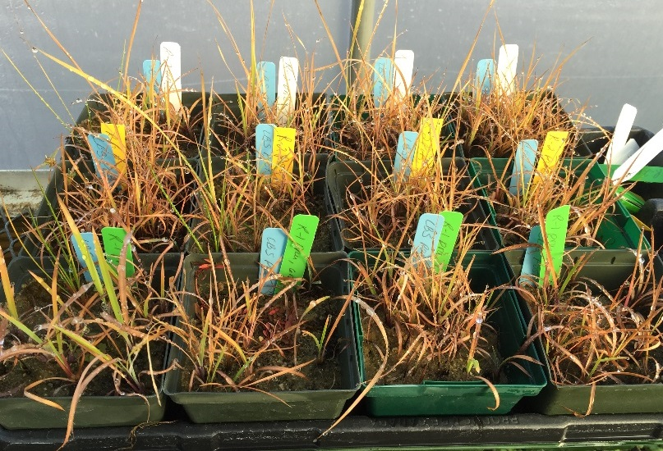
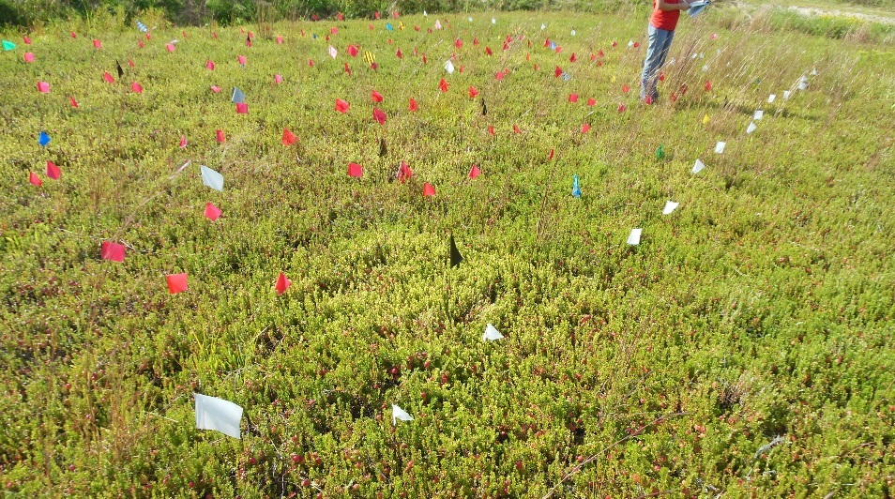
Pesticide Screening Research
Researchers select rates, application timing, etc.
Greenhouse, lab, and field trials
Often in collaboration between regions

Slide 6
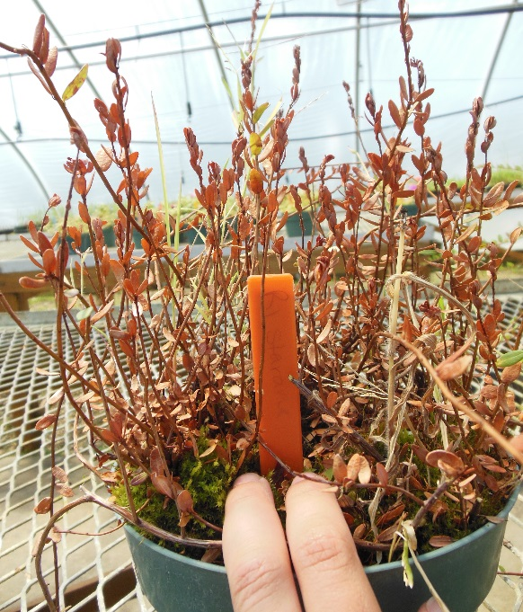
Promising compounds
Identify compounds that:
  Control target pests
  AND safe on cranberry!
Communicate results to chemical company
  Are they supportive of our work?

Slide 7

Pursue registration
The IR-4 Project est. 1963 by USDA
Crop protection industry focuses their efforts on major crops (corn, cotton, soy, rice, wheat, etc.) which leaves specialty crops* with fewer tools
* specialty crops defined as, “Fruits and vegetables, tree nuts, dried fruits, horticulture, and nursery crops (including floriculture)”.
Assist with identification and registration pest management solutions for specialty crops

Slide 8
Pursue registration
    CI solicits input from cranberry research community for projects
    Submits projects for consideration
    CI advocates for cranberry projects to receive an “A Priority” for projects
        Nomination based on factors such as registrant support, IR-4 capacity, and competitiveness
    If a project is nominated
    IR-4 develops protocol for field trials (GLP studies)
    Study directors in each region to execute field trials
    Fruit collected for residue analysis

Slide 9
Pursue registration
Registrant submits application to EPA
Establish “tolerance” for cranberry
  Maximum safe and acceptable amount of residue
Get a product registered in cranberry
Can be a loooooong road (even if it all goes smoothly)!
Example:
  Greenhouse trials 2014
  Field trials 2015 + 2016
  Nominate to IR-4 in 2016
  IR-4 field trials 2017
  IR-4 data analysis completed 2020
  Company just finished submitting application to EPA…maybe another few years for a labeled product!

Slide 10
Current pesticides in pipeline
  Fungicides
  3 compounds with completed trials
    All awaiting analysis or awaiting registrant submission
  1 compounds nominated for 2022 field trials
Herbicides
  2 compounds with completed field trials
    1 submitted to EPA, other on hold due to reg review
  Insecticides
  1 compound recently registered

Slide 11

Registration Review
EPA reviews each registered pesticide at least every 15 years
Ensure pesticide can carry out its intended function without creating unreasonable adverse effects to:
  Human health
  The environment
Outcomes
  No changes
  Label changes to mitigate risk
  Loss of use
  CI tracks each stage
  Solicits and prepares comments if changes will impact industry

Slide 12
Cranberry Pesticides in Registration Review Process
Acephate
Acetamiprid
Bacillus thuringiensis
Carbaryl
Chlorothalonil
Clothianidin
Diazinon
Difenoconazole
Dinotefuran
Fenbuconazole
Ferbam
Fluxapyroxad
Imidacloprid
Mancozeb
Mesotrione
Napropamide
Norflurazon
Phosmet
Pronamide
Propiconazole
Propiconazole
Prothioconazole
Pyrethrins
Spiromesifen
Tebuconazole
Tetraconazole
Thiamethoxam

Slide 13
Tracking foreign MRLs
Once a product is labeled in the US, the industry can work on getting MRLs (Maximum Residue Limits) established in foreign markets
  The goal is “harmonization” with our US tolerances
Complex, and different for every market!
  +70 pesticides
  +15 markets

Slide 14
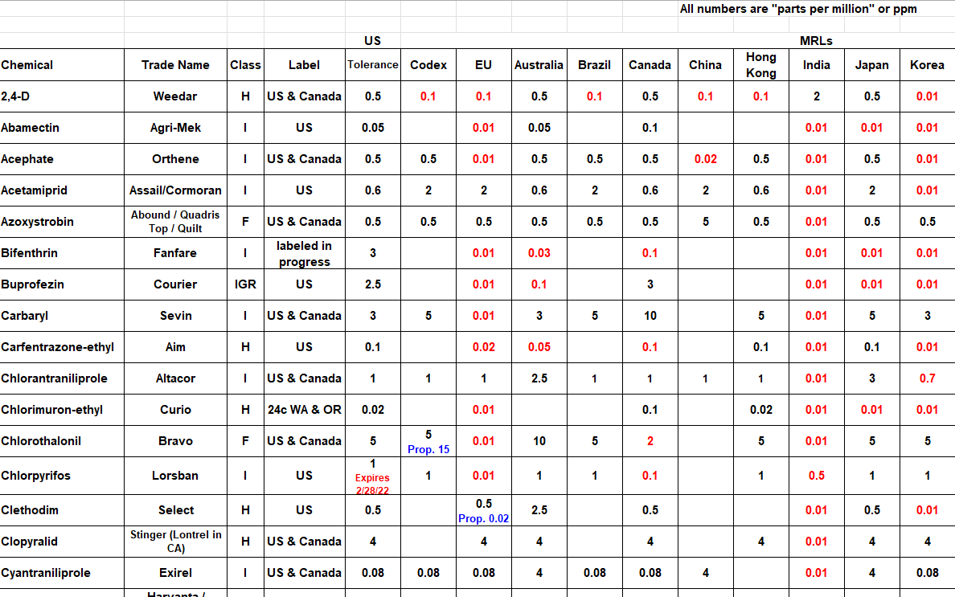

Slide 15
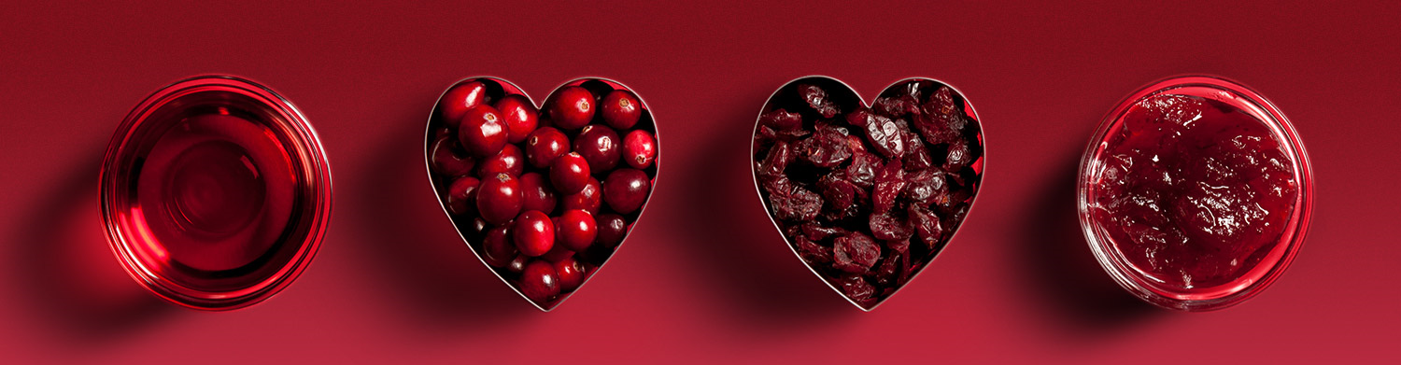
Questions?

