Slide 1
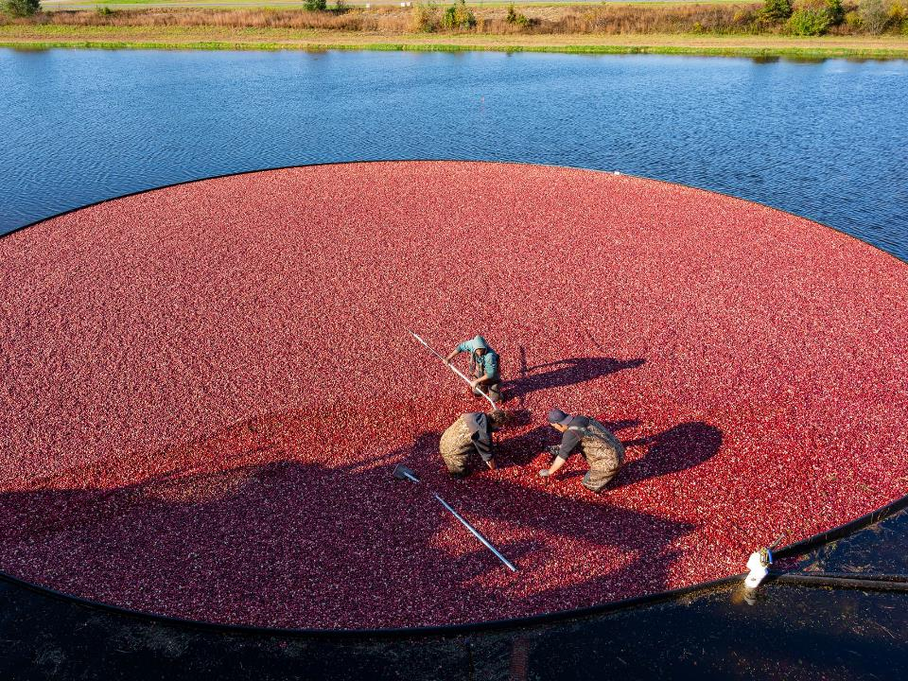

CMC Update
Pacific Northwest Cranberry Congress
February 2022 | Karen Cahill | Marketing Director

Slide 2

USDA MARKETING ORDERS
Initiated by industry
Established/enforced by the USDA
Defined by geographical area
Administered by committee of growers
Ensure stable, orderly supplies of quality product
Almonds
Apricots
Avocados
CRANBERRIES
Dates
Grapes
Hazelnuts
Kiwifruit
Nectarines
Olives
Pistachios
Raisins
Spearmint Oil
Tomatoes
Walnuts
Cherries
Citrus
Onions
Peaches
Pears
Plums/Prunes
Potatoes
Notes:
Initiated in 1962 following the herbicide Aminotriozole scare of 1959. Eisenhower was president and it was reported he would not be having cranberries for Thanksgiving.
When the CMC was formed there was a total of about 20,000 acres. WI acreage was about 4,000. WI acreage today is approximately 20,000 acres.
The Cranberry Marketing Committee is 1 of 22 USDA Marketing Orders

Slide 3

MARKETING COMMITTEE
Established by USDA in 1962
Continuance via Referendum
  Every 4 years in May, grower/volume majority
Assessment
  $0.28/barrel assessed to conventional handlers
  $0.08/barrel assessed to organic handlers
Concentrations
Data Collection
Marketing & Promotion
Trade Policies & Tariffs
MRLs
Health Research
Volume Regulation
Notes:
Next referendum is 2023

Slide 4
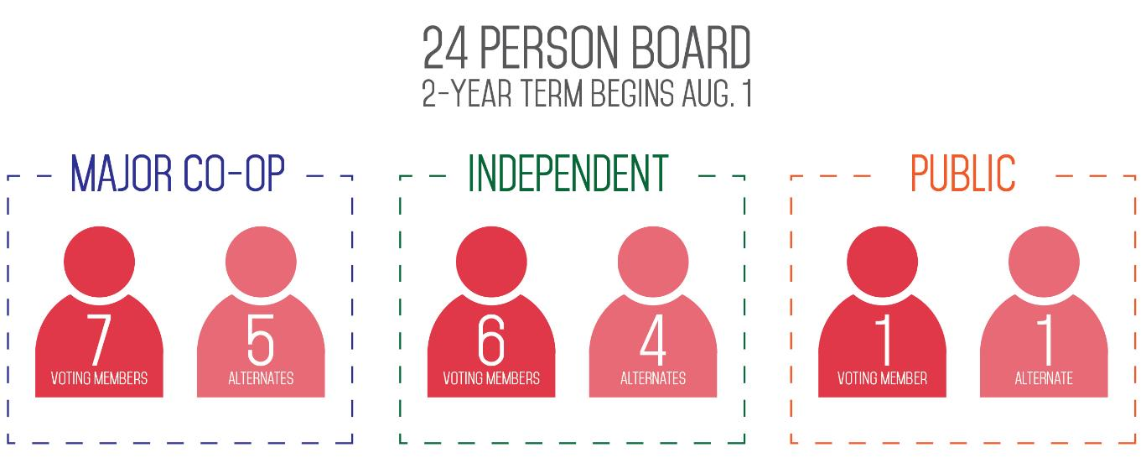
STRUCTURE
Next Election May 2022
USDA Marketing Specialist
  Jen Varela
  Southeast Field Office
CMC Office Staff
  Michelle Hogan, Executive Dir.
  Karen Cahill, Marketing Dir.
  Dotty Pipher, Sr. Executive Asst.
Notes:
Voting will take place this spring – new term begins August 2022

Slide 5
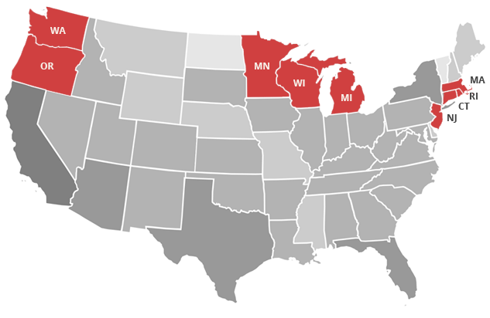
GROWING REGIONS
~1,200 US Cranberry Growers Harvest 40,000+ Acres

Slide 6

DATA COLLECTION
Crop Year 2021
Domestic
Production
(bbls)
Total
6.6 million
bbls

Slide 7
DATA COLLECTION
– CY 2020
Smallest crop since 2007

Slide 8
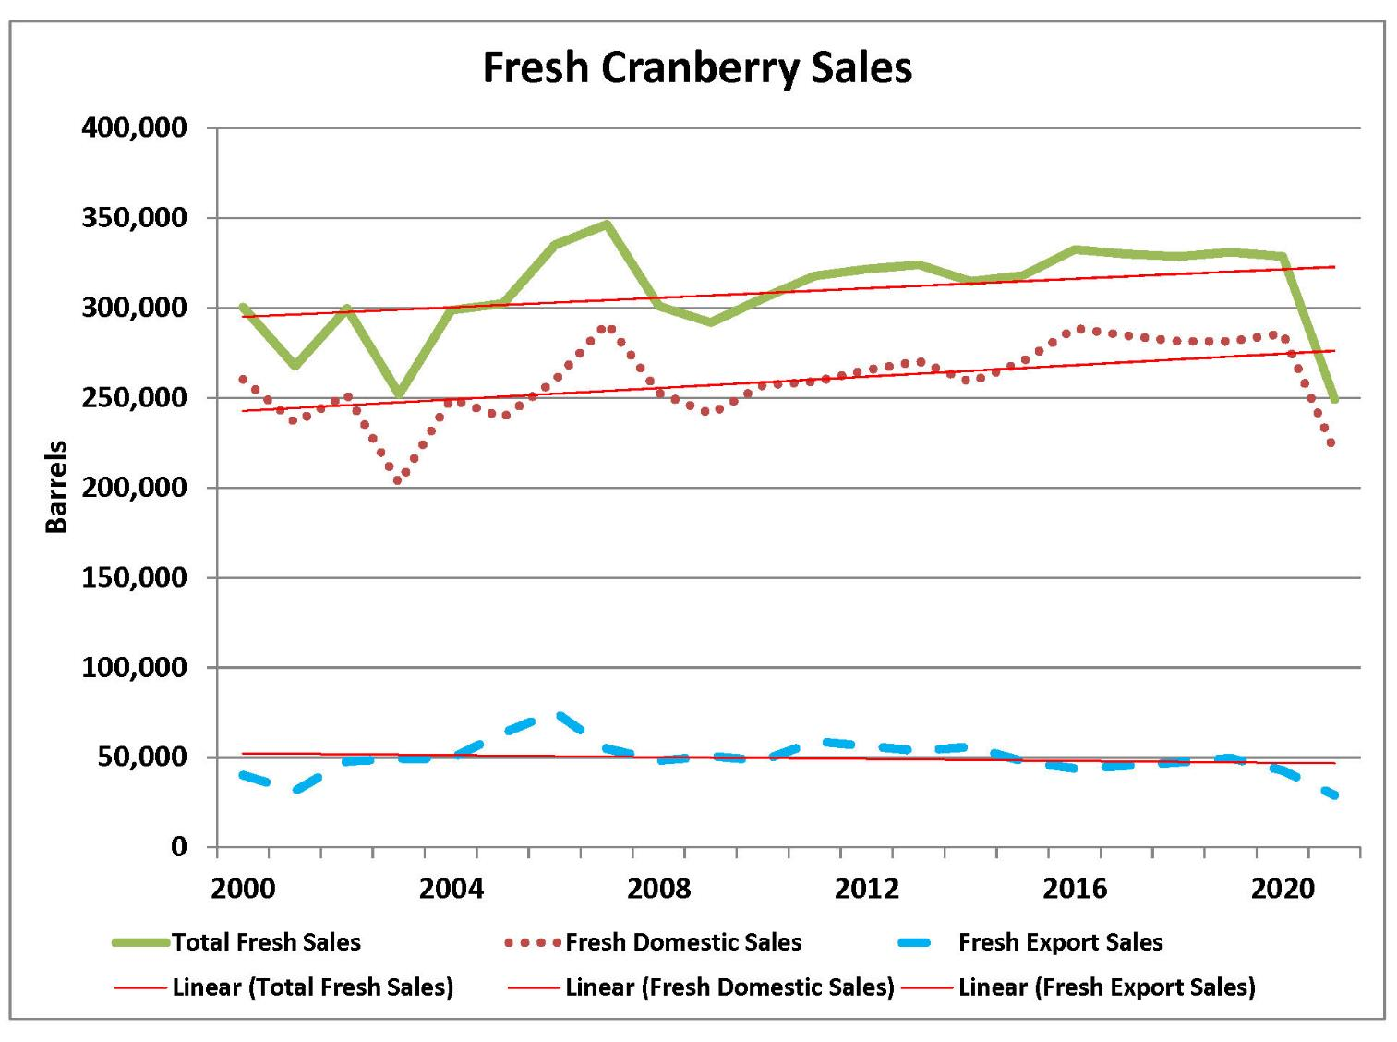
DATA COLLECTION

Slide 9
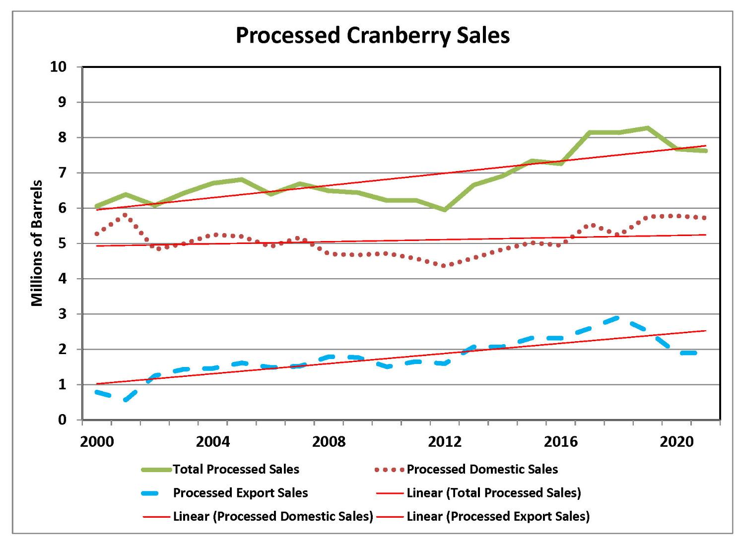
DATA COLLECTION

Slide 10
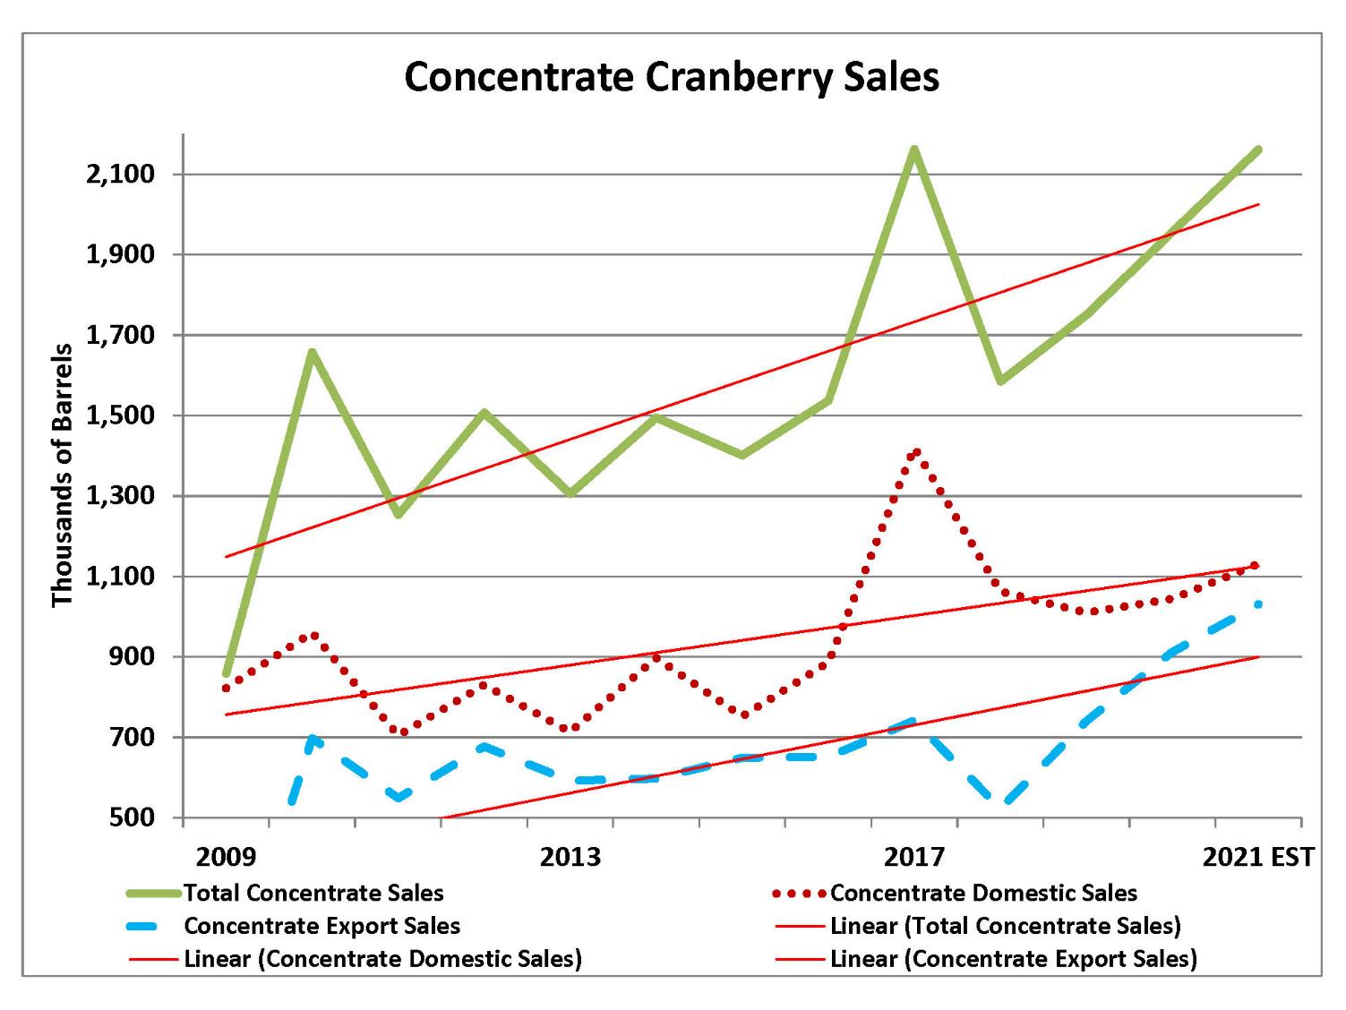
DATA COLLECTION

Slide 11
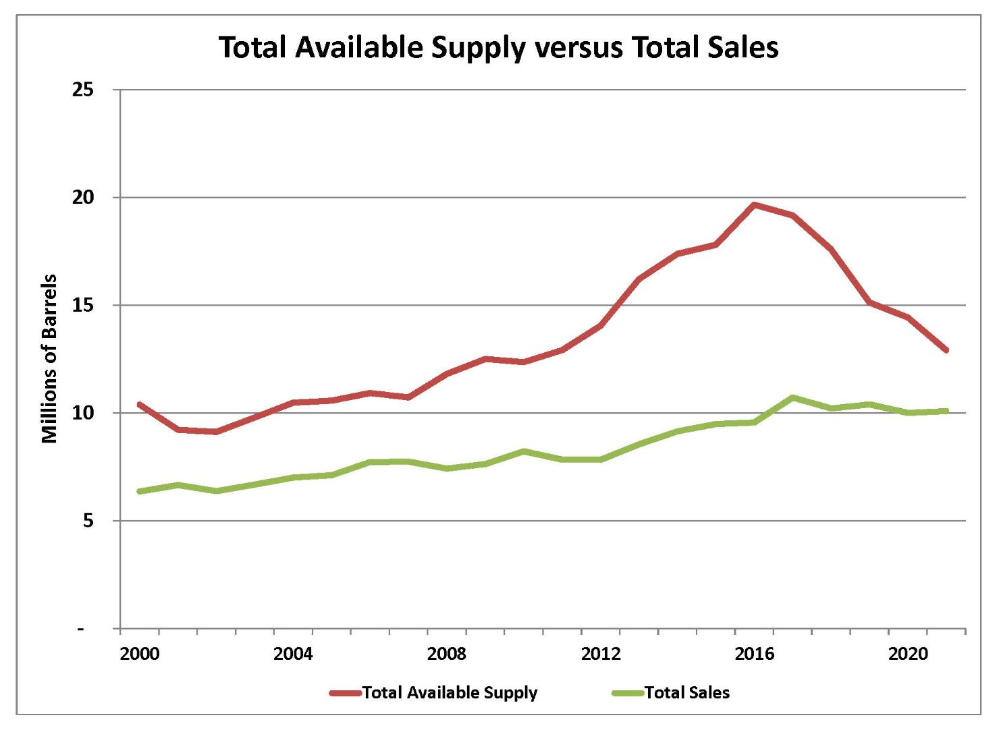

Slide 12
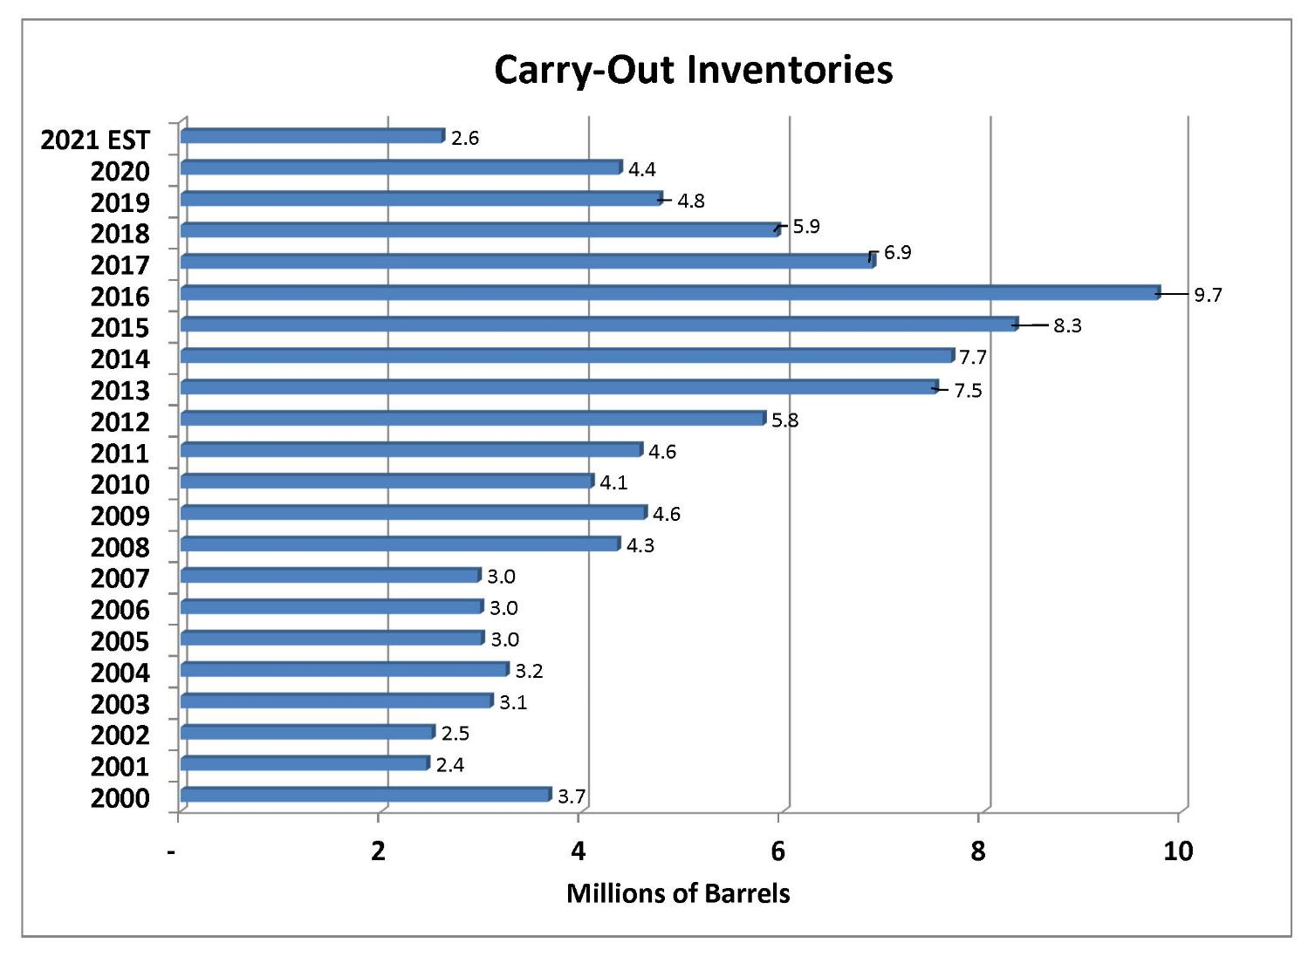

Slide 13
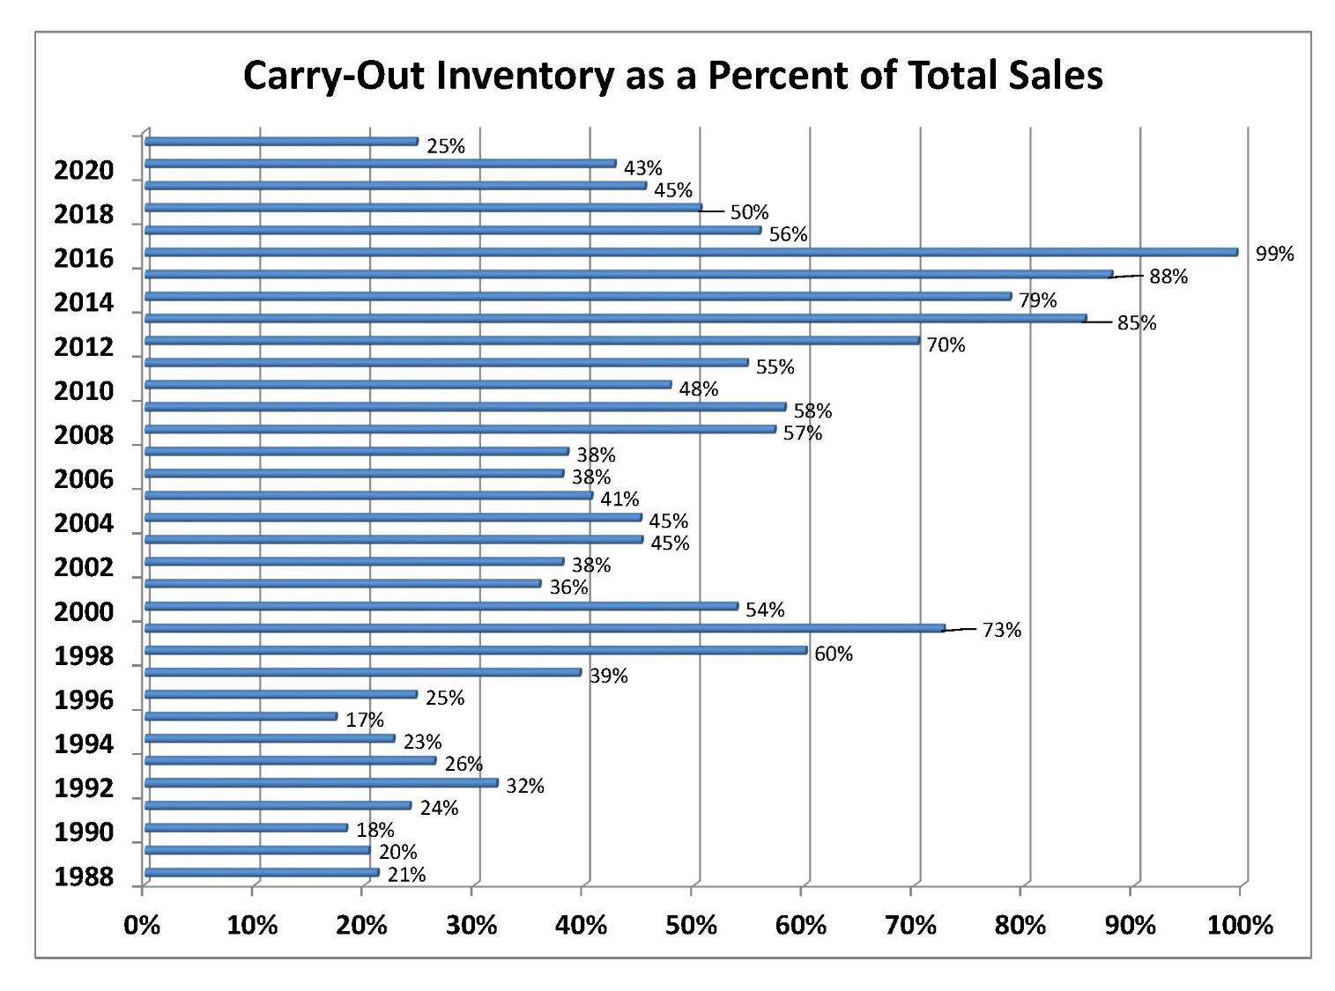

Slide 14

TRADE POLICY - TARIFFS
EU steel and aluminum dispute cranberry duties removed October 2021
EU dried cranberry duty suspension review 2022
UK extended current duty suspensions on cranberry products through 2024
Japanese tariff reductions on dried cranberries and concentrate 4/2022, elimination 4/2023.
Monitoring U.S.-India trade relationship

Slide 15

MRLs – PAST SUCCESS
2016-2020 MRL SUCCESS (new MRLs established, at a minimum)
  17 Korean cranberry MRLs (More to come in 2021, prior to the end of transition time period)
  17 Chinese cranberry MRLs
  15 Australian MRLs
  7 Canadian MRLs
  6 Japanese MRLs
  Quinclorac cranberry MRLs successfully established in Australia, Canada, China, Japan, Korea, and at Codex (Research and efforts still underway in EU)
  Notifications of MRL changes in EU well in advance, challenges to problematic withdrawals proposed
  Codex MRL for Bravo recommended for renewal

Slide 16

HEALTH RESEARCH
Research Studies – Funded 8/2021
  Antibiotic potentiation by cranberry bioactives against drug resistant uropathogenic e-coli
  Modulation of the gut brain axis by cranberries impact on university students’ mental health - the CRANMOOD study
H. pylori Study (2020) - Domestic Promotion
  92 Media Placements, 780 million impressions
  FNCE Expo Theater Event (October 16-19)
    Worked with CI to sponsor Amy Howell’s presentation, “Could Daily Cranberry Consumption Contribute to Helicobacter pylori Suppression?”
    797 attendees, 463 survey submissions

Slide 17

INTERNATIONAL MARKETING
2021-22 USDA FAS Grant Allocations
Market Access Program | $1,588,232
Foreign Market Development | $175,641
Quality Samples Program | $18,000
Emerging Markets Program | $255,000
Branded | $400,000
Agricultural Trade Promotion $3,139,450 (through 2024) | $1,000,000
TOTAL | $3,436,873

Slide 18


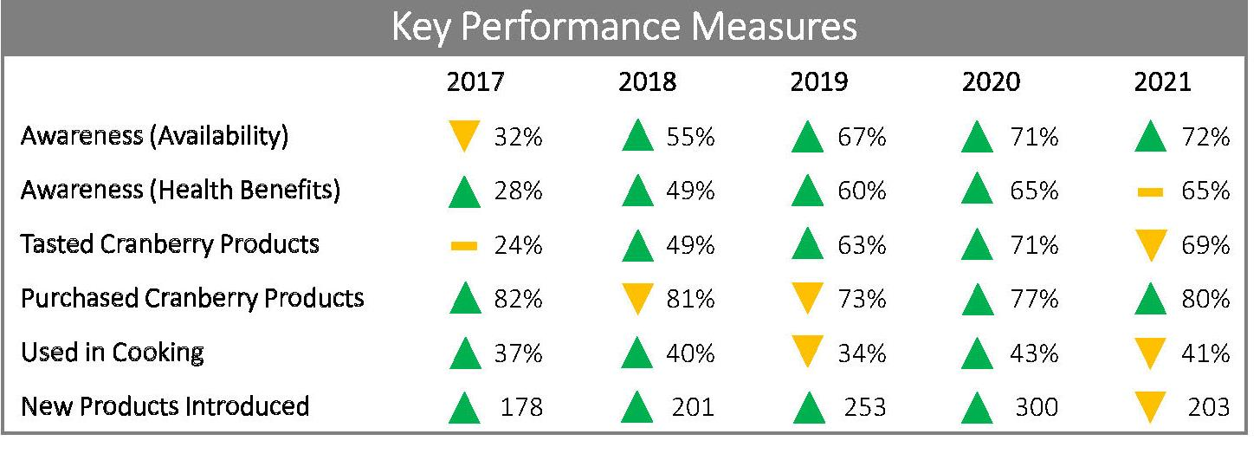
INTERNATIONAL MARKETING
121,068 bbls exported in 2020/21 (-37%)
In-country handler tariff relief
Main Challenges: US/China Trade relations, Supply Chain, Chinese production, Regulations

Slide 19

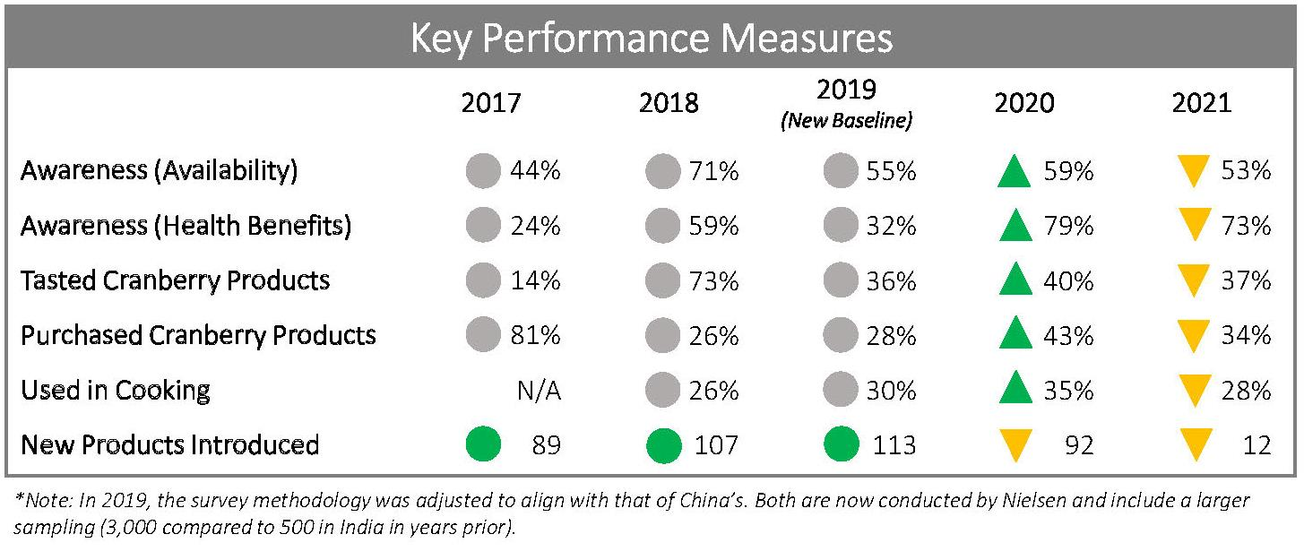
INTERNATIONAL MARKETING
7,002 bbls exported in 2020/21
New in-market rep producing results
Main Challenges: COVID, Supply Chain

Slide 20
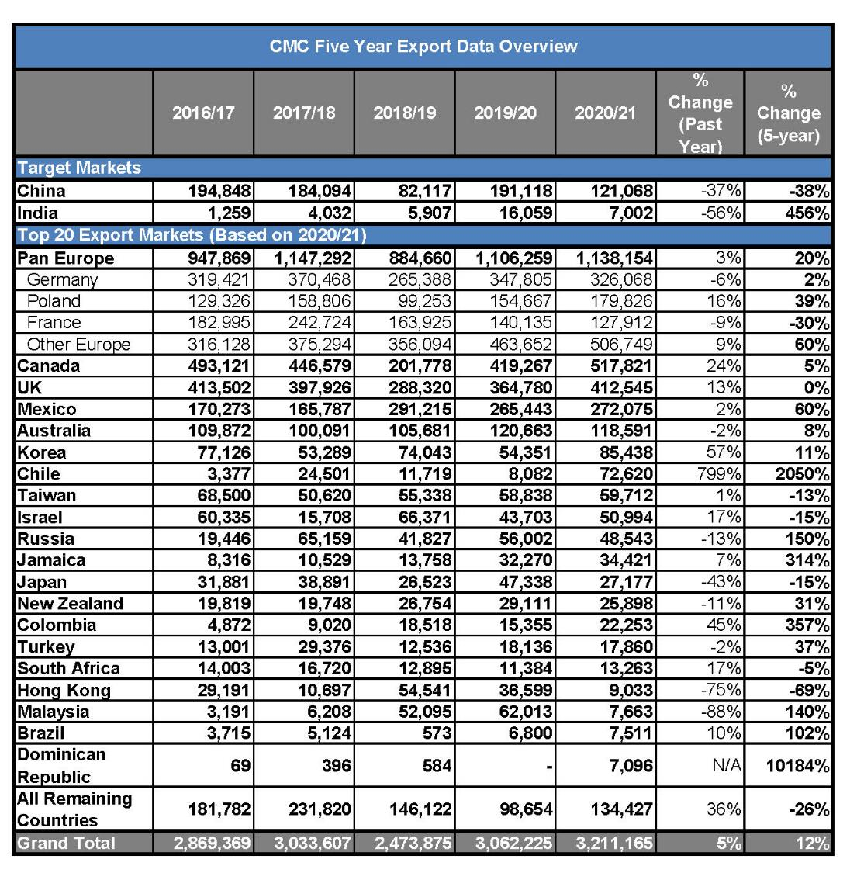
INTERNATIONAL MARKETING

Slide 21

DOMESTIC MARKETING – 2020/2021
(Sept ‘20 – Jan ‘21)
  14 million impressions
  $182,000+ sales
  $2.38 Return on Ad Spend
  27% new customers
(Sept ‘21 – Dec ‘21)
  7 million impressions
  $67,000+ sales
  $1.82 Return on Ad Spend
  14% new customers

Slide 22
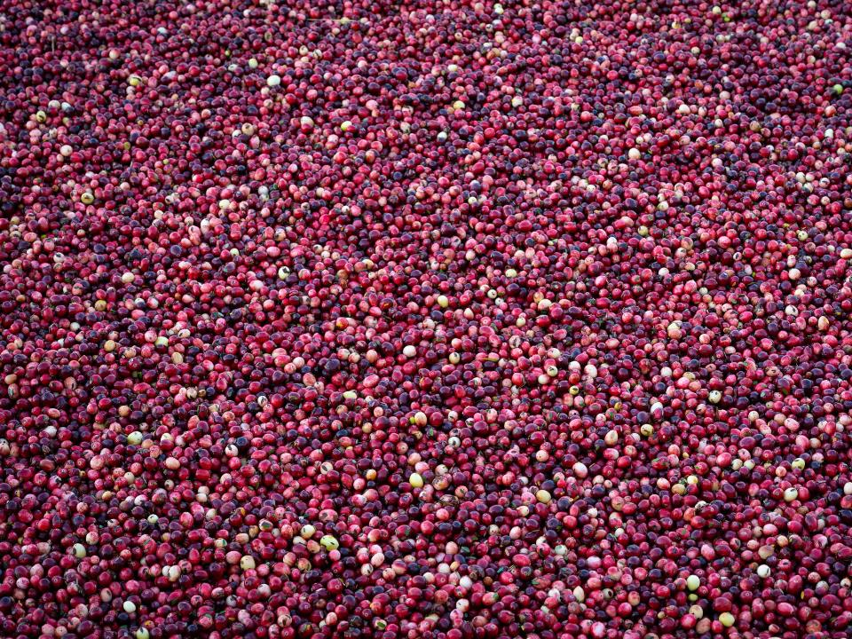





DOMESTIC MARKETING
(Sept ‘20 – Jan ‘21)
  21 million impressions
  $249,000+ sales
  $2.38 average ROI
  27% new customers
(Sept ‘21 – Dec ‘21)
  7 million impressions
  $67,000+ sales
  $1.82 Return on Ad Spend
  14% new customers
CMC 2022 WINTER MEETING
FEBRUARY 24 & 25
www.uscranberries.com
Follow @uscranberries on social media

