Slide 1
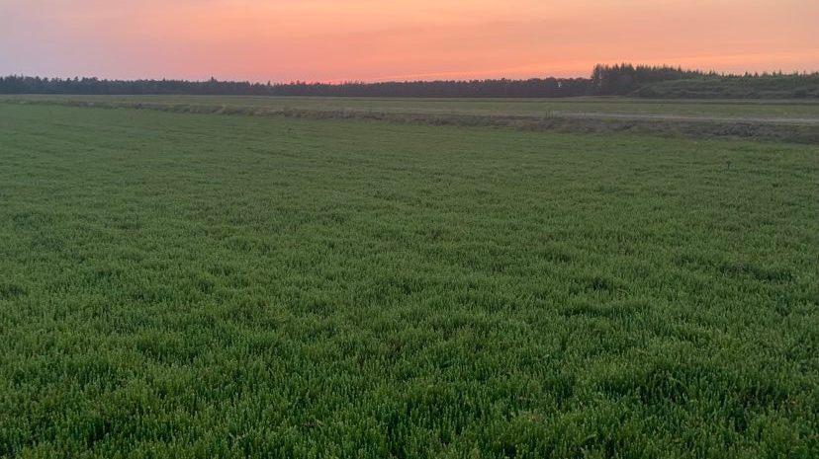






Control of the Blackheaded Fireworm and Cranberry Weevil
Didier Labarre*, François Gervais, Annabelle Firlej, Marc Fournier, Daniel Chapdelaine, Shawn A. Steffan, Daniel Cormier, Éric Lucas
*dlabarre@notrecanneberge.com

Slide 2
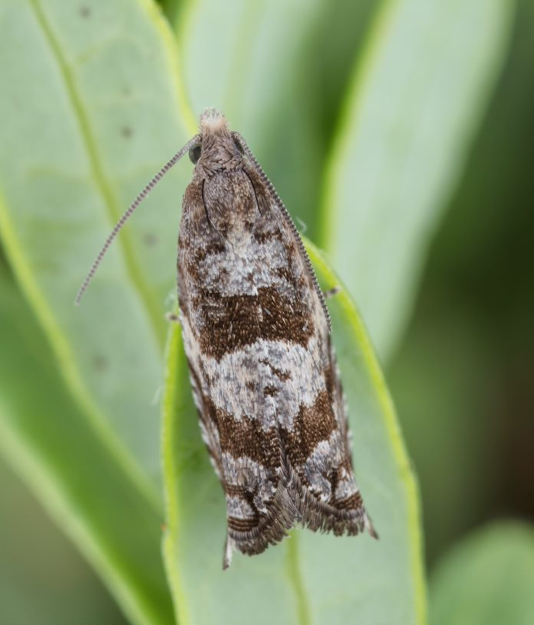
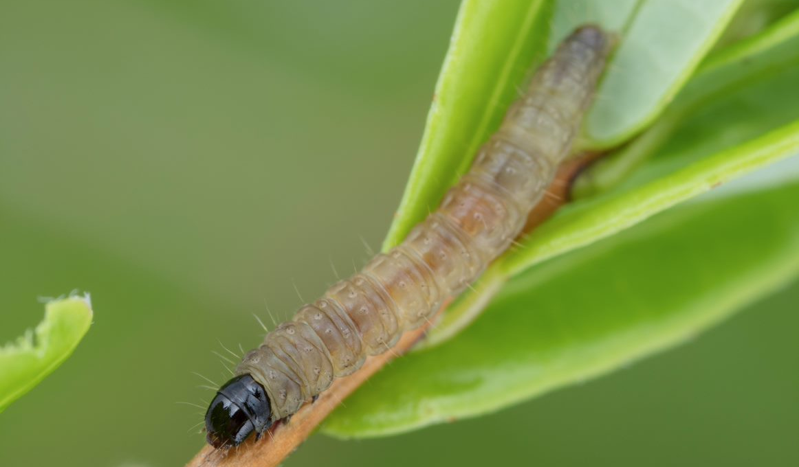
The Blackheaded Fireworm
Rhopobota naevana (Hübner) (Lepidoptera: Tortricidae) ;
Few host plants (specialized for cranberries);
Bivoltine species (2 generations per year);
Damages to buds, hooks, leaves, flowers, fruits;
Major pest throughout North-America (#1 enemy in organic).
© Joseph Moisan-De Serres, MAPAQ
© Joseph Moisan-De Serres, MAPAQ
(Drolet et al., 2018; Fitzpatrick, 2009; Sylvia and Averill, 2005)

Slide 3
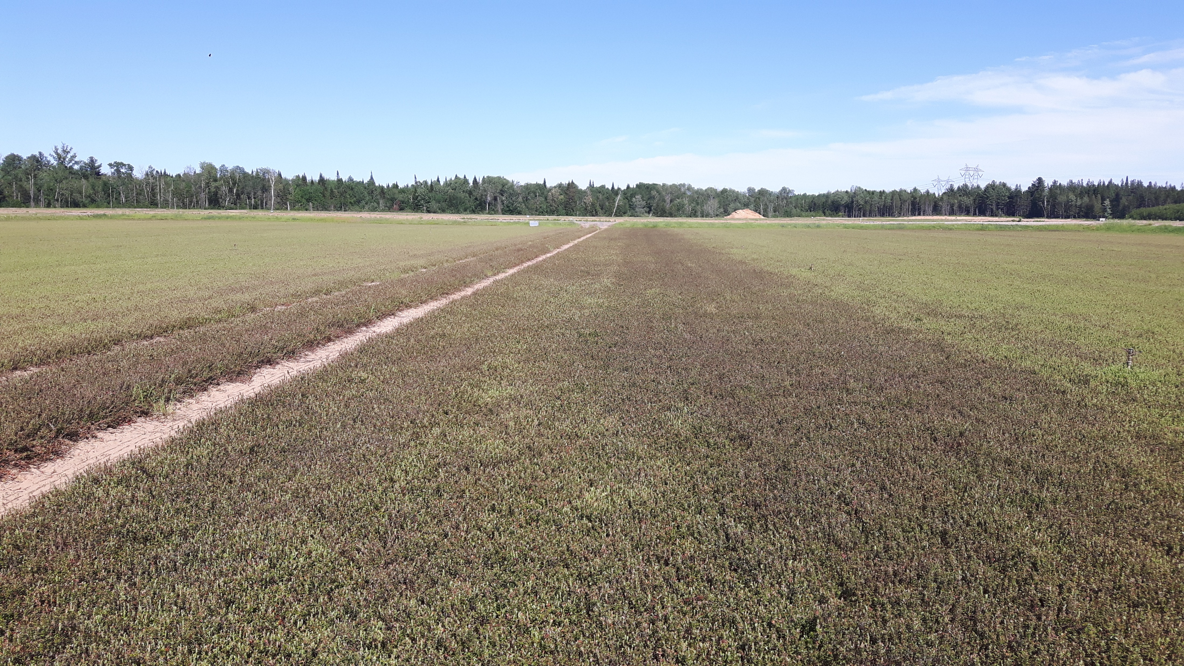
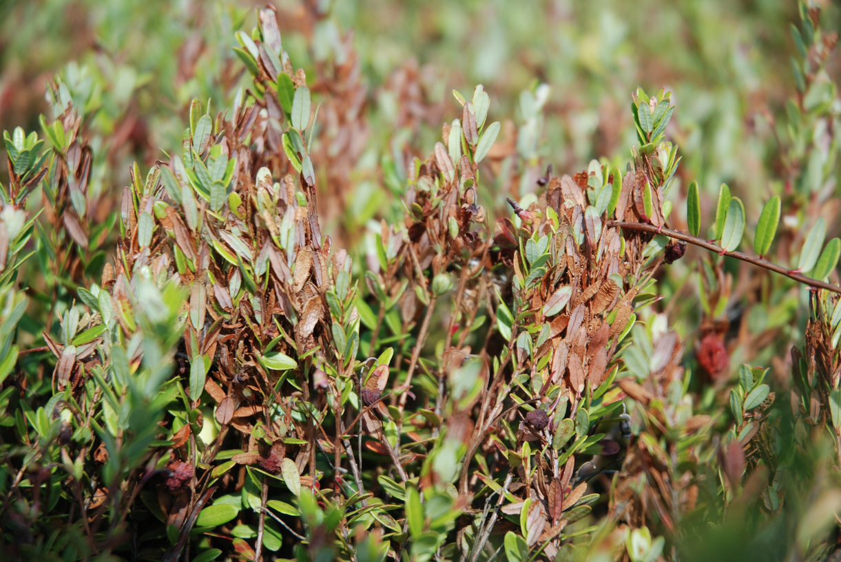
Damages caused by the Blackheaded fireworm
© Isabelle Drolet, MAPAQ
© François Gervais, CETAQ
Up to 95% yield loss!
Impact on subsequent years.
(Drolet et al., 2018; Deland et al., 2014; Le Duc et al., 2004)

Slide 4
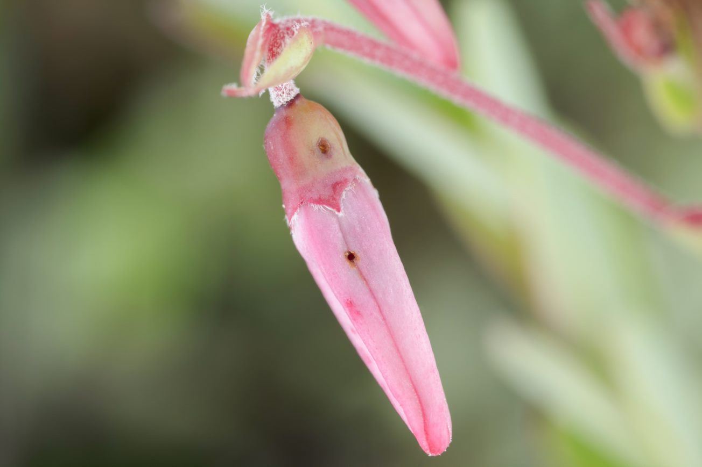
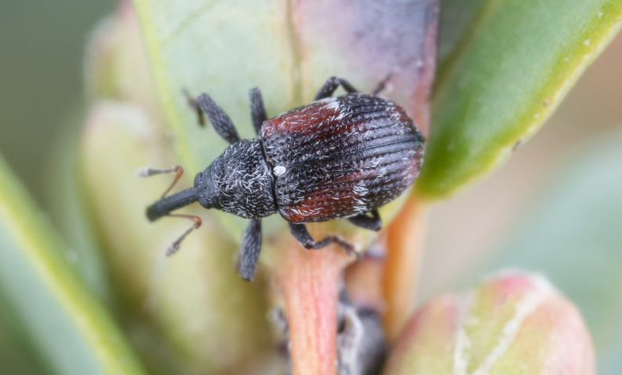
The Cranberry Weevil
Anthonomus musculus Say (Coleoptera: Curculionidae) ;
Univoltine species (1 generation per year);
Damages to hooks and leaves (minor);
Important pest on the midWest and East (still minor on the West Coast).
© Joseph Moisan-De Serres, MAPAQ
© Joseph Moisan-De Serres, MAPAQ
(Drolet et al., 2018;Lacroix, 1926; Guédot and Hietala-Henschell, 2015)

Slide 5
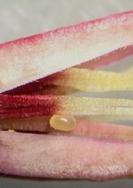
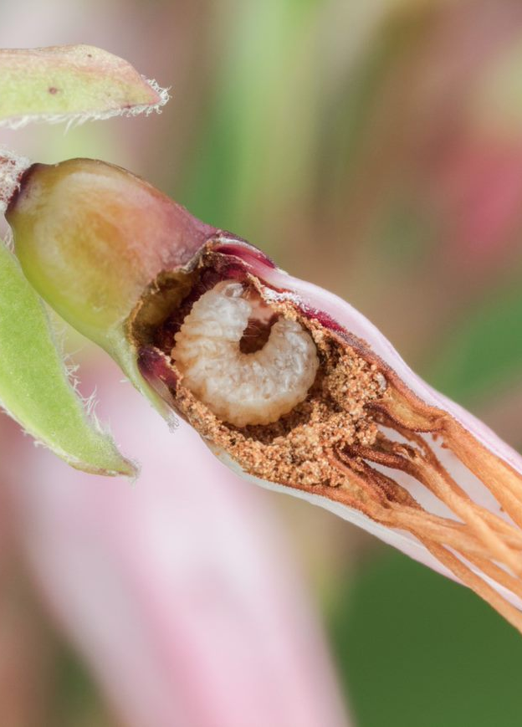
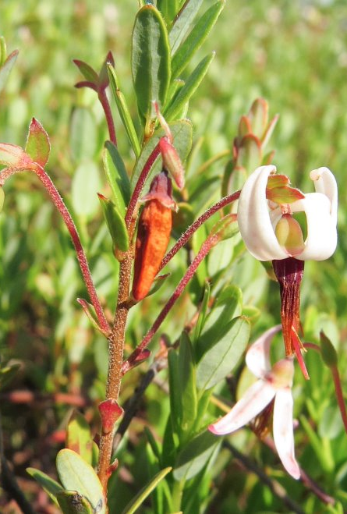
Damages caused by the cranberry weevil
© Isabelle Drolet, MAPAQ
© François Gervais, CETAQ
Up to 75% of damaged hooks ;
Overwinters as adults in litter and woody areas surrounding the bog.
(Drolet et al., 2018; Labarre et al., 2021; Lacroix et al., 1926; Le Duc et al., 2004)

Slide 6




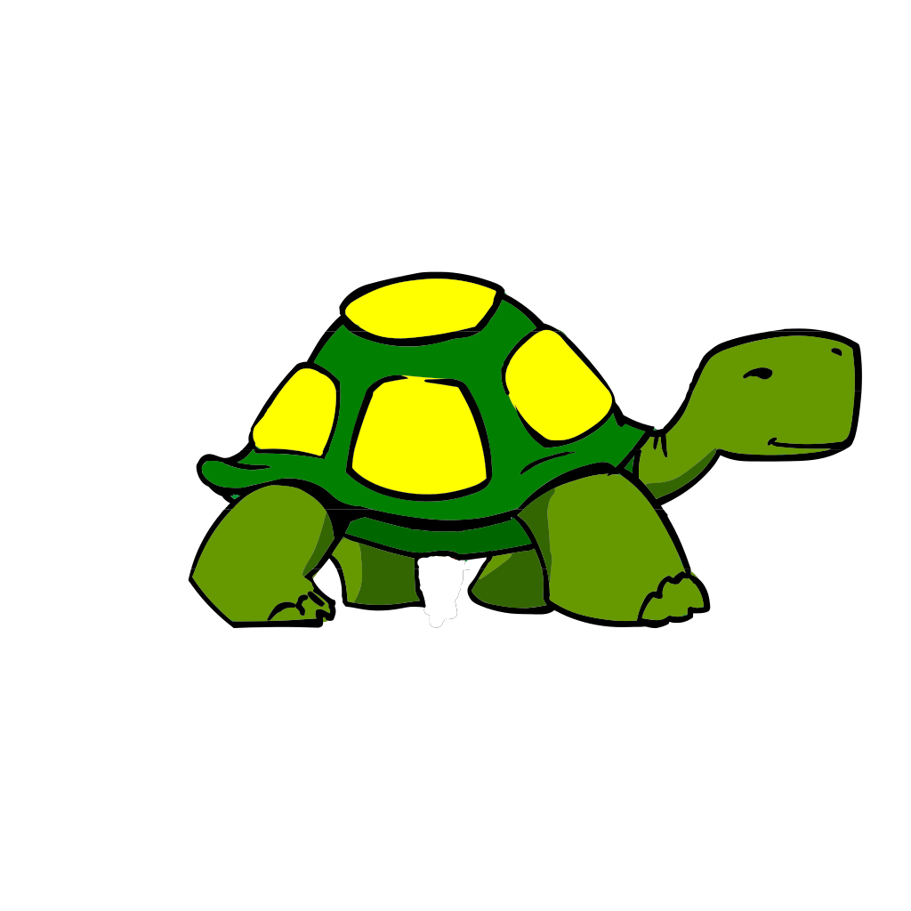


Control Methods
Chemical:
Limited number of insecticides on the market;
  Long process for registration;
  Threath of registration removal;
  Public will to decrease the use of (evil) pesticides.

Slide 7


Control Methods
Biological control
Physical control
Behavioral (mating disruption)

Slide 8

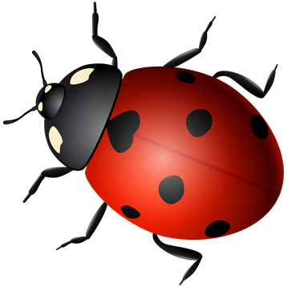

Agenda
Insecticide screening
2. Alternatives (biological, physical and behavioral) control methods

Slide 9

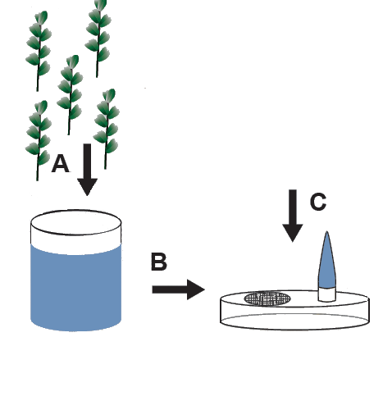
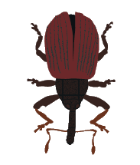
Methodology : Insecticide Screening LAB
X15

Slide 10
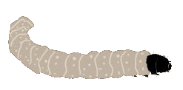
Methodology : Insecticide Screening FIELD
X15
X15

Slide 11
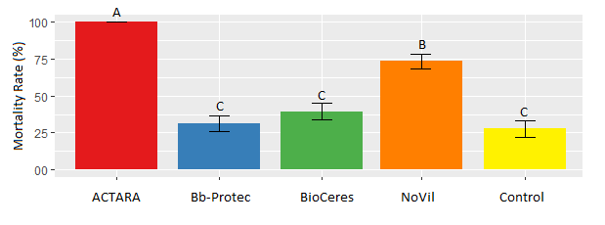
Results: Insecticide Screening LAB
Entomopathogenic fungi
Product | A. I.
ACTARA | Thiamethoxam
Bb-Protec | Beauveria bassiana
BioCeres | Beauveria bassiana
NoVil | Metarhizium robertsii

Slide 12
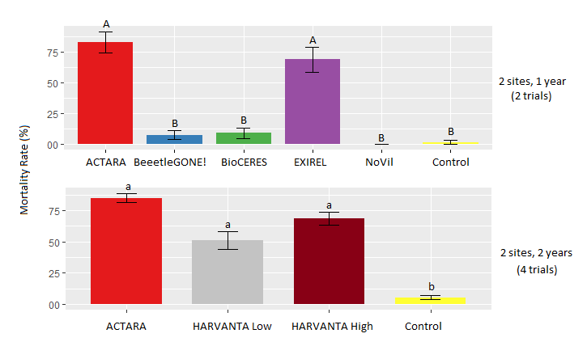
Results: Insecticide Screening FIELD
Product | A. I.
ACTARA | Thiamethoxam
BeetleGONE! | B. t. galleria
BioCeres | Beauveria bassiana
NoVil | Metarhizium robertsii
HARVANTA Low = 1.2L/ha High = 1.6L/ha | Cyclaniliprole
EXIREL | Cyantraniliprole

Slide 13
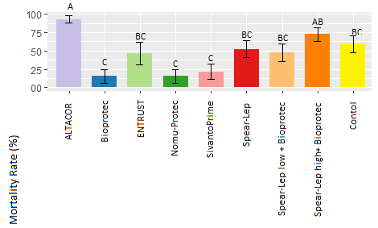
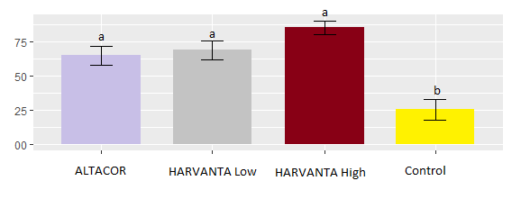
Results: Insecticide FIELD
Product | A. I.
ALTACOR | Chlorantraniliprole
Bioprotec | B. t. kurstaki
Entrust | Spinosad
Nomu-Protec | Metarhizium rileyi
Sivanto Prime | Flupyradifurone
Spear-Lep | GS-omega kappa-Hxtx-Hv1a 2%
HARVANTA Low = 1.2L/ha High = 1.6L/ha | Cyclaniliprole

Slide 14


Results: Insecticide Screening
Product | A. I.
ACTARA
BeetleGONE!
Beauveria bassiana
NoVil | LAB FIELD
HARVANTA | High dose = better
EXIREL
Product | Result
ALTACOR
Bioprotec
Entrust
Nomu-Protec
Sivanto Prime
Spear-Lep | Only with Bioprotec High dose = better
HARVANTA | Both doses

Slide 15
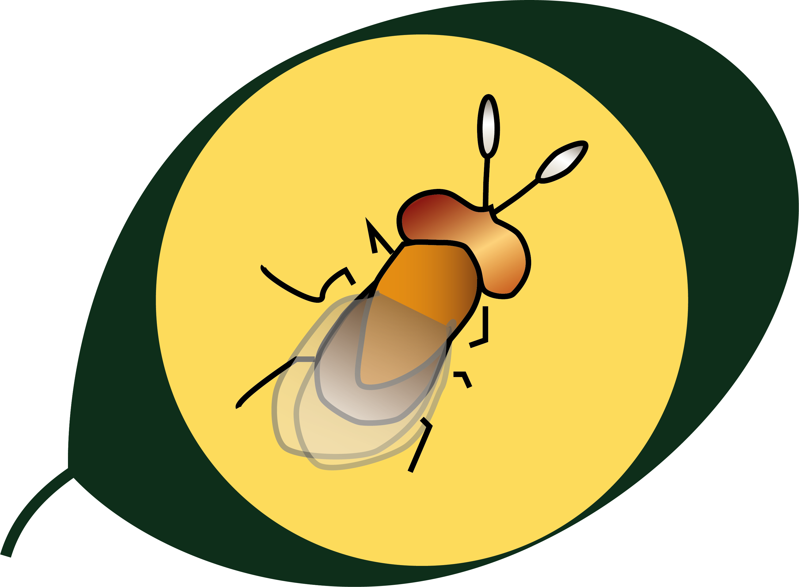

Alternatives: Bio Control using Trichogramma spp.

Slide 16
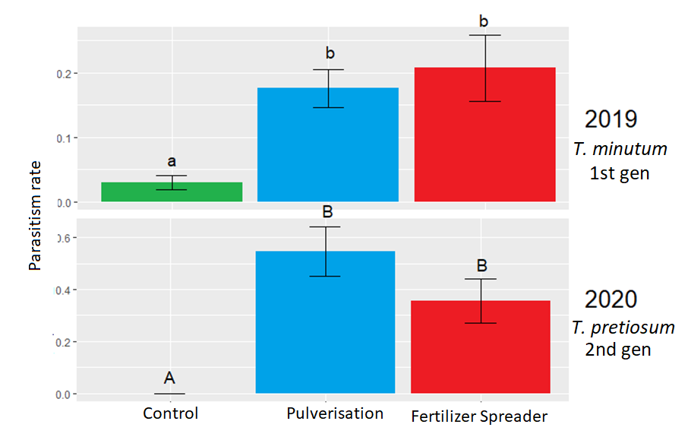
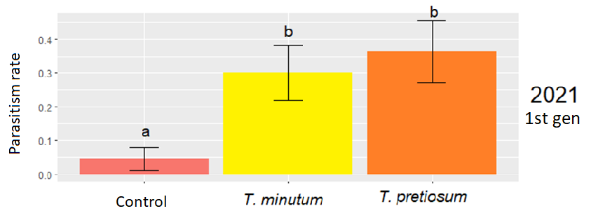
Alternatives: Bio Control using Trichogramma spp.
Old News on the West Coast (Trichogramma sibericum)
New on the East Coast
(Henderson, 2001; Li et al., 1993; 1994)

Slide 17
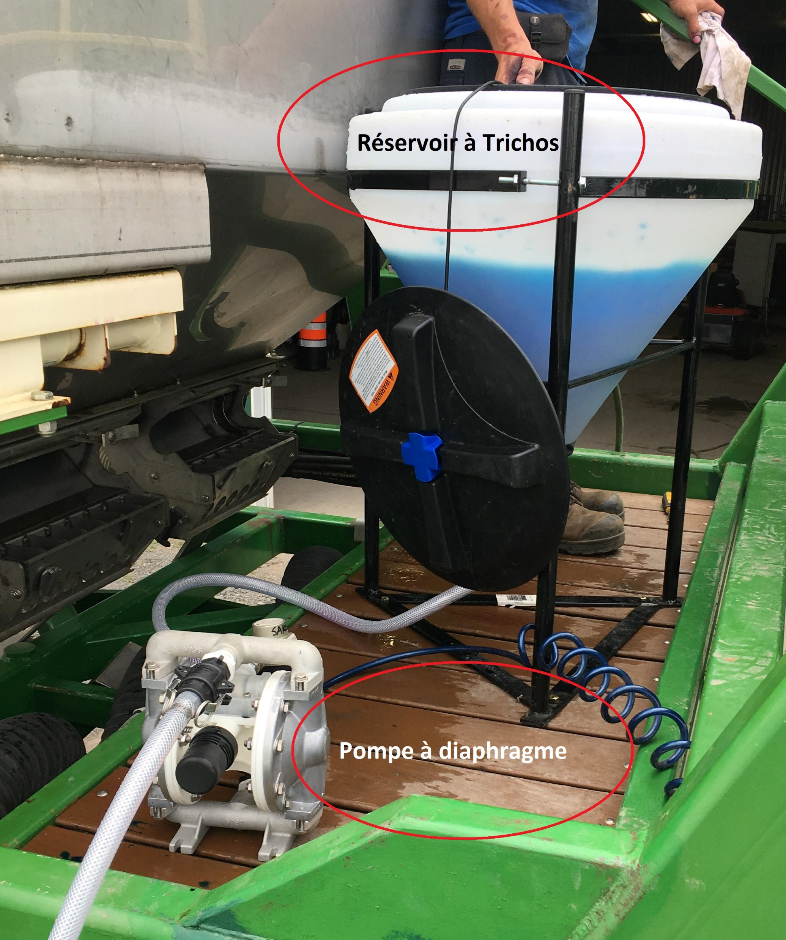
Alternatives: Bio Control using Trichogramma spp.
2022
T. pretiosum
2nd gen

Slide 18
Alternatives: Physical control (Spring flooding)
Old News in Cranberries
Why does it not always work in Quebec?
Population size
Time
50%
90%
(Goff 1893; Packard, 1893;Smith, 1884, 1903; Franklin, 1915… Steffan et al., 2014)

Slide 19
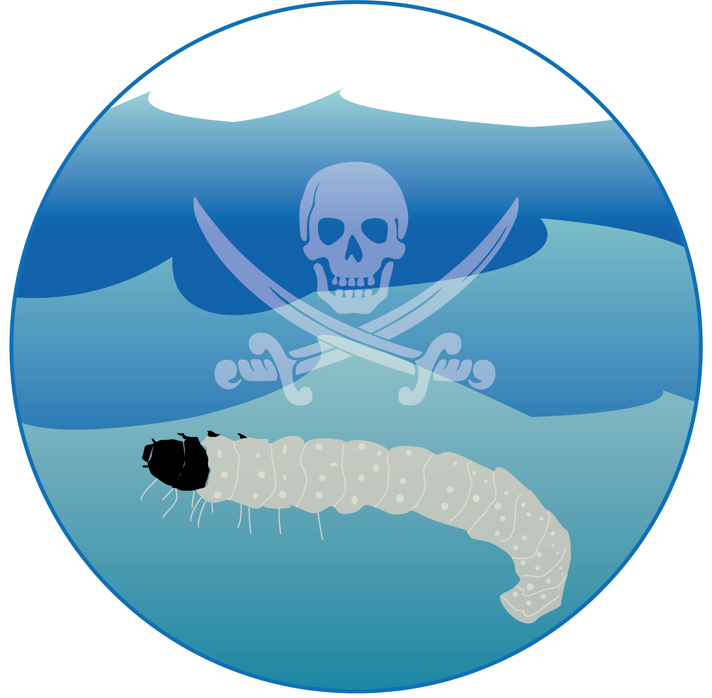
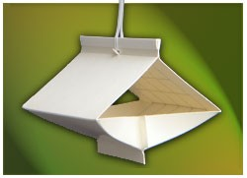

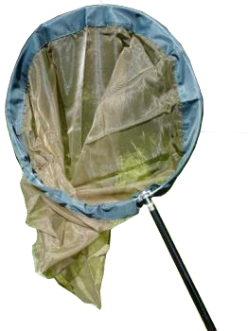
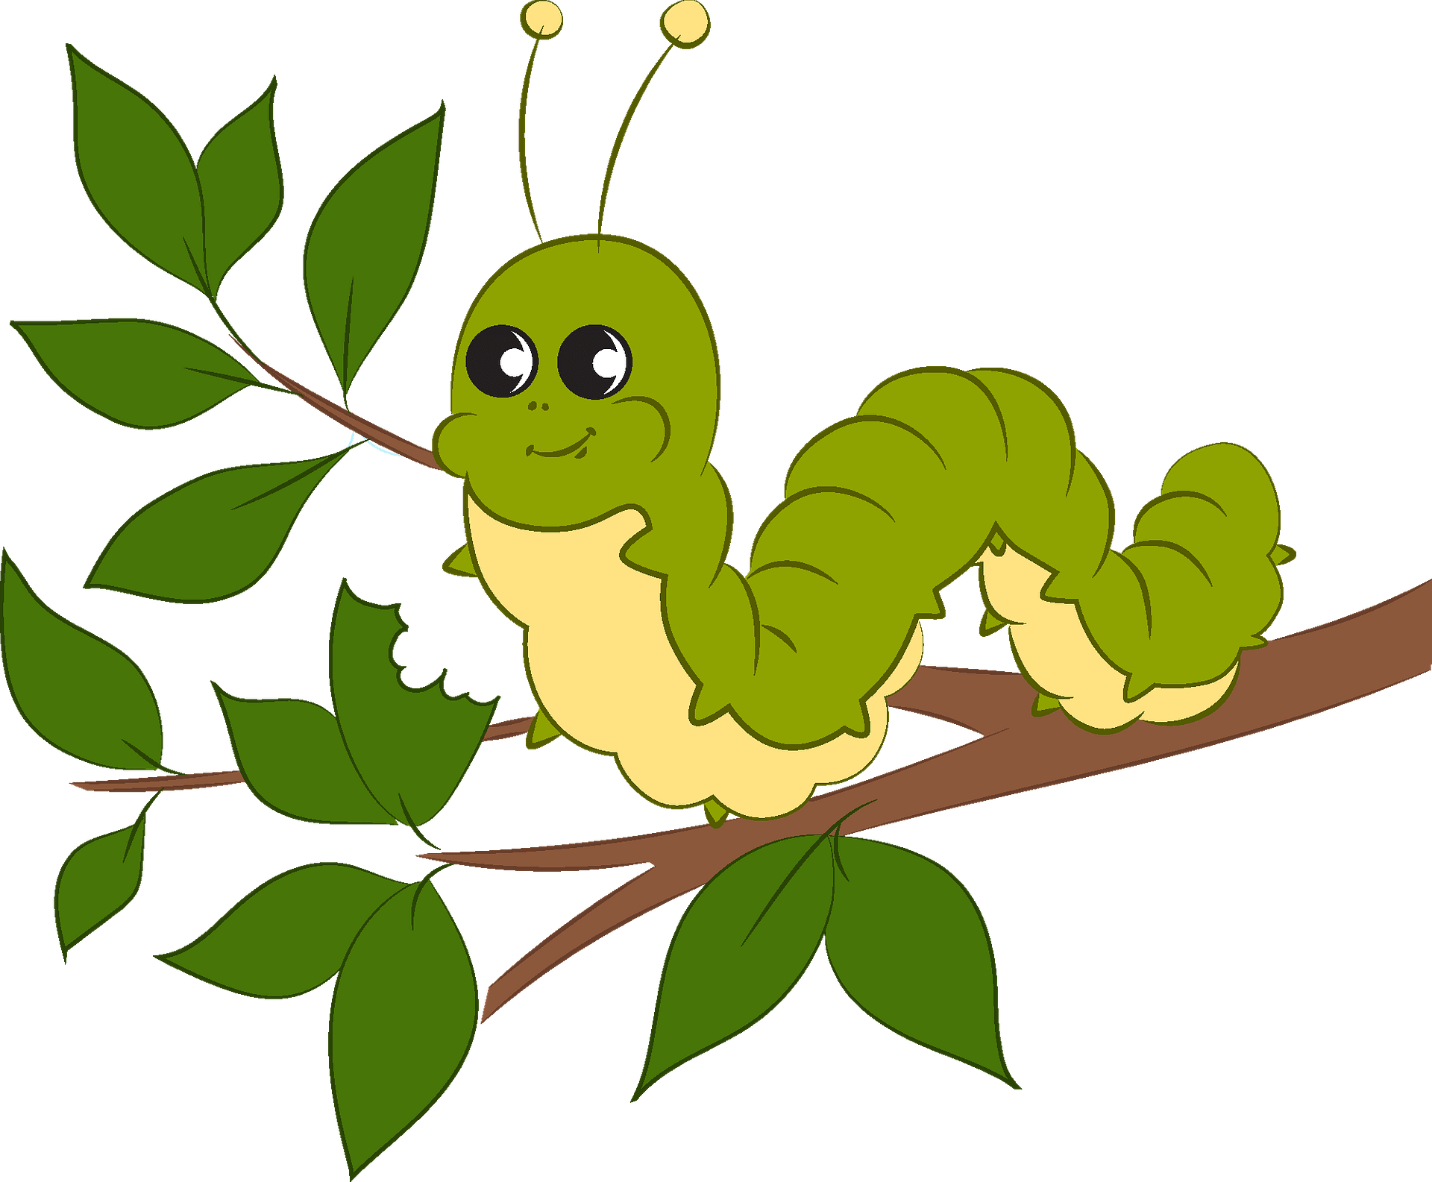
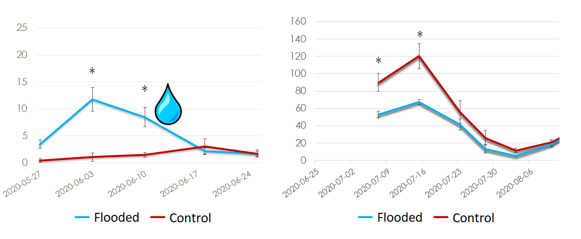
Alternatives: Physical control (Spring flooding)
(Horth et al., 2021)

Slide 20
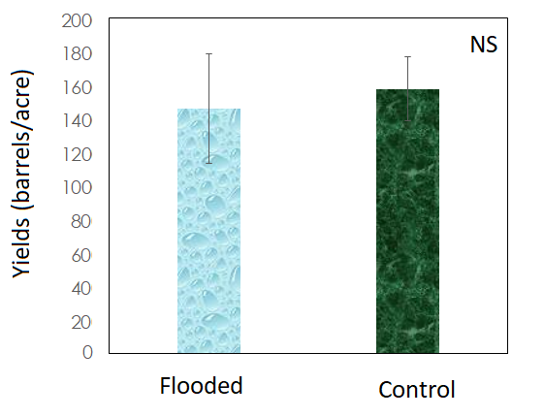
Alternatives: Physical control (Spring flooding)
(Horth et al., 2021)

Slide 21
Alternatives: Physical control (Spring flooding)
(Drolet and Firlej, 2016)

Slide 22
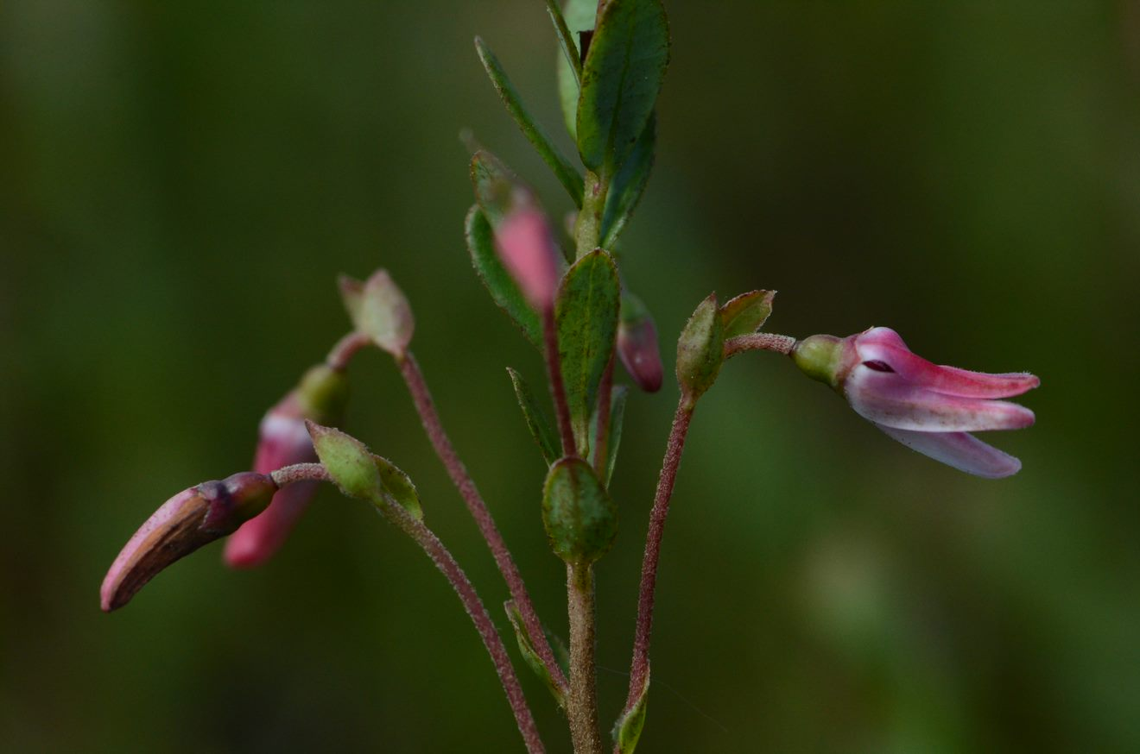

Alternatives: Physical control (Spring flooding)

Slide 23

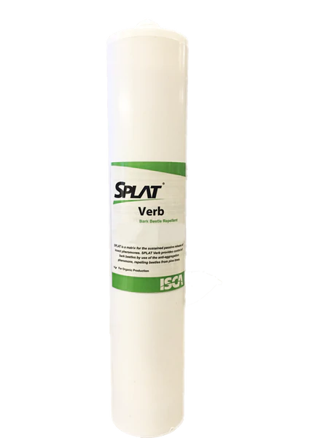
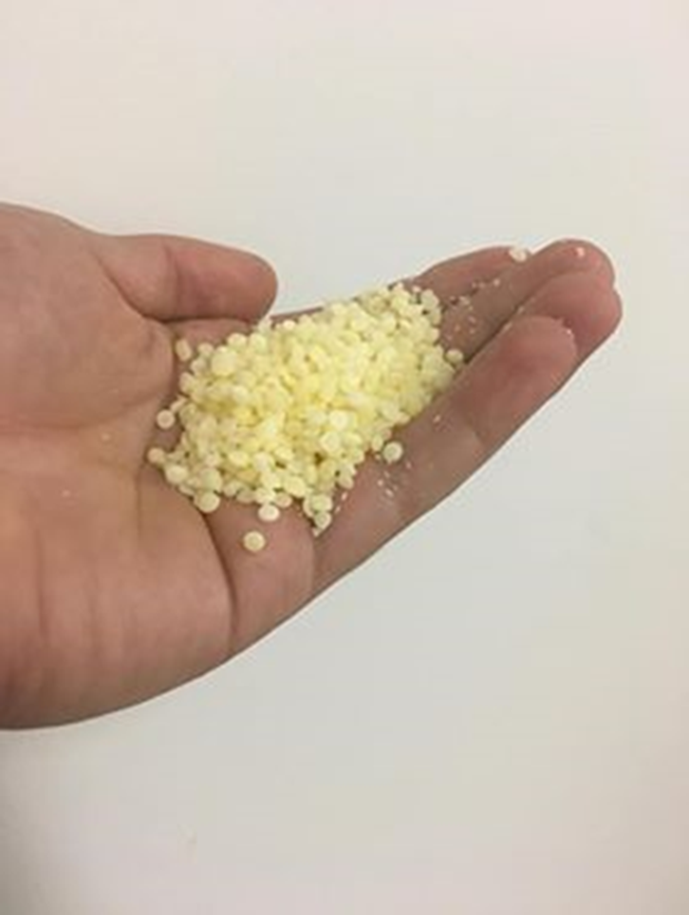
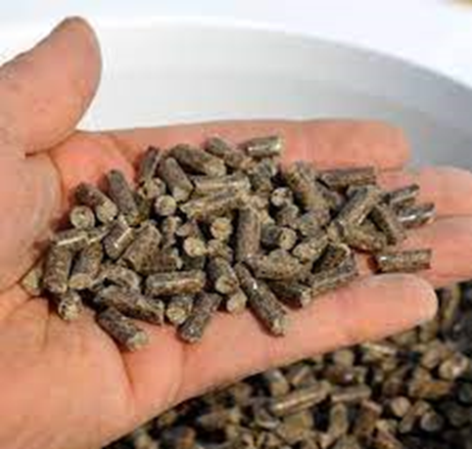

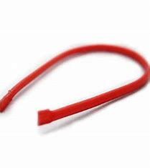
Alternatives: Behavioral method (mating Disruption)
We Know it works!
Pursuit for the right dispenser
(Fitzpatrick et al., 1995, 2004; Baker et al., 1997; Fadamiro et al., 1998; Steffan et al., 2017 …)

Slide 24
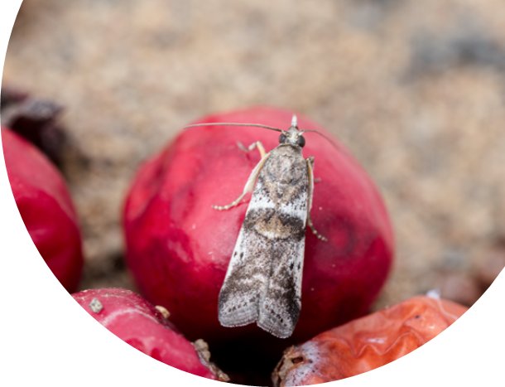

Alternatives: Behavioral method (mating Disruption)
(Labarre et al., 2018)

Slide 25
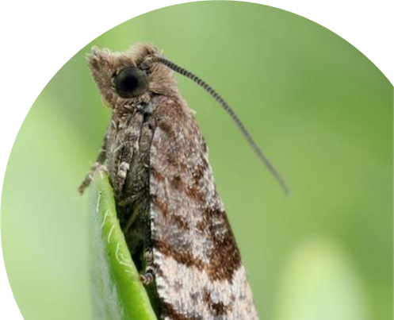
Alternatives: Behavioral method (mating Disruption)
(Labarre et al., 2018)

Slide 26
Alternatives: Behavioral method (mating Disruption)
(Pouët et al., 2021)

Slide 27

Alternatives: Behavioral method (mating Disruption)
(Pouët et al., 2021)

Slide 28




Acknowledgements
These projects were carried out under subsection 3.1 of the 2018-2023 and subsection 4 of the 2013-2018 Prime-vert program, PADAAR program, subsection1 of the Innov’action (through the federal-provincial-territorial initiative growing forward 2) and received funding support from the Ministère de l'Agriculture, des Pêcheries et de l'Alimentation (MAPAQ) and Agriculture and Agri-Food Canada. Authors would like to thank technical support staff from the Association des producteurs de canneberges du Québec and the Club environnemental et technique Atocas Québec as well as partner growers.

