Slide 1
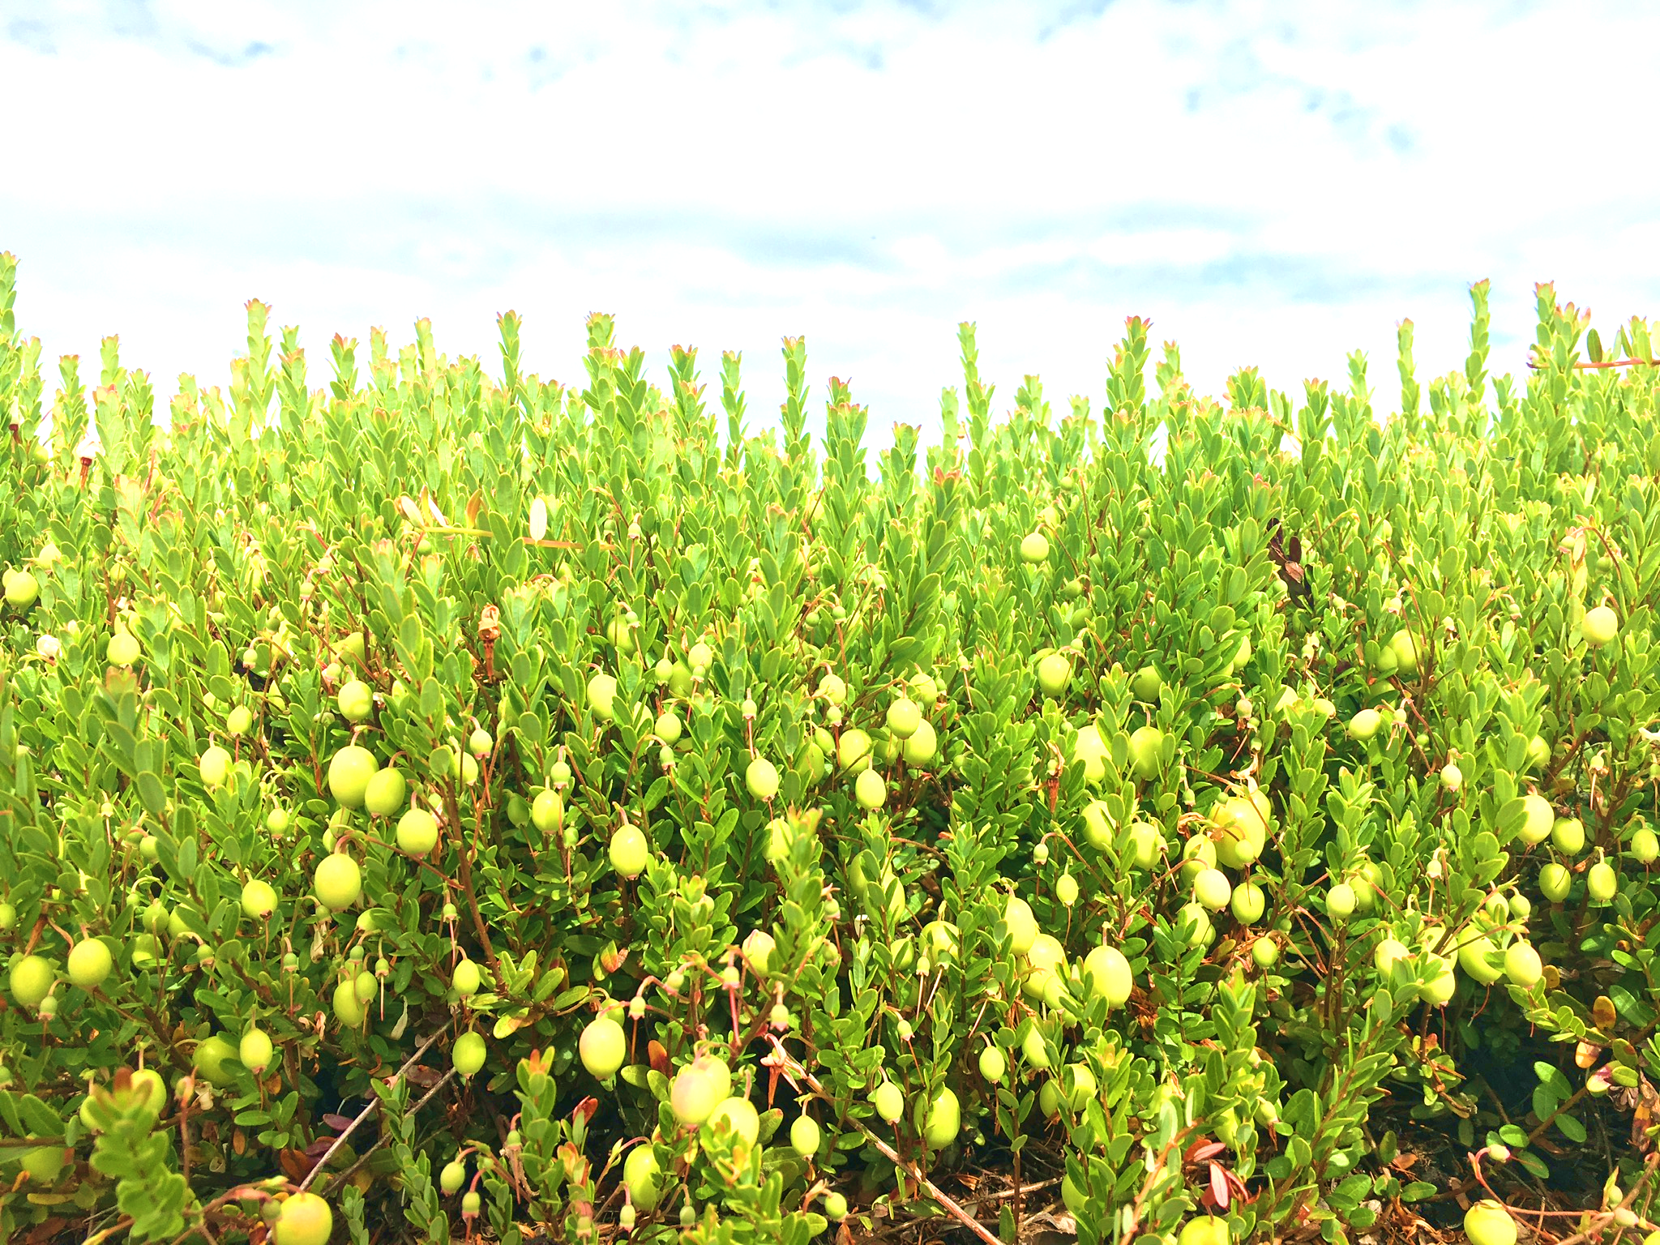
Miranda Elsby, Senior Agricultural Scientist
Ocean Spray Cranberries, BC
Pacific Northwest Cranberry Congress 2022
BC Research and Product Update

Slide 2
Overview
Registration Updates
Herbicide Work
Tipworm Screening
Canopy Project BCCRF
DigiEye Colour Tracking

Slide 3
Registration
Updates
Indar (fenbuconazole) – Group 3
Chemigation allowed, check pricing
Harvanta (cyclaniliprole) – Group 28
On CI Chart, no pests labelled, likely no 2022 use
Lontrel (clopyralid) – Group 4
URMULE pending
Authority (sulfentrazone) – Group 14
No later than end of March, wash-in required
Bravo/Echo (chlorothalonil) – Group M5
Special review proposing removal all food uses

Slide 4
Herbicide Work
2020-2021 Project
Looked at 10 herbicides
Pipeline and novel products
Thank you to the Cranberry Institute (CI) for funding

Slide 5
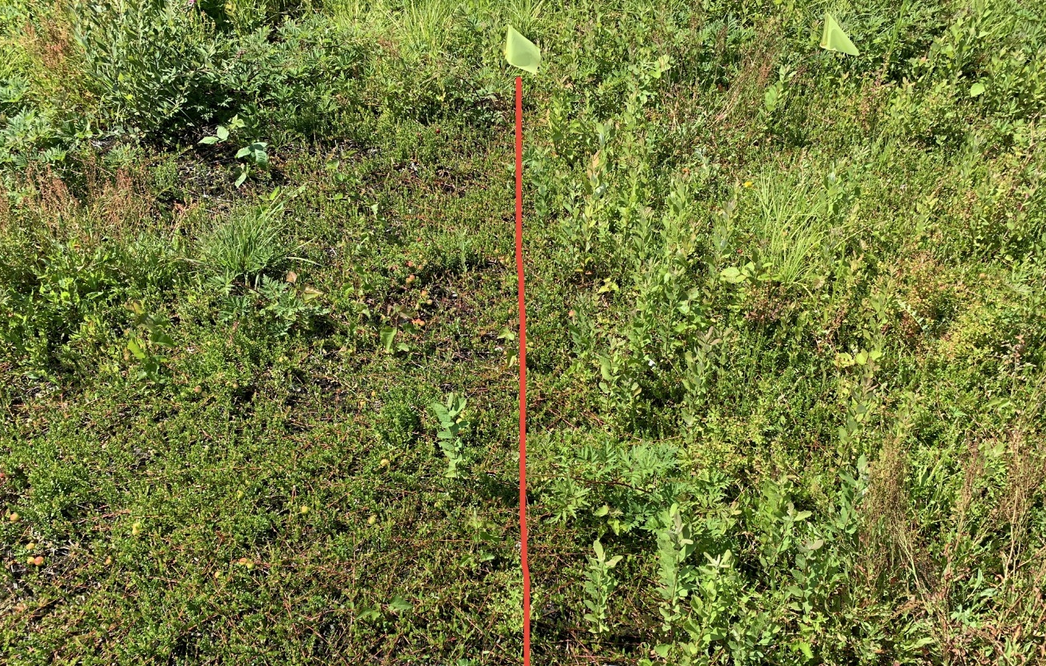
Authority Treatment (mid-March)
Untreated

Slide 6
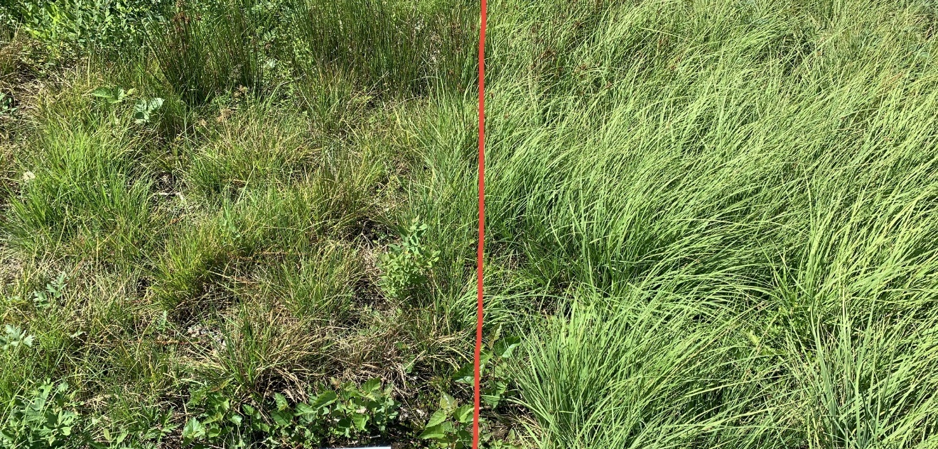
Treated
Untreated

Slide 7
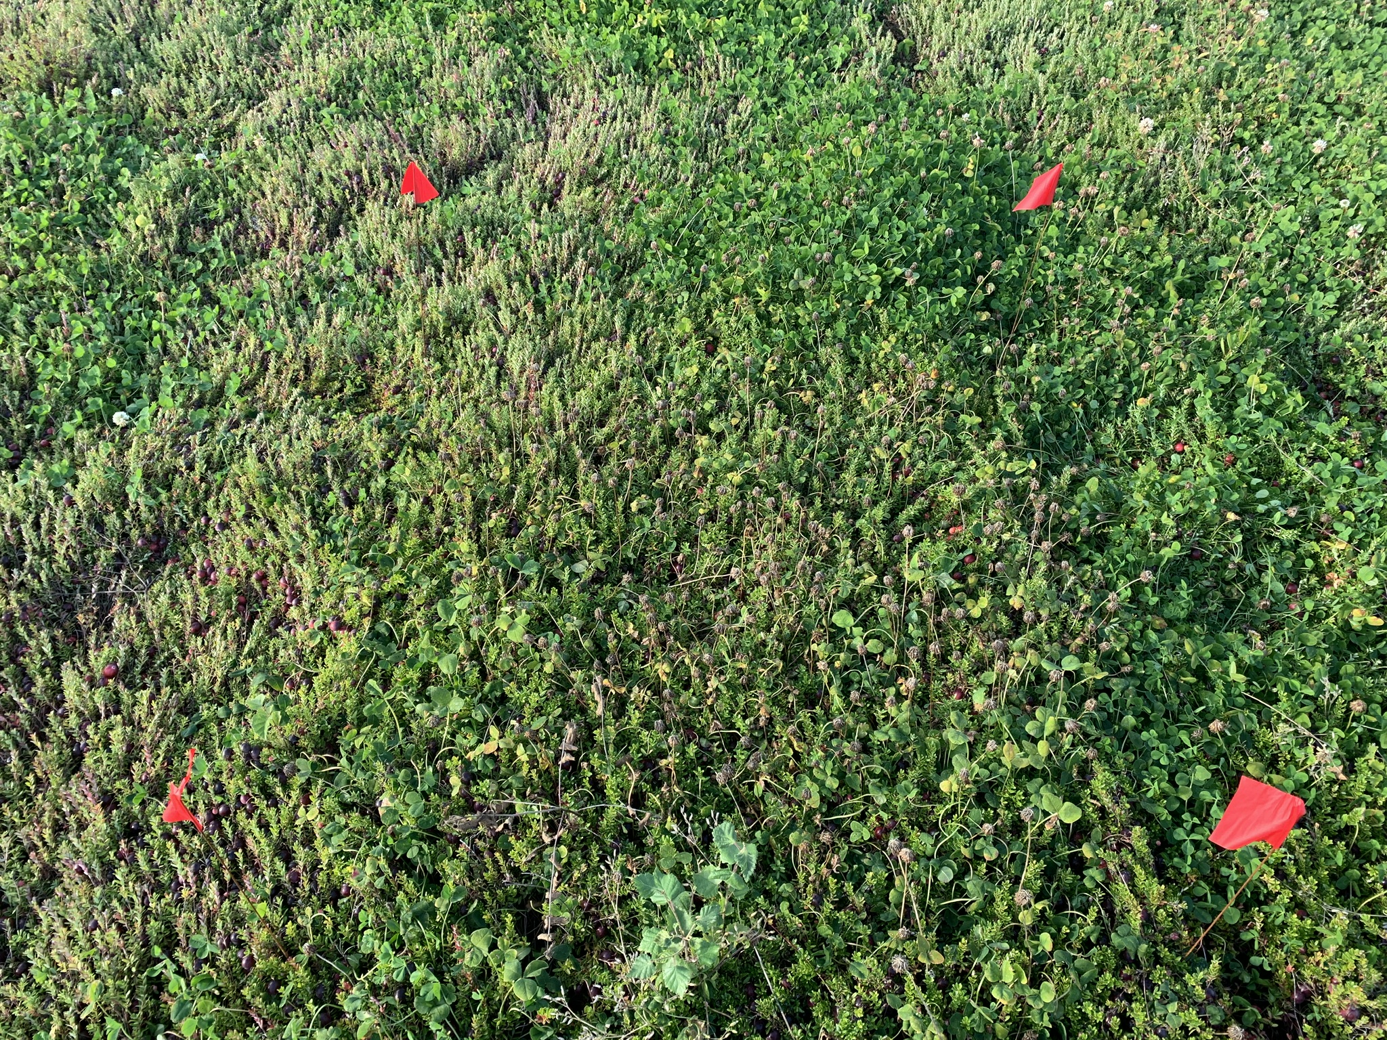
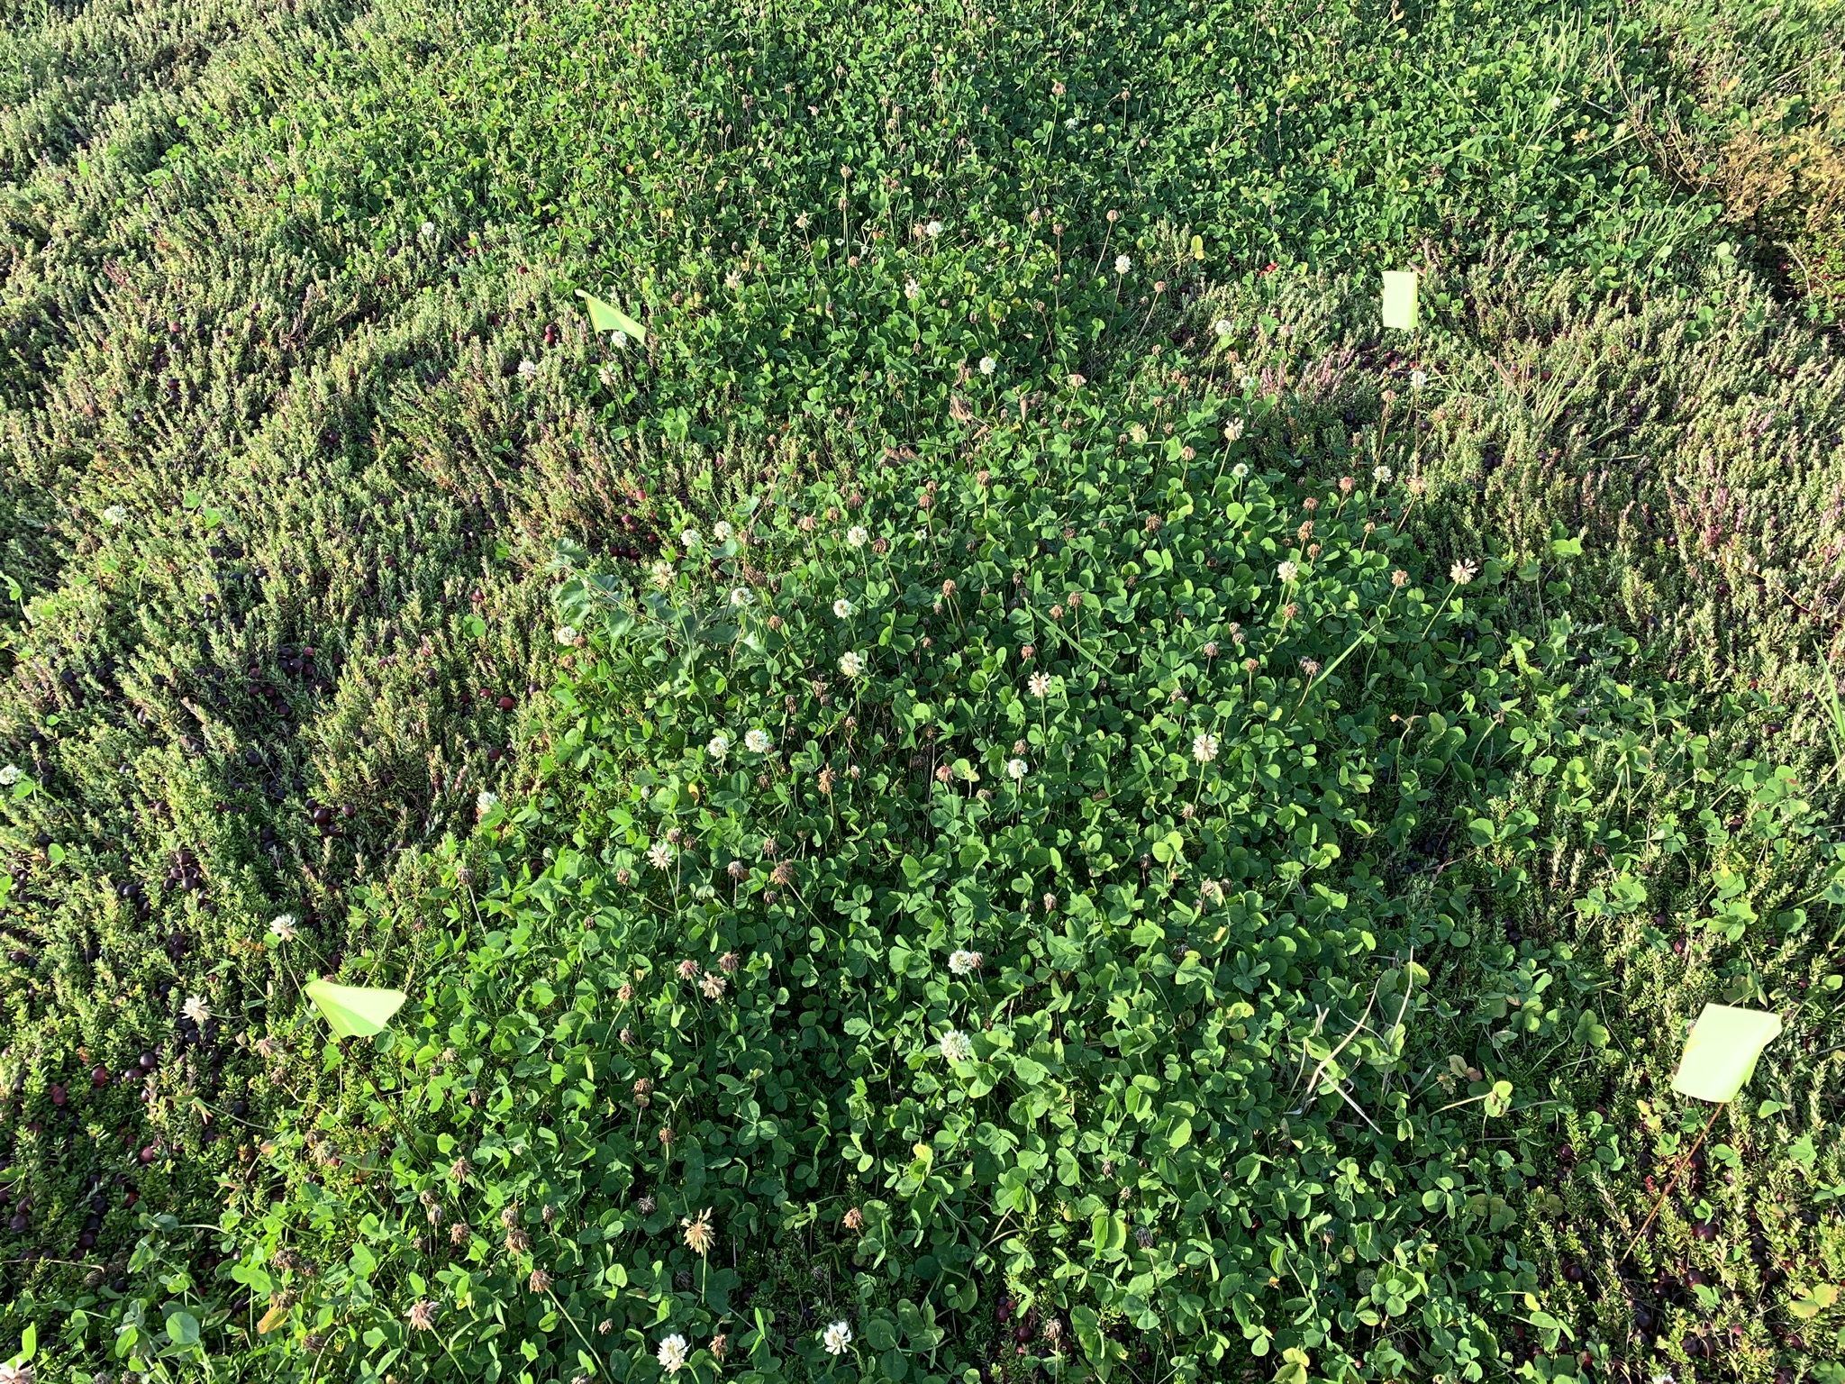
Treated
Untreated

Slide 8
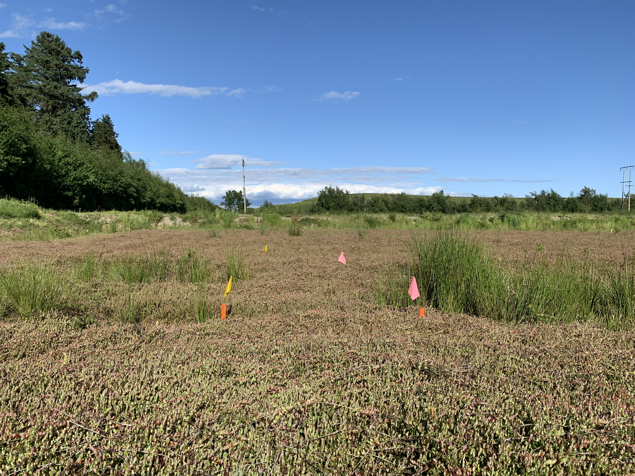
Treated
Untreated

Slide 9
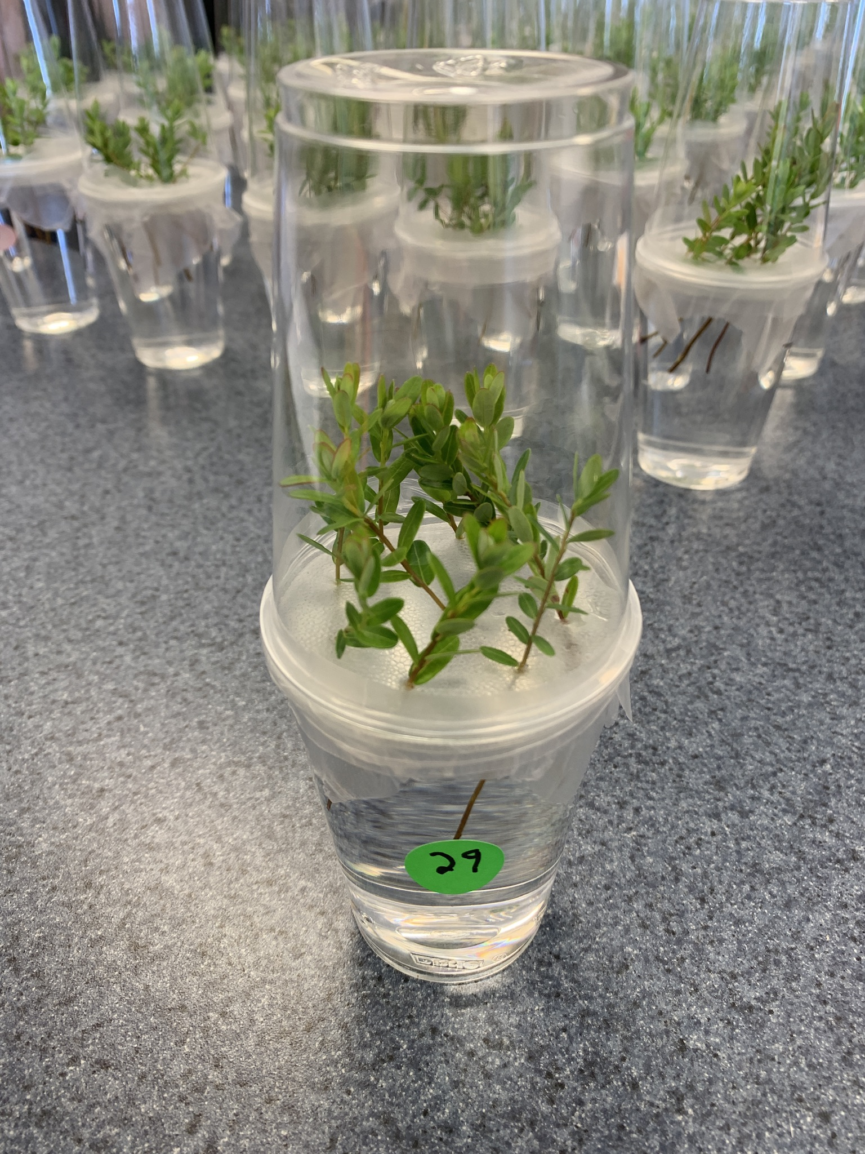
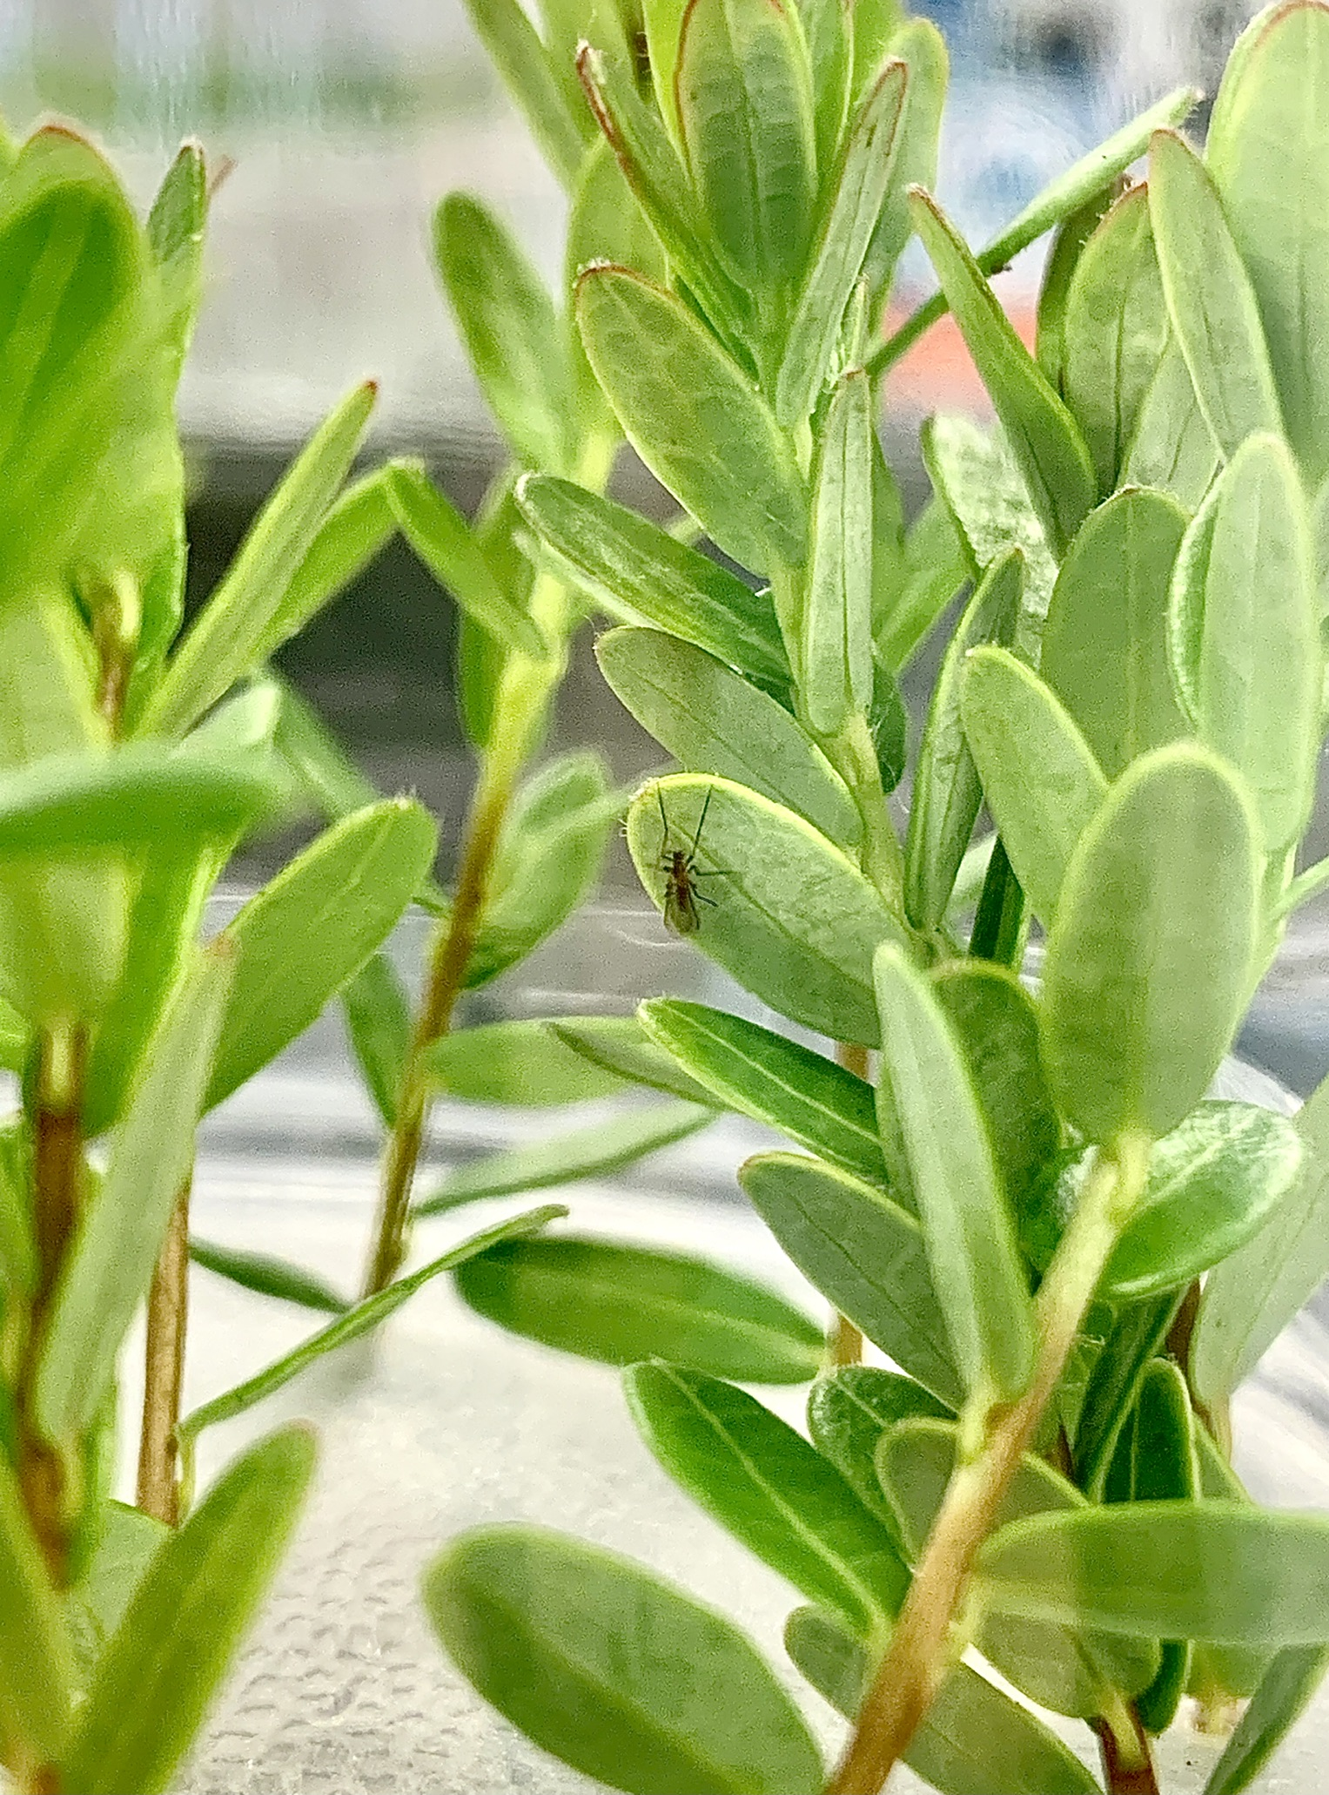

Slide 11
Mowing and Sanding Trial
BCCRF Field 1
10 varieties
Combination of low mow, high mow, and sand treatments
3 years of data collected so far
(2019 – onwards)
Interesting trends in yields rebounding and vine response (go have a look!)

Slide 12
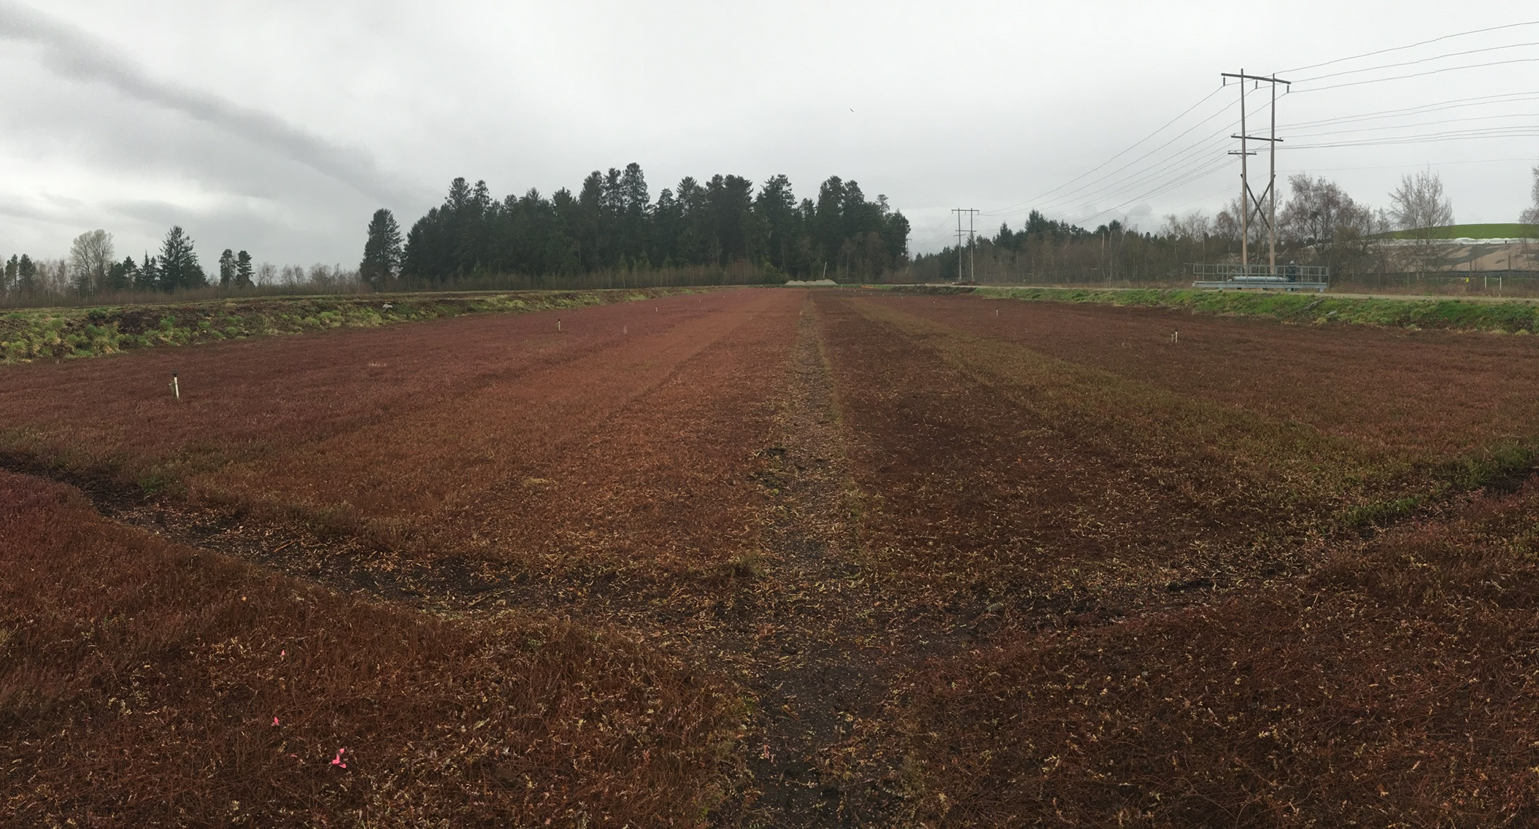

Slide 13
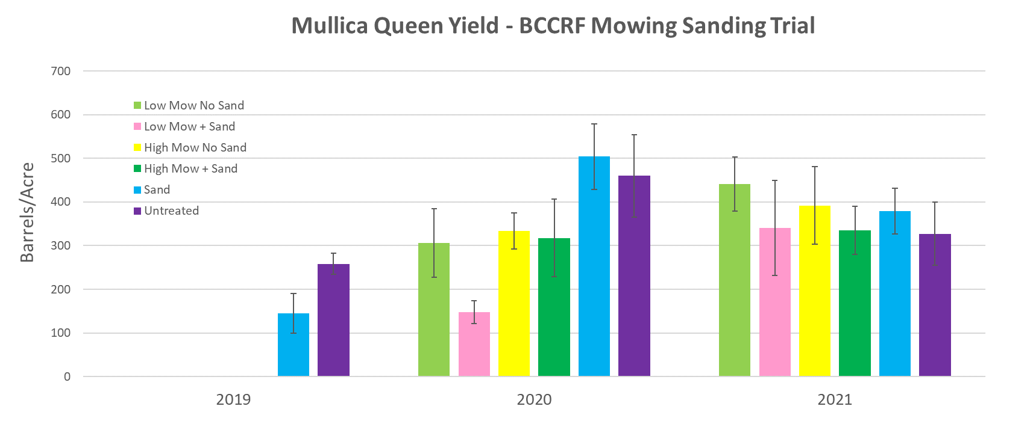
Also measuring upright density, runners, canopy depth (green:brown)

Slide 14
Colour Progression Tracking
BCCRF Field 1
2020 – 6 varieties
2021 – scaled up to 8 varieties
Weekly sampling leading up to harvest
Colour analysis completed at Ocean Spray with DigiEye optical assessment technology (pixel sorting)

Slide 15
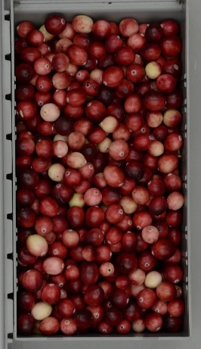
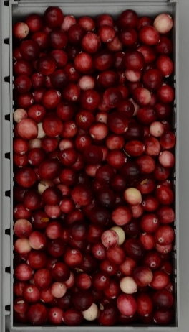
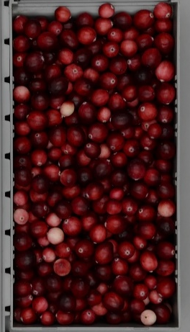
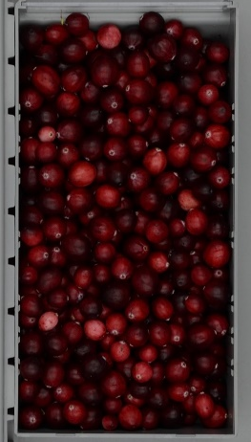
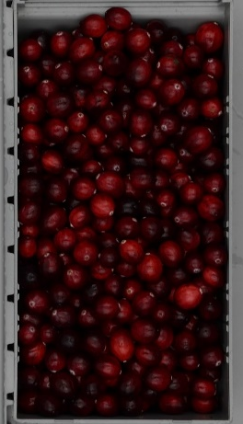
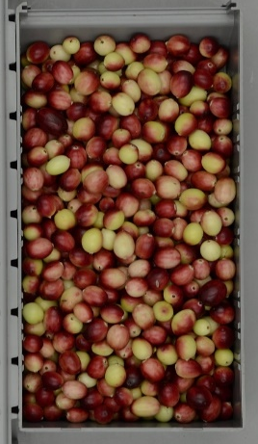
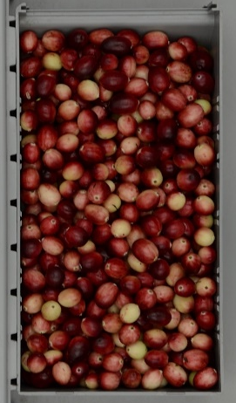
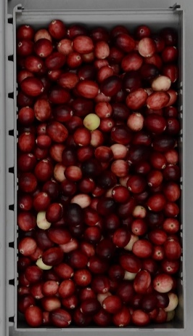
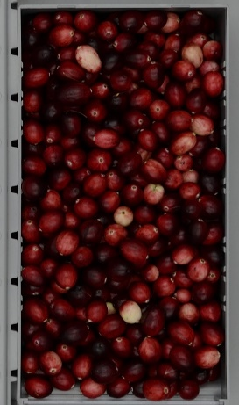
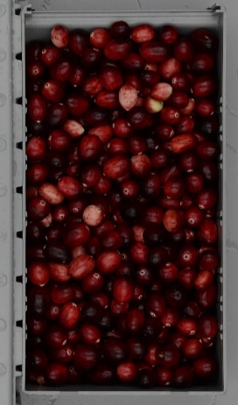
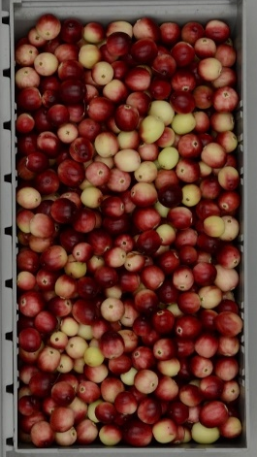
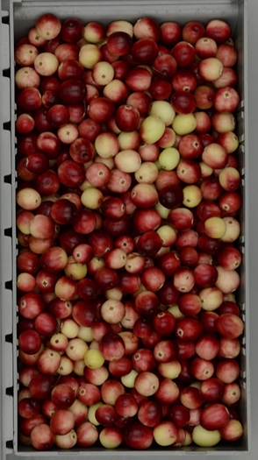
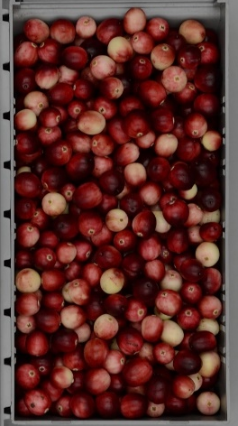
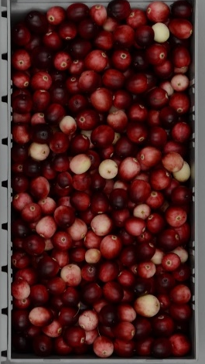
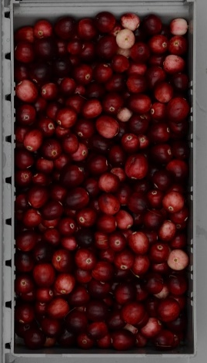
Sept 9th
Sept 16th
Sept 23rd
Sept 30th
Oct 7th
Crimson Queen
Vasanna
Mullica Queen

Slide 16
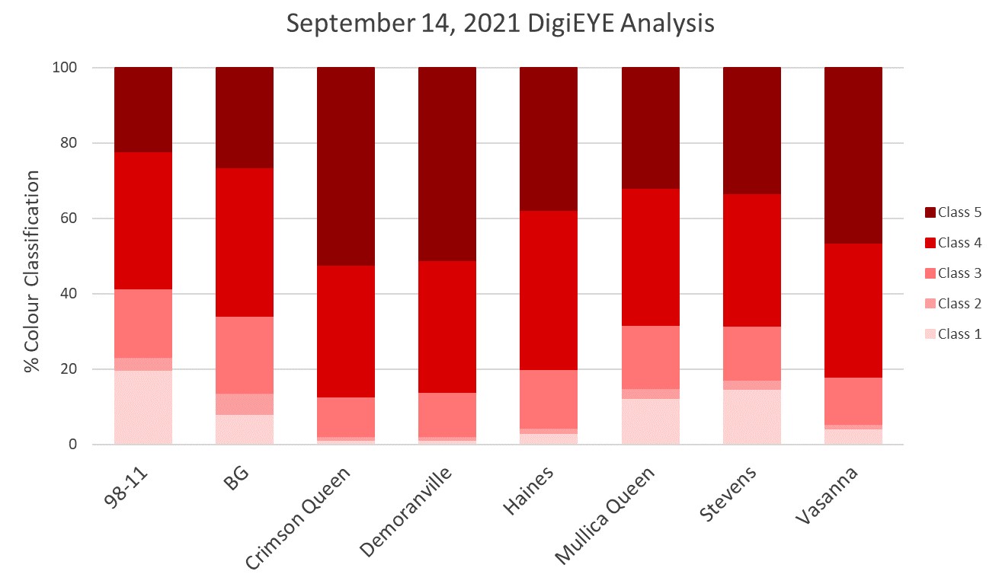

Slide 17
Thank you!
Questions?
Thank you to BC cranberry growers, the BC Cranberry Research Farm (BCCRF), Ocean Spray Cranberries, and the Cranberry Institute for project support. Special thanks to Bailey Sutherland for her hard work last year on these projects!

