Slide 1
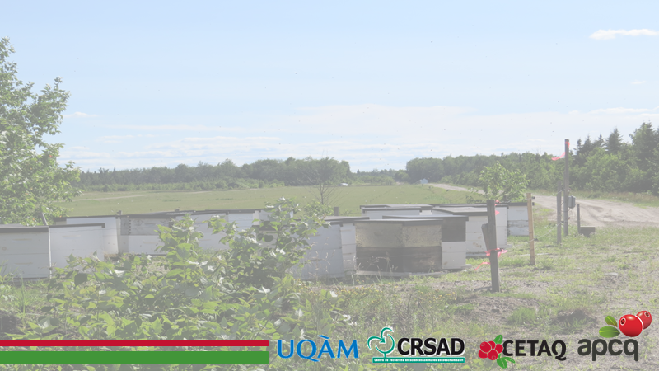
Confinement of honeybees as a protective measure against exposure to pesticides following pesticide treatments
Madeleine Chagnon, François Gervais, Georges Martin, Didier Labarre

Slide 2
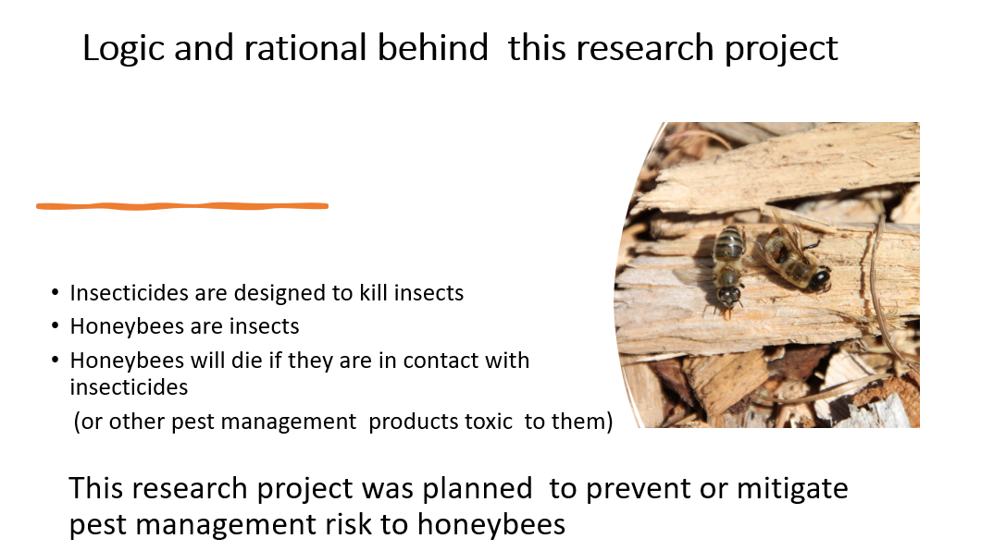

Slide 3
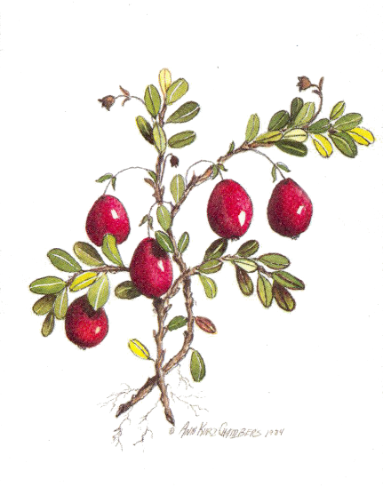
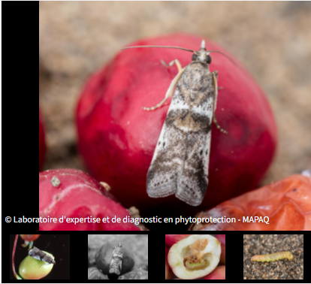
Cranberry fruitworm
(Acrobasis vaccini)

Slide 4
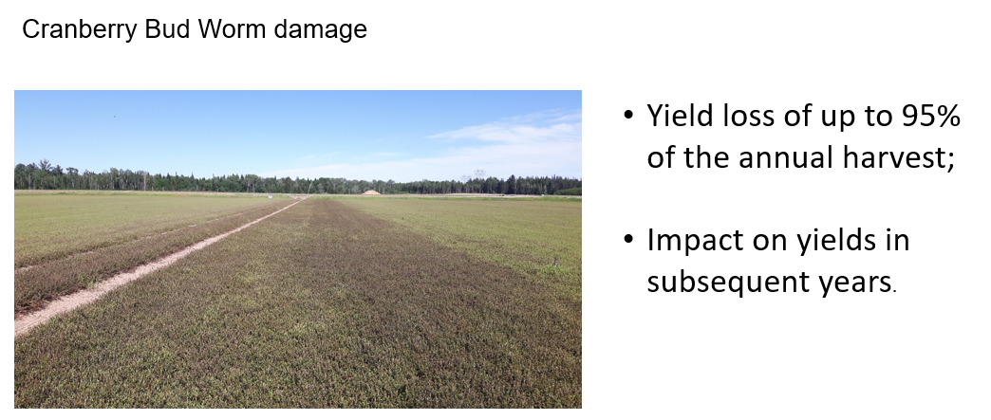
Fruitworm damage

Slide 5
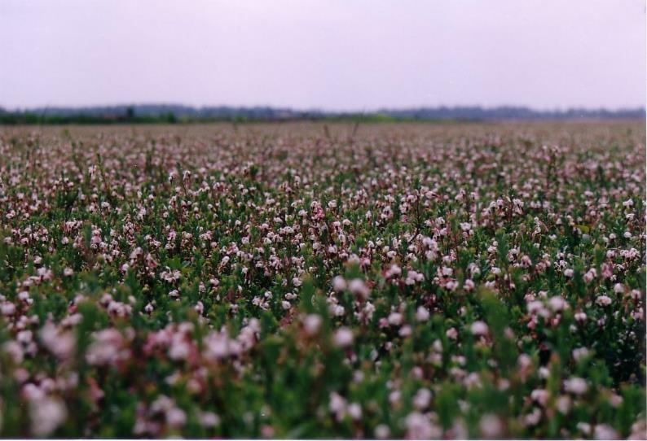
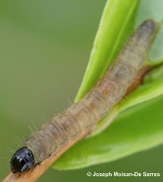
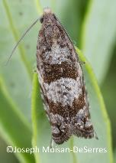
Blackheaded fireworm Larva
Rhopobota naevana (Hübner)

Slide 6
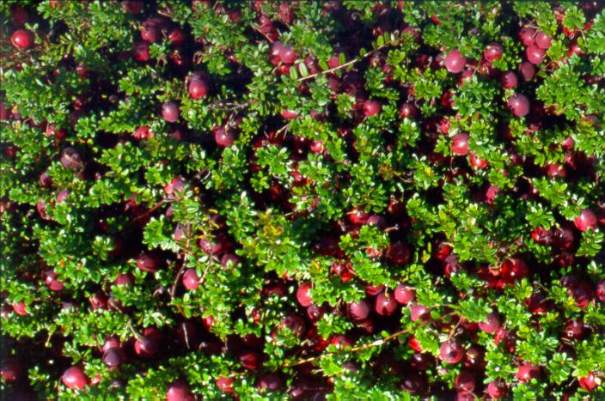
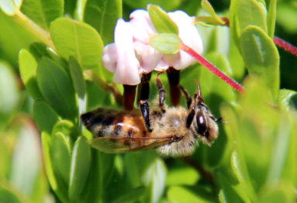

Importance of the role of honeybees in the pollination of cranberry crops
Depends on Honeybee hive rentals
…. and
Depends of the abondance of wild bees;

Slide 7
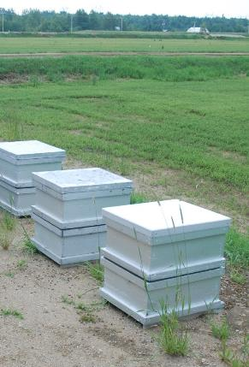
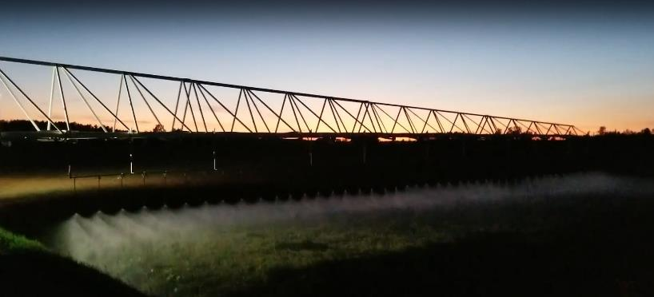
We must protect the crop against pests …
… without harming honeybees

Slide 8
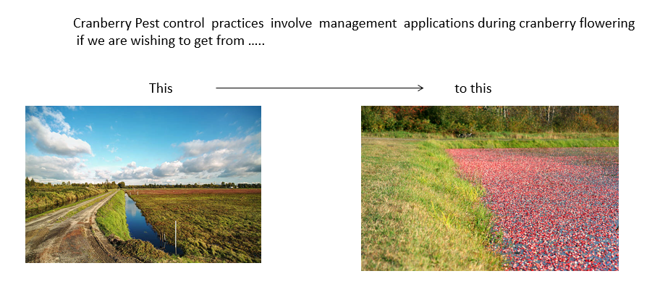
However …

Slide 9
We tried
Sound management of Bee colonies
in Cranberry Fields

Slide 10
Sound management of bee colonies in cranberry fields
We considered …
Using the appropriate equipment (spray boom, anti-drift nozzles, etc.); to avoid drift dammage
Period of treatments against pest ;
Environmental factors ;
Cleaning of equipment (contamination of water puddles );
Better positioning of beehives on the farm;
Etc.

Slide 11
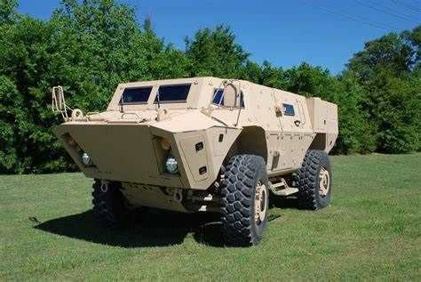

But nothing worked

Slide 12


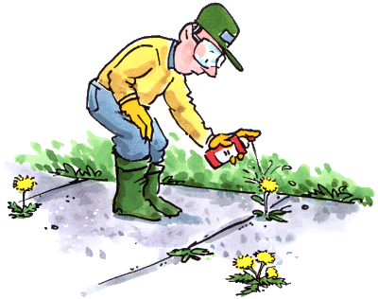


Our past studies revealed that honeybees were mostly getting poisoned
while foraging cranberry flowers after pesticide treatments … in the morning
ZZzzZZz

Slide 13
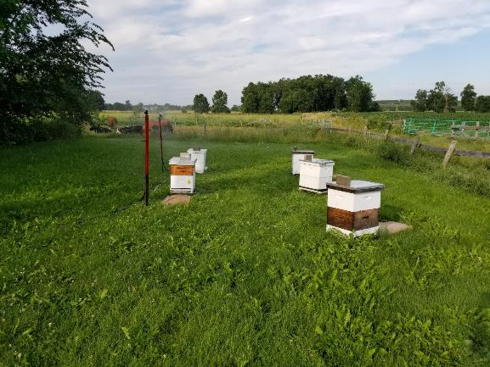
Containment (confinement) of honeybees
Main goal
Temporarily confine bees safely inside the hive until the foliage is dry.
.

Slide 14
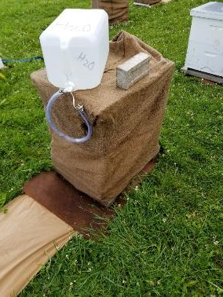
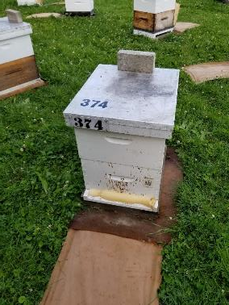
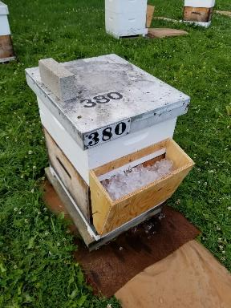
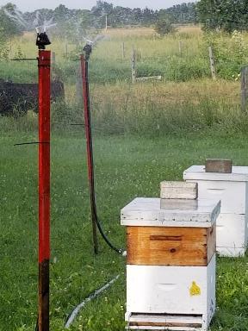
Containment methods studied
Xcel-Wobbler at median angle
(between 6000 and 10 000L)
Burlap with high humidity Blocking entrance and Under hive screening ice at the entrance sprinklers
Burlap with high humidity Blocking entrence and Uder hive sceening ice at the entrance sprinklers

Slide 15

Expérimental conditions
6 hours of confinement ;
Starting at sunrise ;
Repeated 3 times during summer;
5 hives were used per confinement method 4(methods) and 5 hives for the control for a total of 25 hives (2019) ;
Then the two best methods (according to safety criteria) were chosen to carry on the next year;
8 hives per confinement methods (the 2 winners ) et 8 control hives (2020). Total of 24 hives.

Slide 16

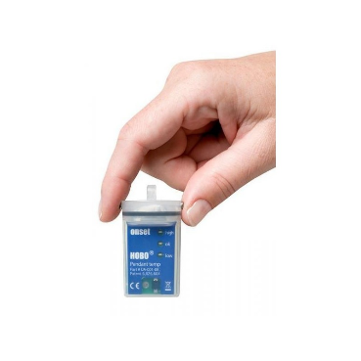

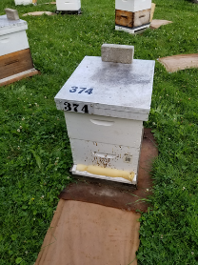
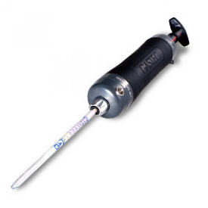
Variables observed
Number of bees leaving the hive (middle and end of confinement);
Mortality 2 hours after treatment and AM the day after confinement;
Maximum temperature reached in the hives during containment;
Variation in the rate of carbon dioxide (CO2) emitted in the hive.
Internal hive temerture
monitoring device

Slide 17




Selection criteria
1. Efficacious containment of bees within hive;
2. Survival of bees;
3. Ease of application ;
4. Costs.

Slide 18
First year goal :
Selecting the best confinement the methods for further studies
2019

Slide 19
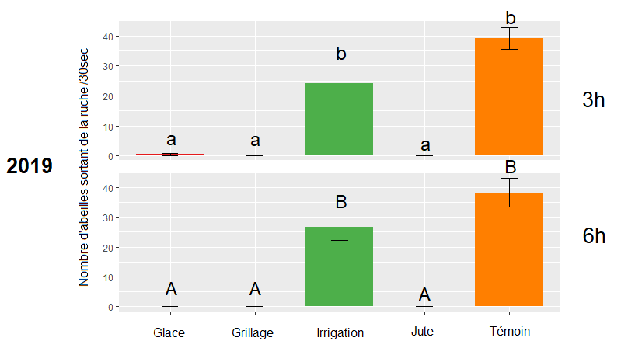
Results: escaping honeybees
Ice Under hive screening Sprinklers Burlap Control

Slide 20
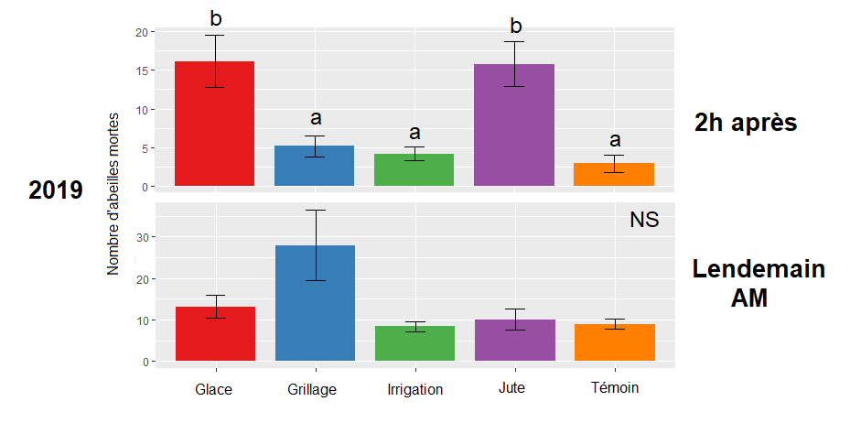
Results: honeybee mortality
2 hours later
Number of dead honeybees
Next day
(AM)
Ice Under hive screening Sprinklers Burlap Control

Slide 21
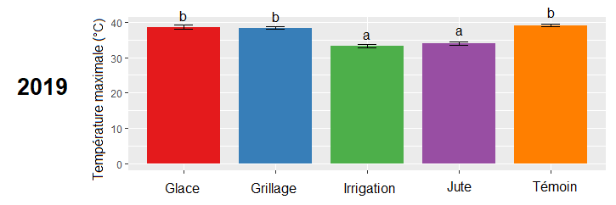
Results: Maxim temperature within hive
Ice Under hive screening Sprinklers Burlap Control

Slide 22
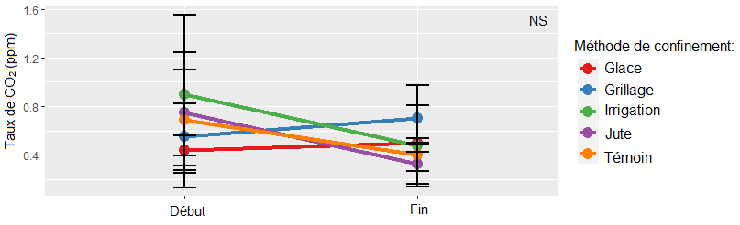
Résults: CO2 levels reached within hives
Ice
Under hive sceening
Sprinklers
Burlap
Control
Beginning end

Slide 23
Results
 | Performance | Security | Feasibility | Costs
Ice | +++ | +/- | ++ | +++
Screen | +++ | ++ | +++ | ++
Irrigation | - | +++ | ++ | -
Burlap | +++ | +/- | - | +++

Slide 24



The
Under hive screening
and the
Ice at the entrance
made the first eliminations
Under hive
Screening Ice

Slide 25
2020

Slide 26
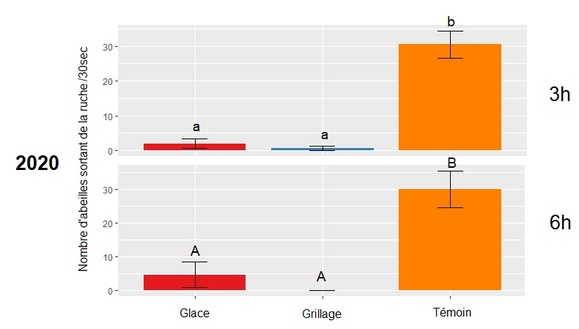
Number of bees leaving hive/30 sec.
Results: Number of bees leaving hive
After 3 hrs
IDEM 2019
After 6hrs
Ice Screen Control

Slide 27
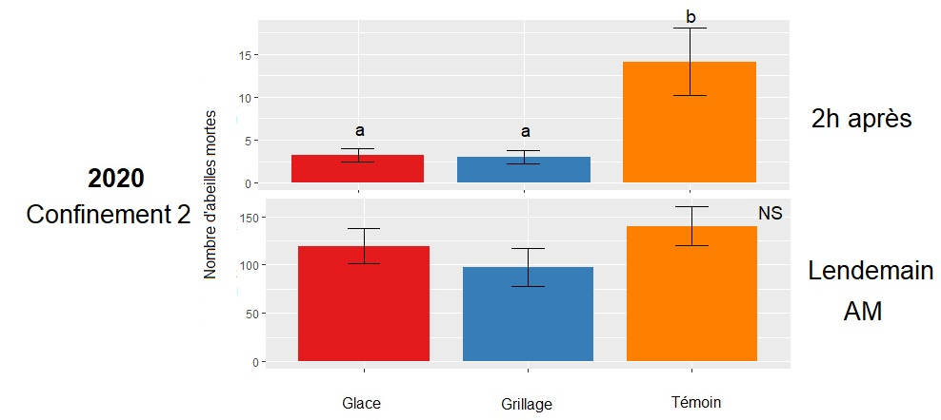
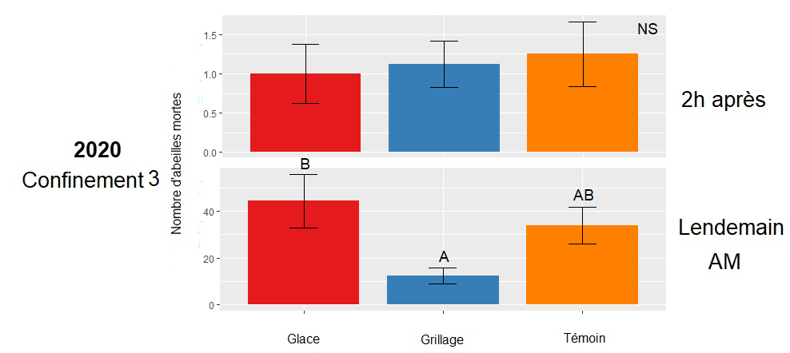
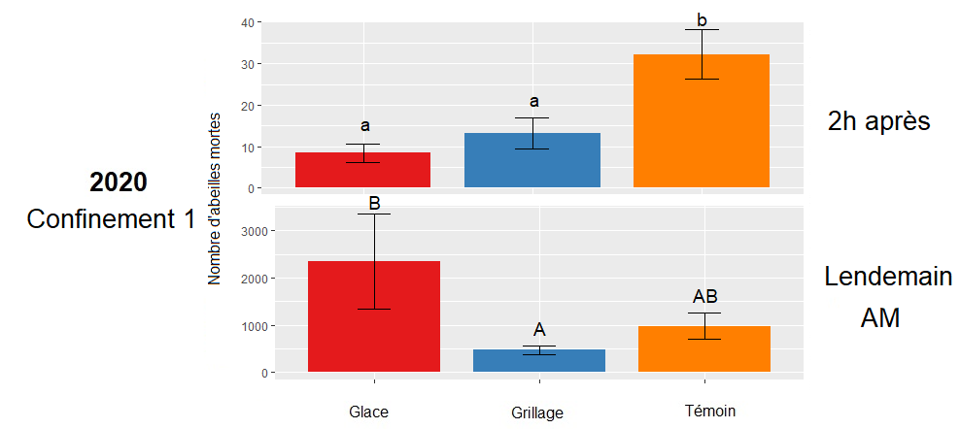
Results: mortality
2hrs later
Number of dead honeybees
Next day
Ice Screen Control

Slide 28
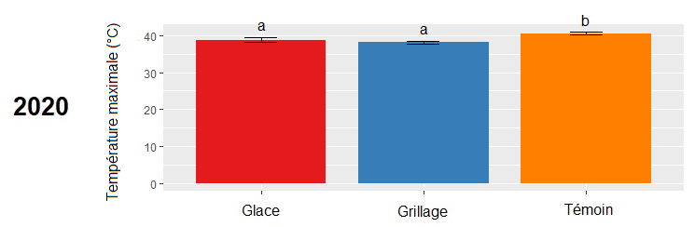
Results: maximum temperature reached
IDEM 2019
Ice Screen Control

Slide 29
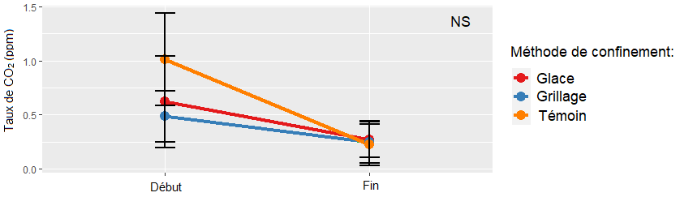
Results: CO₂ levels in hives
CO₂ level (ppm)
Confinement methods
IDEM 2019
Ice
Screen
Control
Beginning end

Slide 30
Results
 | Performance | Security | Faisability | Costs
Ice | +++ | +/- | ++ | +++
Screen | +++ | ++ | +++ | ++

Slide 31


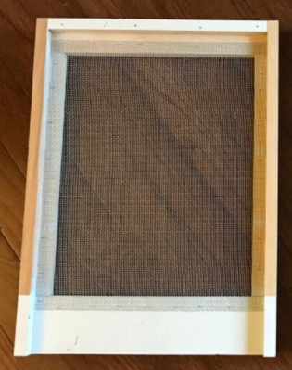
A varroa mite screen
bord can be used
AND THE WINNER is ….
Under hive screen

Slide 32

Remerciements
Acknowledgements
The CRSAD apiculture team;
The CETAQ and APCQ team;
Marie- Josée Duval and Hélène Cajolet-Boisclair ;
The biological control laboratory.

Slide 33


Acknowledgements
This research project was made possible thanks to the financial assistance of the Quebec Provincial Innov'Action Program, a program resulting from the agreement of the framework Growing Forward 2 concluded between the Ministry of Agriculture, Fisheries and Food and Agriculture and Agri-Food Canada.

