Slide 1

Assessing an herbicide layering strategy in newly renovated and established cranberry fields
Jichul Bae^{1*}, Nathan Young², Miranda Elsby³ and Ryan Critchley¹
¹ Agriculture and Agri-Food Canada, Agassiz, BC, Canada
² Department of Biological Sciences, Simon Fraser University, Burnaby, BC, Canada
³ Ocean Spray of Canada Ltd., Richmond, BC, Canada
* Principal Investigator: jichul.bae@agr.gc.ca | +1 (604) 796-6136
Pacific Northwest Cranberry Congress 2022
February 16-17, 2022

Slide 2
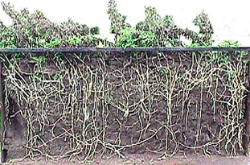
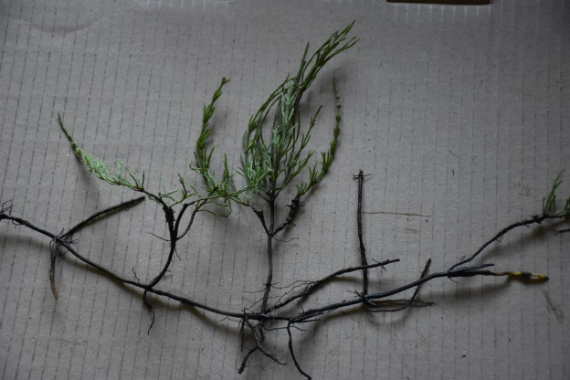
Challenge: Perennial Weed Management
The majority of conventional herbicides registered for use are primarily useful for annual weed management.
Seldom controlled by a single herbicide application due to deep and extensive root and shoot systems

Slide 3
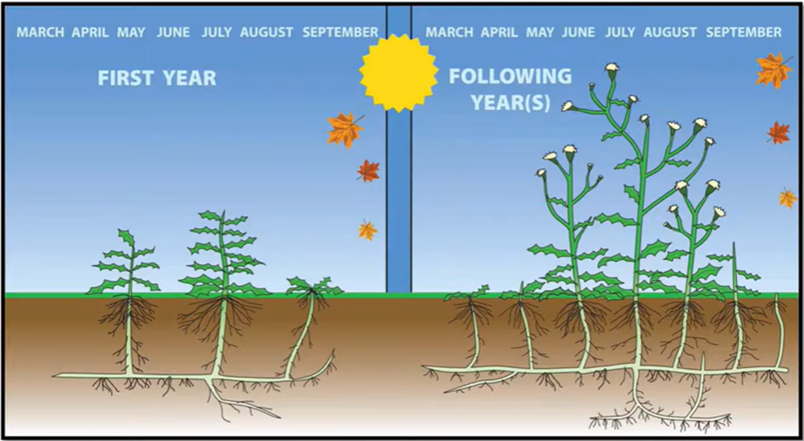
Challenge: Perennial Weed Management
Larger starting capital and longer growth period
Nutrient reserves in storage organs
Rhizomes, stolons, tubers, horizontal roots
Ability to regrow a new set of leaves and stems until the nutrient reserves run out

Slide 4
Perennial Weed Management
Forcing weeds to deplete their nutrient reserves
Killing storage organs
Forcing growth of leaves/stems without opportunity to photosynthesize and replenish nutrient reserves
(Chicouene 2007; Melander et al. 2012)
Herbicide layering strategy composed of both single and multiple applications of pre-emergence (PRE), post-emergence (POST) and/or post-harvest (POST-H)

Slide 5
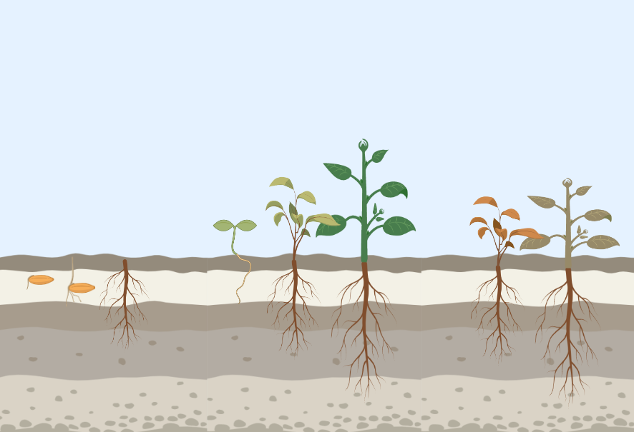

Herbicide Layering Strategy
Pre-emergence herbicide at lower label rate
Spring (pre-bud break)
Suppress any new growth from seedbank and delay/suppress the growth of established weeds
PRE

Slide 6
Herbicide Layering Strategy
Post-emergence herbicides
Spring and Summer (Bud break and Hook)
Damage/kill perennial weed plants
Prevent photosynthesizing and replenishing nutrient reserves
PRE
POST

Slide 7
Herbicide Layering Strategy
Post-harvest herbicide (winter)
Region with relatively mild winters (e.g., southern coast BC)
Translocate carbohydrate reserves from the leaves/stems to the overwintering organs
Post-harvest herbicides are absorbed into the plants and translocate with the carbohydrates to the storage organs

Slide 8
Herbicide Layering Strategy
Post-harvest herbicide (winter)
Damaging/killing overwintering storage organs
Prevent new spring growth
Residual effects that carry into spring
PRE
POST
POST-H

Slide 9

BCCMC Research (2021- Present)
Research Objectives
To identify and evaluate an effective and safe herbicide layering strategy to manage persistent perennial weeds in both establishing and established cranberry beds.
To establish the safety of the herbicide layering strategy for use in cranberry production in both crop tolerance and subsequent fruit residues.

Slide 10
Study Sites
Prepared and set up in March 2021
Establishing cranberry beds
BC Cranberry Research Farm (BCCRF) in Delta, BC
Planted in Spring 2020 with plugs of two-year-old plants
Established cranberry beds
Cranberry farm in Pitt Meadows, BC
Well established – at least 6 years old
Rutgers varieties (New Brunswick, New Jersey)
BCCRF – “98-11”
Pitt Meadows – Mullica Queen®

Slide 11
Herbicide types and application rates
Trade Name | Active Ingredient | Application rate | Surfactant (if needed)
Devrinol 2XT | Napropamide | 4500 g ai ha⁻¹
Authority 480 | Sulfentrazone | 140.16 g ai ha⁻¹
Lontrel XC | Clopyralid | 102 g ai ha⁻¹
Callisto 480SC | Mesotrione | 100.8 g ai ha⁻¹ | Agral 90 (0.2% v/v.)
Poast Ultra | Sethoxydim | 495 g ai ha⁻¹ | Merge (1L ha⁻¹)
Casoron G-4 | Dichlobenil | 4400 g ai ha⁻¹

Slide 12
Timing of treatment applications
Treatment | Application time (cranberry phenology)
 | Pre-bud break | Bud break | Hook | Post-harvest
PRE1+POST1 | Napropamide | Clopyralid | Mesotrione + Sethoxydim | -
PRE1+POST2 | Napropamide | Mesotrione | Mesotrione + Sethoxydim | -
PRE2+POST1 | Sulfentrazone | Clopyralid | Mesotrione + Sethoxydim | -
PRE2+POST2 | Sulfentrazone | Mesotrione | Mesotrione + Sethoxydim | -
POST1+POST-H | - | Clopyralid | Mesotrione + Sethoxydim | Dichlobenil
POST2+POST-H | - | Mesotrione | Mesotrione + Sethoxydim | Dichlobenil
PRE1+POST1+POST-H | Napropamide | Clopyralid | Mesotrione + Sethoxydim | Dichlobenil
PRE1+POST2+POST-H | Napropamide | Mesotrione | Mesotrione + Sethoxydim | Dichlobenil
PRE2+POST1+POST-H | Sulfentrazone | Clopyralid | Mesotrione + Sethoxydim | Dichlobenil
PRE2+POST2+POST-H | Sulfentrazone | Mesotrione | Mesotrione + Sethoxydim | Dichlobenil

Slide 13
Experiment Design
Randomized Complete Block Design
10 Treatments | 4 replicates

Slide 14
Experiment Design
Each plot is 4 x 2 m with 2 m untreated buffers on all sides
Buffers used as weedy-check plots (vs. the adjacent treated plots)
2 m
2 m
2 m
T1
T2
4 m
4 m

Slide 15
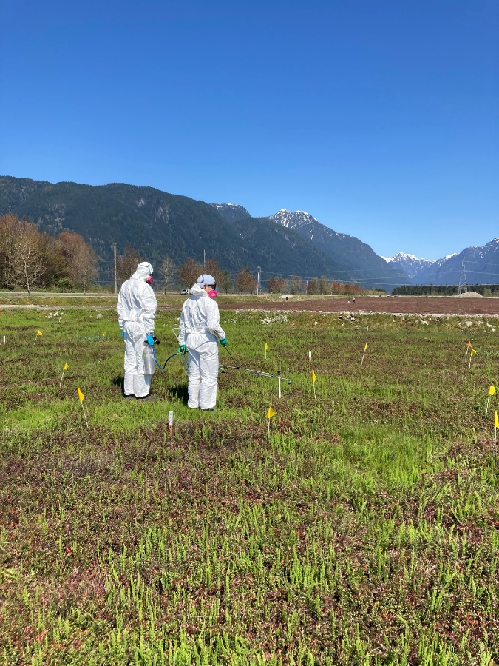
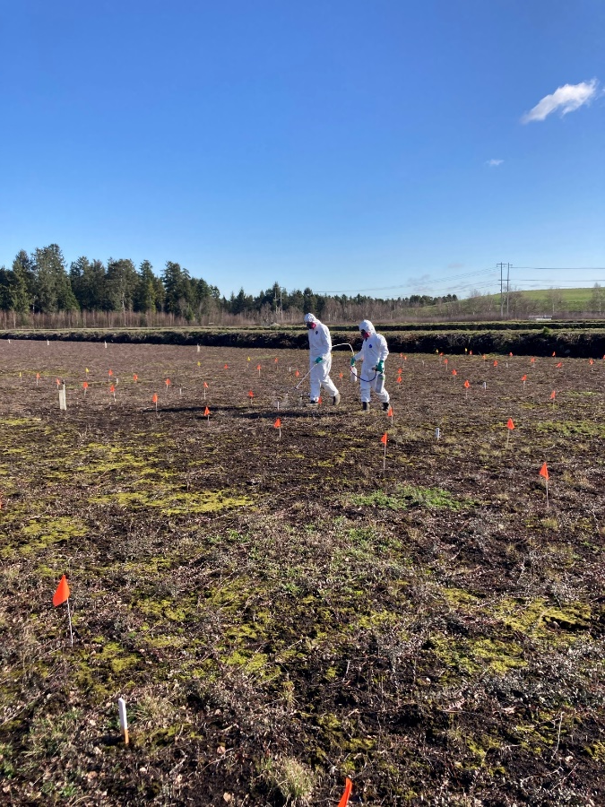
PRE and POST herbicide treatments
CO₂-pressurized backpack sprayer
A four-nozzle boom fitted with 8002VS flat-fan nozzles (TeeJet Technologies, Wheaton, IL) spaced 50 cm apart
Calibrated to deliver 200 L ha⁻¹ at 207 kPa.

Slide 16
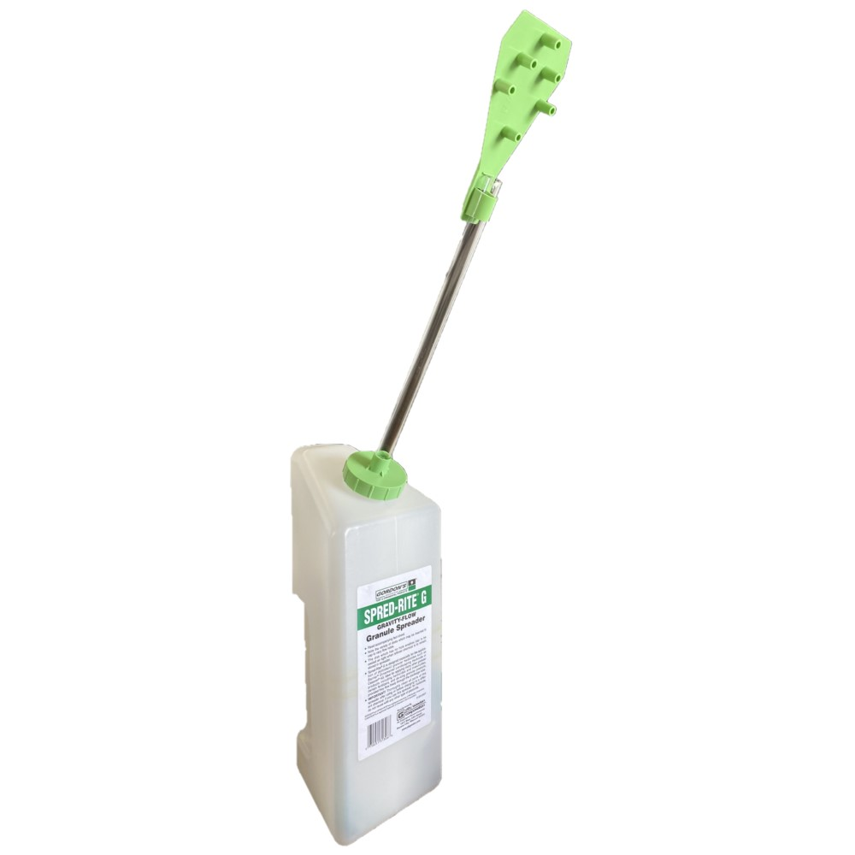
POST-H herbicide treatment
Granular herbicide
Hand-held applicator (Spread-Rite G, PBI Gordon Corp.)

Slide 17
Assessment
Weed and crop assessment
Bi-weekly starting after 2nd POST application
Phytotoxicity – 0% (no injury) to 100 % (complete crop loss)
Weed coverage (0-100%) of individual weed species
Crop yield and safety
Yield - all fruits harvest from two 0.25 m² quadrats
Subsample sent to laboratory for residue analysis

Slide 18
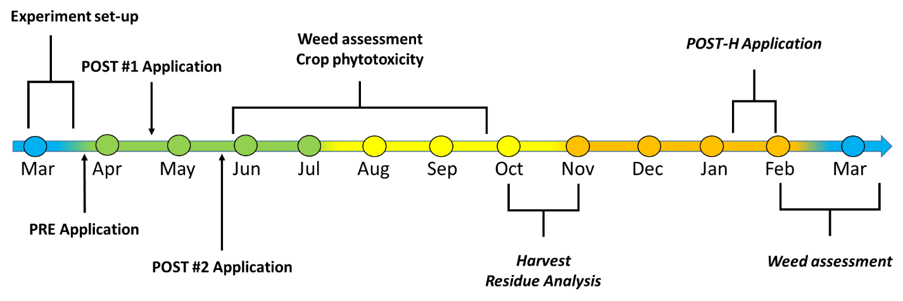
Timeline/Procedures (Year 1: 2020-2021)
PRE: March 26 (BCCRF) | March 29, 2021 (Pitt Meadows)
POST #1: April 20, 2021
POST #2: May 26, 2021
POST-H: January 26, 2022

Slide 19
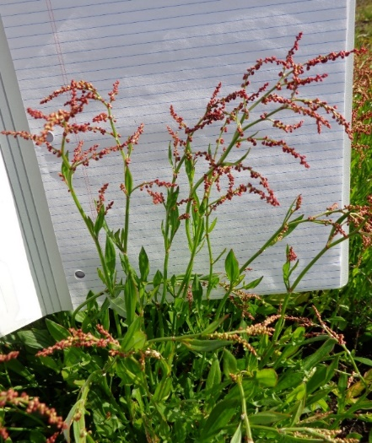
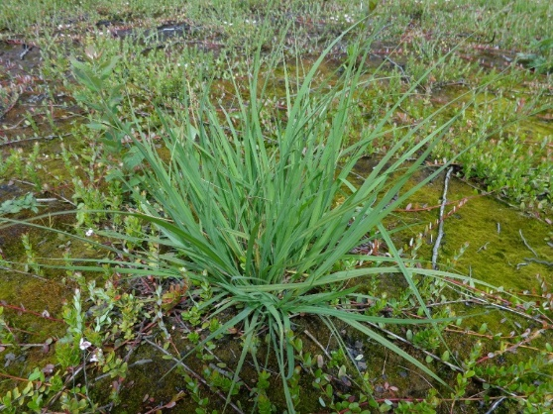
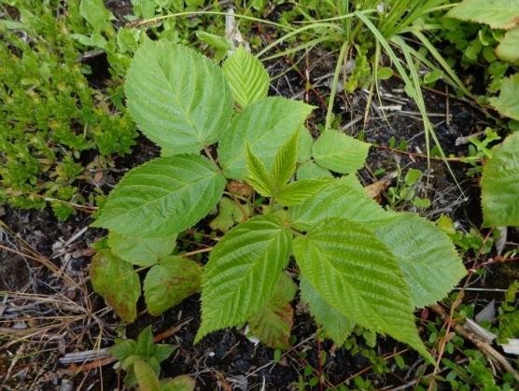
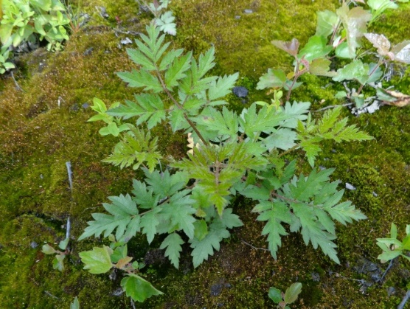
BC Cranberry Research Farm
14 weed species were present
Weed species commonly found in the experimental plots include:
Sheep sorrel
(Rumex acetosella)
Silvery sedge
(Carex canescens)
Cutleaf blackberry
(Rubus laciniatus)
Himalayan blackberry
(Rubus arme)

Slide 20
BC Cranberry Research Farm
Distribution and density are spatially and temporally heterogeneous throughout the experimental plots
Difficult to validate efficacy of the herbicide treatments
Sheep sorrel
(Rumex acetosella)
Silvery sedge
(Carex canescens)
Cutleaf blackberry
(Rubus laciniatus)
Himalayan blackberry
(Rubus arme)
0 to 90%
0 to 55%
0 to 25%
0 to 35%

Slide 21
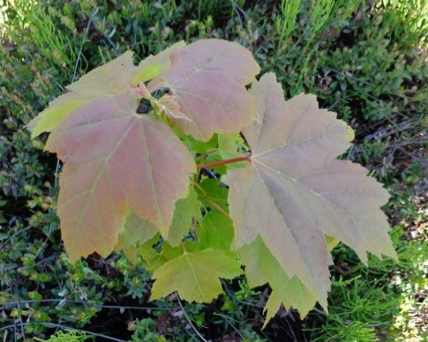


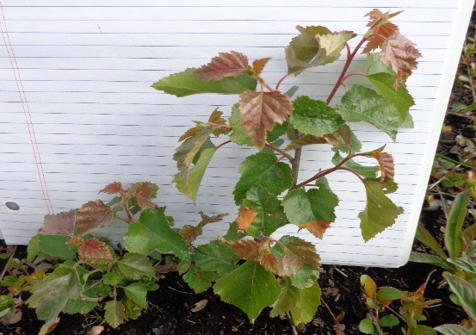
BC Cranberry Research Farm
No effect of the treatments on woody plants
Woody plants became dominant throughout the field sites
Summer (~56 days after 2nd POST application)
Blackberry, maple and birch
Very difficult to access to the plots for weed/crop assessments and POST-H treatment application in January 2022

Slide 22
BC Cranberry Research Farm
Distribution and density are spatially and temporally heterogeneous throughout the experimental plots
Difficult to validate efficacy of the herbicide treatments
The areas that have uniformly high pressure of weed species most commonly found in the field will be identified and experimental plots will be set up in March 2022

Slide 23
BC Cranberry Research Farm
No effect of the treatments on woody plants
Woody plants became dominant throughout the field sites
Hand-weeding of those woody plants will be performed before the commencement of the re-designed experiment.
Delayed 2nd POST treatments (at late hook or early blooming stage) or additional POST treatment (early blooming stage)

Slide 24
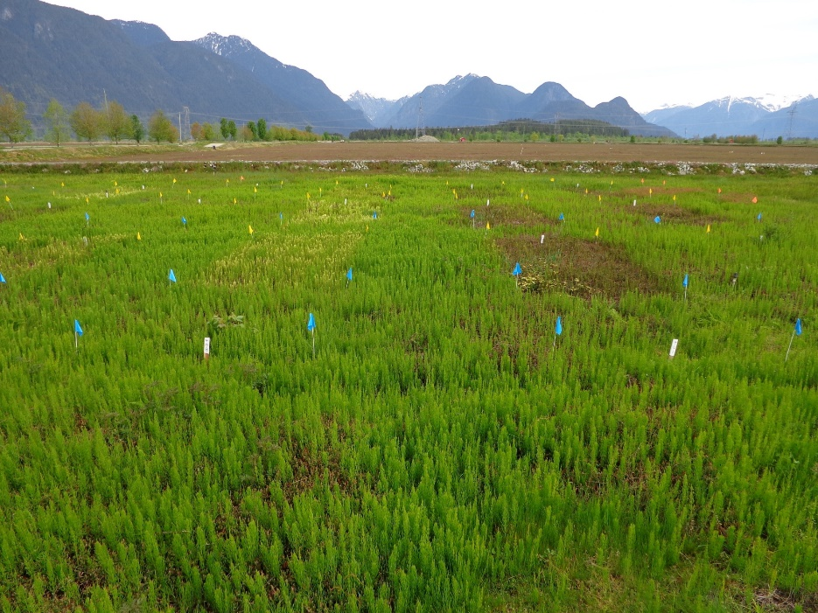
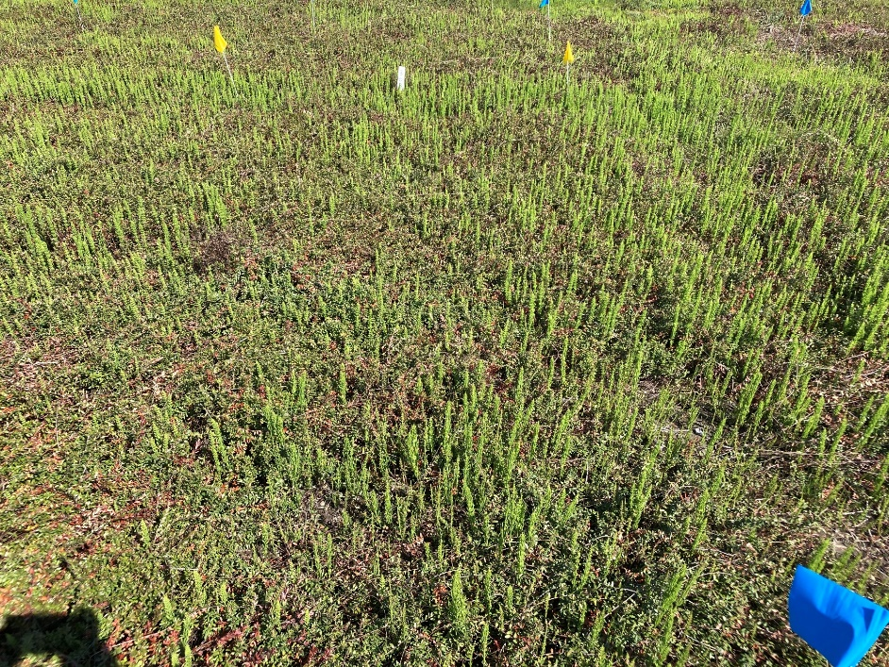
Pitt Meadows Site
Field horsetail (Equisetum arvense)
Dominant species in all the experimental plots (60 to 90% density)

Slide 25
Pitt Meadows Site
TRT | Application time (cranberry phenology)
 | Pre-bud break (March 29, 2021) | Bud break (April 20, 2021) | Hook (May 26, 2021) | Post-harvest (January 26, 2022)
#1 | Napropamide | Clopyralid | Mesotrione + Sethoxydim | -
#2 | Napropamide | Mesotrione | Mesotrione + Sethoxydim | -
#7 | Napropamide | Clopyralid | Mesotrione + Sethoxydim | Dichlobenil
#8 | Napropamide | Mesotrione | Mesotrione + Sethoxydim | Dichlobenil
Napropamide + POST : No or poor field horsetail control
TRT | June 9, 2021 | June 24, 2021 | July 22, 2021 | Sept 16, 2021 | Spring 2022
#1 | 10 ± 4% c | 13 ± 8% c | 9 ± 7% b | 25 ± 16% c | TBD
#2 | 0% c | 0 % c | 10 ± 6% b | 15 ± 10% c | TBD
#7 | 3 ± 2% c | 19 ± 10% c | 13 ± 6% b | 12 ± 7% c | TBD
#8 | 3 ± 3% c | 11 ± 11% c | 21 ± 7% b | 23 ± 16% c | TBD

Slide 26
Pitt Meadows Site
TRT | Application time (cranberry phenology)
 | Pre-bud break (March 29, 2021) | Bud break (April 20, 2021) | Hook (May 26, 2021) | Post-harvest (January 26, 2022)
#5 | - | Clopyralid | Mesotrione + Sethoxydim | Dichlobenil
#6 | - | Mesotrione | Mesotrione + Sethoxydim | Dichlobenil
POST only: Poor field horsetail control
TRT | June 9, 2021 | June 24, 2021 | July 22, 2021 | Sept 16, 2021 | Spring 2022
5 | 10 ± 4% c | 14 ± 12% c | 17 ± 10% b | 39 ± 20% abc | TBD
6 | 15 ± 13% c | 13 ± 9% c | 20 ± 9% b | 37 ± 5% abc | TBD

Slide 27
Pitt Meadows Site
TRT | Application time (cranberry phenology)
 | Pre-bud break (March 29, 2021) | Bud break (April 20, 2021) | Hook (May 26, 2021) | Post-harvest (January 26, 2022)
#3 | Sulfentrazone | Clopyralid | Mesotrione + Sethoxydim | -
#9 | Sulfentrazone | Clopyralid | Mesotrione + Sethoxydim | Dichlobenil
Sulfentrazone → Clopyralid → Mesotrione + Sethoxydim
Fair/good field horsetail control
But, the control efficacy was not maintained
TRT | June 9, 2021 | June 24, 2021 | July 22, 2021 | Sept 16, 2021 | Spring 2022
#3 | 42 ± 19% b | 52 ± 19% b | 50 ± 20% a | 33 ± 19% bc | TBD
#9 | 62 ± 2% ab | 77 ± 2% ab | 72 ± 7% a | 49 ± 9% abc | TBD

Slide 28
Pitt Meadows Site
TRT | Application time (cranberry phenology)
 | Pre-bud break (March 29, 2021) | Bud break (April 20, 2021) | Hook (May 26, 2021) | Post-harvest (January 26, 2022)
#4 | Sulfentrazone | Mesotrione | Mesotrione + Sethoxydim | -
#10 | Sulfentrazone | Mesotrione | Mesotrione + Sethoxydim | Dichlobenil
Sulfentrazone → Mesotrione → Mesotrione + Sethoxydim
Fair/good field horsetail control until the harvest
Post-harvest treatment – Fair/good or Excellent control?
TRT | June 9, 2021 | June 24, 2021 | July 22, 2021 | Sept 16, 2021 | Spring 2022
#4 | 68 ± 4% a | 80 ± 5% a | 77 ± 5% a | 71 ± 5% a | TBD
#10 | 60 ± 7% ab | 86 ± 3% a | 70 ± 13% a | 69 ± 12% a | TBD

Slide 29
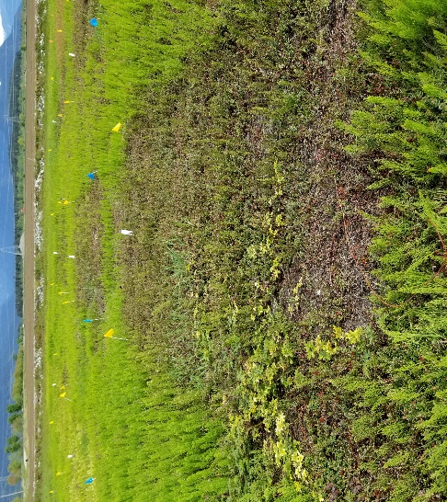
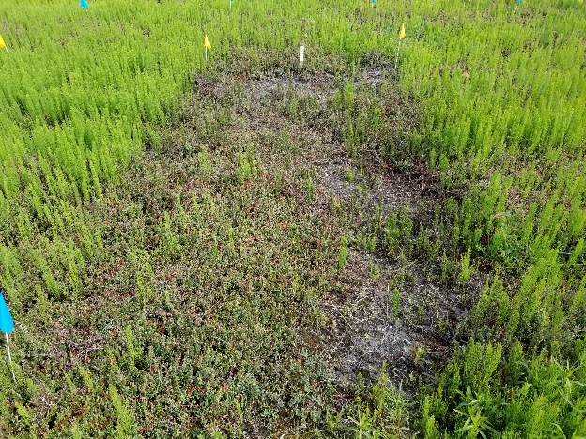
Pitt Meadow Site
TRT | Application time (cranberry phenology)
 | Pre-bud break (March 29, 2021) | Bud break (April 20, 2021) | Hook (May 26, 2021) | Post-harvest (January 26, 2022)
#4 | Sulfentrazone | Mesotrione | Mesotrione + Sethoxydim | -
#10 | Sulfentrazone | Mesotrione | Mesotrione + Sethoxydim | Dichlobenil

Slide 30
Pitt Meadow Site
Yield was ranged from 120 to 585 g m⁻²
No difference in yields among the treatments (p=0.22)
Heterogeneous cranberry establishment
None of the active ingredients was detected from the residue analyses
POST-H treatment applied on January 26, 2022
Efficacy on field horsetail will be assessed from March 2022
Crop residue of the post-harvest herbicide will be assessed in Fall 2022

Slide 31
Summary: Pitt Meadows Site
Sulfentrazone (pre-bud break stage) + mesotrione (bud break stage) + mesotrione tank-mixed sethxydim (hook stage)
Fair to good field horsetail control efficacy until the harvest
No herbicide residue in the berries
The POST-H efficacy on field horsetail in the following spring?
Efficacy of the multi-year herbicide layering?

Slide 32

Thank you
jichul.bae@agr.gc.ca

