Slide 1
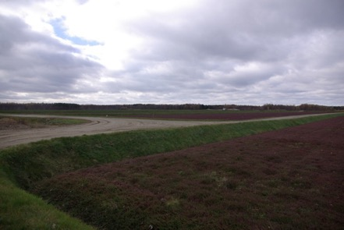
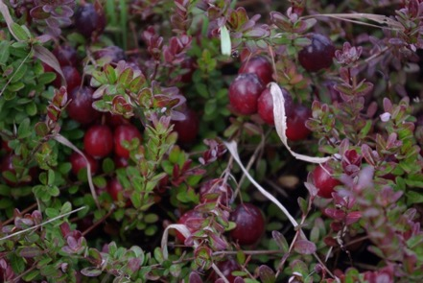
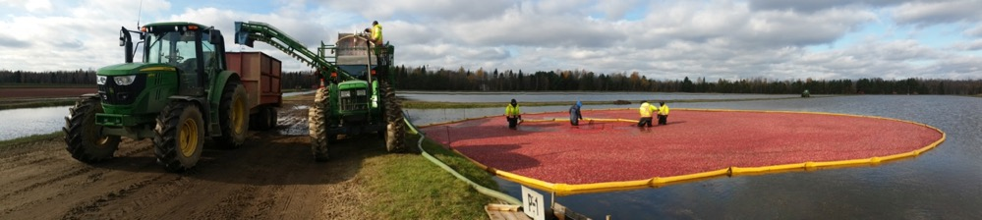
A new molecular tool to quickly detect cranberry fruit rot fungi and to perform large scale analyses
Prof. Richard R. Bélanger
Laval University
Québec, Canada
Pacific Northwest Cranberry Congress 2022
February 17, 2022

Slide 2
Importance of cranberry worldwide
(FAO, 2020)

Slide 3
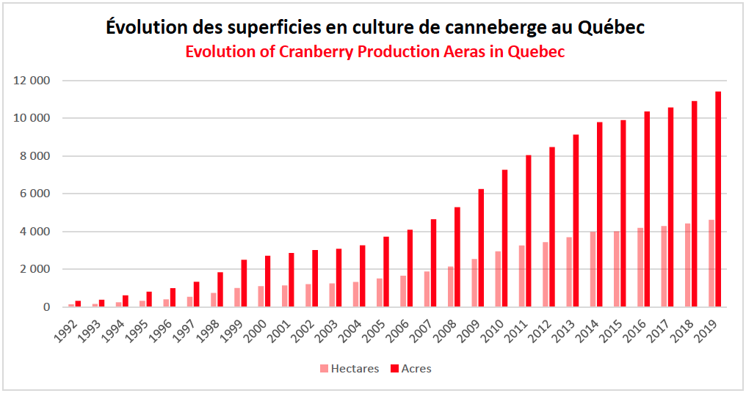
Importance of cranberry in Québec
Evolution of cranberry production areas in Quebec
(APCQ, 2019)

Slide 4
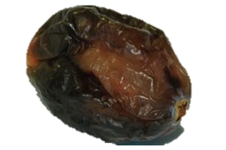
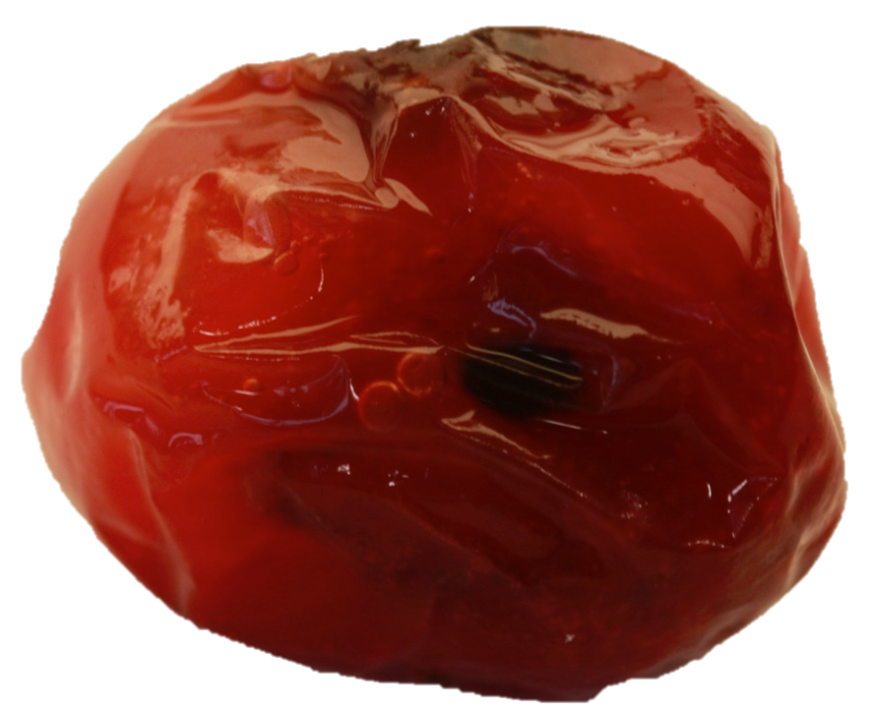
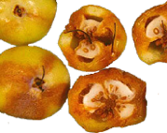
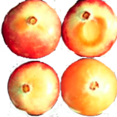
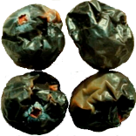
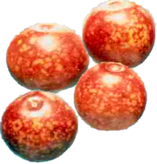
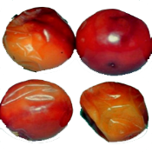
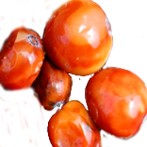
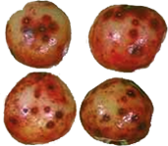
Cranberry fruit rot

Slide 5
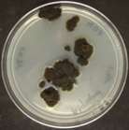
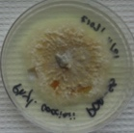
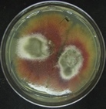
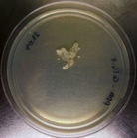
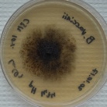
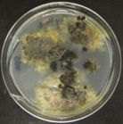

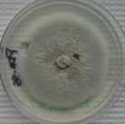
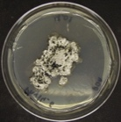
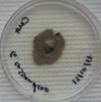
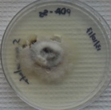
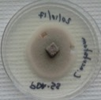
Cranberry fruit rot
1850 -> discovery of a problematic disease in the industry
1889 -> fungal pathogens were to blame for the disease
Today -> 12 main fungal species involved
Notes:
De une maladie à un complexe de maladie à un complexe d’espèces

Slide 6
Cranberry fruit rot
Family | Genus | Species | Type of rot
Glomerellaceae | Colletotrichum | fioriniae | Bitter rot | Field
Glomerellaceae | Colletotrichum | fructivorum
Sclerotiniaceae | Monilinia | oxycocci | Cottonball
Diaporthaceae | Phomopsis | vaccinii | Viscid rot
Phyllostictaceae | Phyllosticta | vaccinii | Early rot
Hyphonectriaceae | Physalospora | vaccinii | Blotch rot | Field and storage
Helotiale incertae sedis | Coleophoma | empetri | White rot
Helotiaceae | Godronia | cassandrae | End rot
Phacidiaceae | Allantophomopsis | cystisporea | Black rot | Storage
Phacidiaceae | Allantophomopsis | lycopodina
Phacidiaceae | Strasseria | geniculata
Botryosphaeriaceae | Botryosphaeria | vaccinii | Berry speckle

Slide 7
CFR: a complex disease

Slide 8
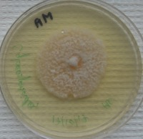
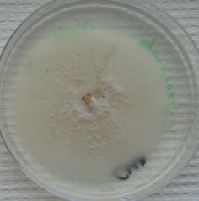
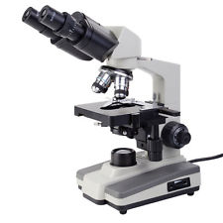
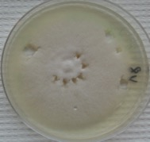
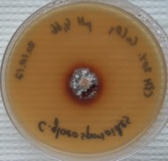
CFR diagnosis
Standard procedure
Purification
Isolation
Rotten fruit
Identification

Slide 9
CFR diagnosis
Standard procedure
Time consuming: can take up to 3-4 months
Cumbersome: all fungi (pathogenic or not) will grow on a petri dish
Late: the result of the analysis is available too late in the season
Not adapted for large scale analyses
Notes:
3-4, mais en étant un excellent mycologue, pas pour tout le monde, exige des bonnes connaissances

Slide 10
CFR diagnosis
Standard procedure
…important to develop a new method of detection

Slide 11
Objectives
develop a multiplex PCR tool able to detect the 12 main fungi involved in CFR
perform a large scale analysis in cranberry farms in Québec

Slide 12
Objective 1: the multiplex

Slide 13
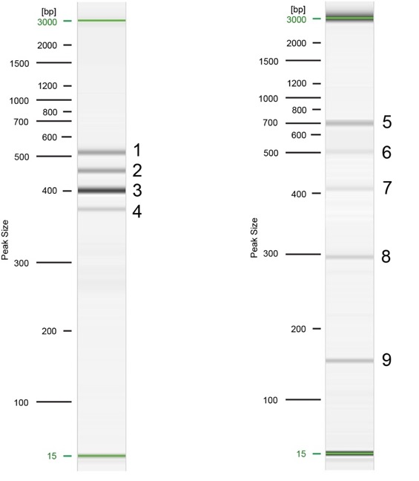
The multiplex
Reaction A
Reaction B
1 | Phyllosticta | vaccinii
2 | Monilinia | oxycocci
3 | Phacidiaceae (3)
4 | Phomopsis | vaccinii
5 | Coleophoma | empetri
6 | Godronia | cassandrae
7 | Botryosphaeria | vaccinii
8 | Physalospora | vaccinii
9 | Glomerellaceae (2)

Slide 14
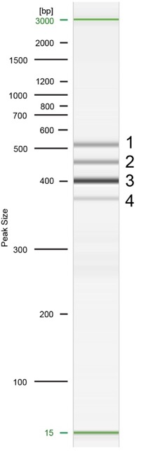
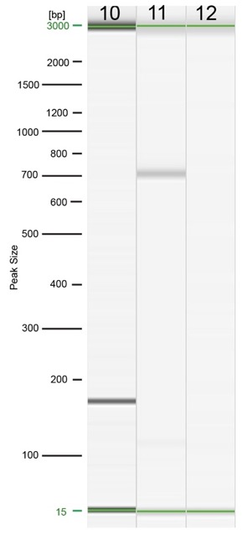
The multiplex
Reaction A
Reaction C
3 | Phacidiaceae
10 | Allantophomopsis | cytisporea
11 | Allantophomopsis | lycopodina
12 | Strasseria | geniculata

Slide 15
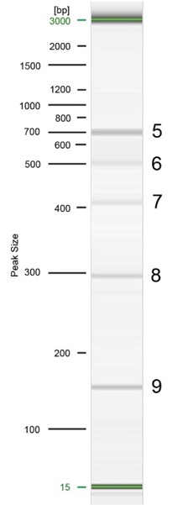
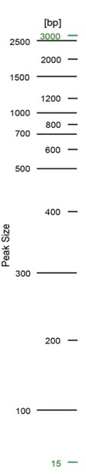

The multiplex
Reaction B
Reaction D
9 | Glomerellaceae
13 | Colletotrichum | fioriniae
14 | Colletotrichum | fructivorum
13 14

Slide 16
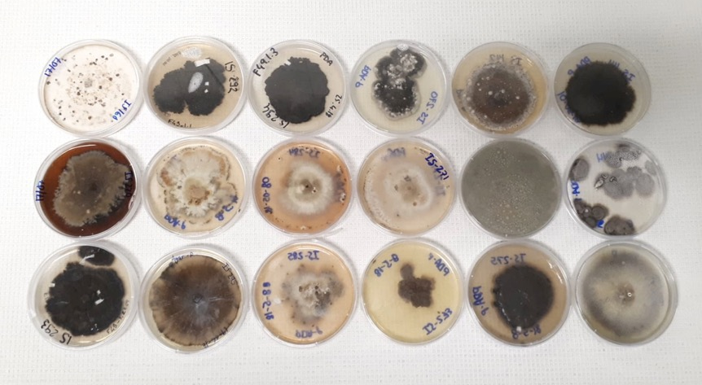
The multiplex: VALIDATION
Sequences of 300 isolates from rotten fruit
Notes:
Ces champignons la sont ceux qui prédominent au québec
Prendre plus de temps pour insister sur le fait que le test est discriminant et il ne s’interese pas aux saprophytes qui peuvent induire à des erreurs

Slide 17
The multiplex: VALIDATION
Sequences of 300 isolates from rotten fruit
Trichoderma sp., Penicillium sp., Mucor sp., etc.
Fungi responsible for CFR
Notes:
Ces champignons la sont ceux qui prédominent au québec
Prendre plus de temps pour insister sur le fait que le test est discriminant et il ne s’interese pas aux saprophytes qui peuvent induire à des erreurs

Slide 18
The multiplex: VALIDATION
Fungi responsible for CFR
Notes:
Ces champignons la sont ceux qui prédominent au québec

Slide 19
To sum up
The molecular tool allows:
  A precise diagnosis of the main CFR fungi (and only of those!)
  A rapid identification (only a few hours needed)
  An identification in multiple plant tissues, not only on fruit
The tool can be used for a quick diagnosis as well as for large scale surveys
  Up to 2000 times more efficient than the traditional methods
  Can provide a reliable representation of the epidemiological situation of an entire region

Slide 20
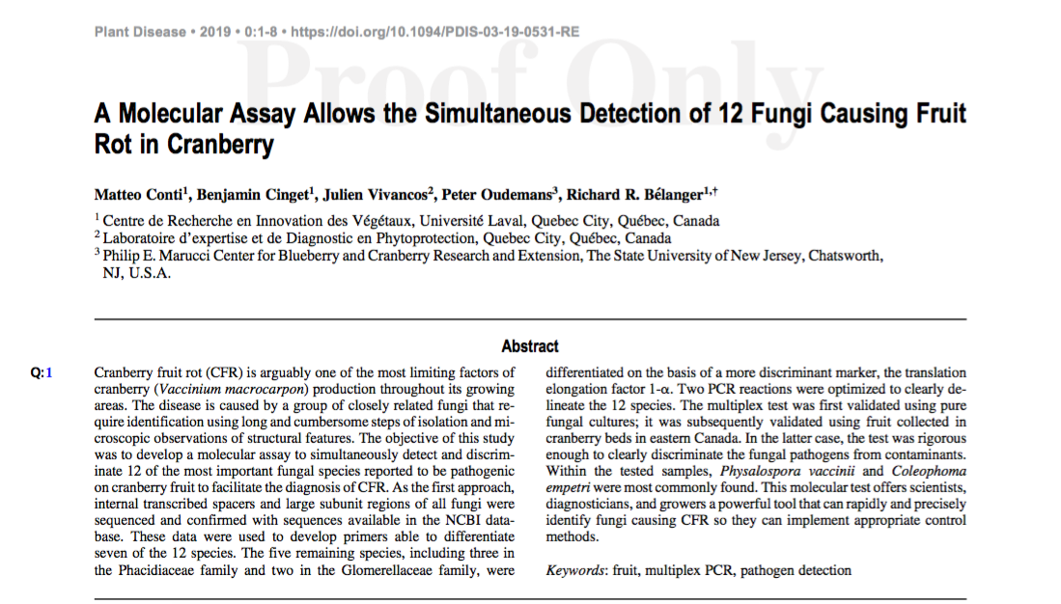

Slide 21
Objectives
develop a multiplex PCR tool able to detect the 12 main fungi involved in CFR
perform a large scale analysis in cranberry farms in Québec

Slide 22
Objective 2: large scale survey

Slide 23
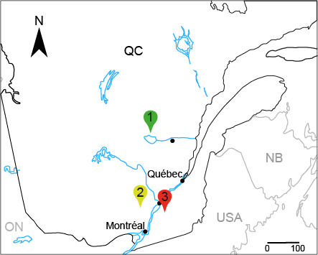
Parameters
Large scale survey
126 fields analysed
3 farms
Parameter 1: impact of fungicides
  Farm 1: organic
  Farm 2: whitout fungicides since 2015
  Farm 3: conventional

Slide 24
Large scale survey
Parameters
Parameter 2: Sampling time
  Harvest
  Storage: fruits sampled after 3 and after 6 weeks of storage
Harvest
3 weeks
6 weeks
3300 fruits
2260 fruits
2265 fruits
7825 fruits = 18780 observations

Slide 25
Large scale survey
Parameters
Number of fields sampled by farm according to the cultivars and the sampling time
Parameter 3: Cultivar
  Bergman
  Ben Lear
  Gryglesky
  Howes
  Mullica Queen
  Pilgrim
  Scarlett Knight
  Stevens
 | Cultivars
 | BE | BL | GR | HW | MQ | PL | SK | ST
Sampling at harvest
Farm 1 | 1 | 0 | 0 | 0 | 0 | 2 | 0 | 32
Farm 2 | 0 | 0 | 5 | 0 | 4 | 0 | 5 | 15
Farm 3 | 0 | 13 | 0 | 6 | 0 | 12 | 0 | 30
Sampling after 3-week storageª
Farm 1 | 0 | 0 | 0 | 0 | 0 | 0 | 0 | 0
Farm 2 | 0 | 0 | 5 | 0 | 4 | 0 | 5 | 15
Farm 3 | 0 | 13 | 0 | 6 | 0 | 12 | 0 | 30
Sampling after 6-week storageª
Farm 1 | 0 | 0 | 0 | 0 | 0 | 0 | 0 | 0
Farm 2 | 0 | 0 | 5 | 0 | 4 | 0 | 5 | 15
Farm 3 | 0 | 13 | 0 | 6 | 0 | 12 | 0 | 31
ªNo sampling was done after 3- and 6-weeks of storage for the farm 1.
^{Conti et al., 2021}

Slide 26
Large scale survey: RESULTS

Slide 27
Large scale survey: RESULTS

Slide 28
Large scale survey: RESULTS
Michigan:
A. lycopodina, C. empetri, C. fioriniae, G. cassandrae, Phom. vaccinii, Phyl. vaccinii, Phys. vaccinii
Washington
Allantophomopsis spp., C.empetri, Colletotrichum spp., G. cassandrae, Phys. vaccinii
New Jersey
A. cytisporea, A. lycopodina, C. empetri, C. fructivorum, Phom. vaccinii, Phyl. vaccinii, Phys. vaccinii

Slide 29
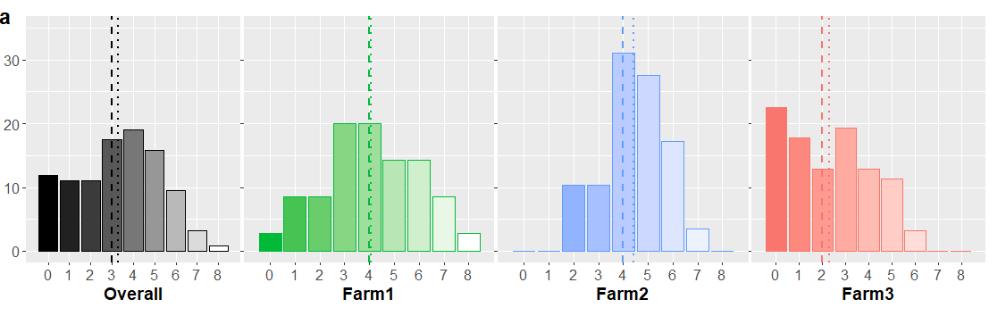
Impact of fungicides
% de champs
Transition
^{Conti et al., 2021}
Organic
Conventional
Richness
Notes:
Richesse: pouvant aller de 0 à 12, est déterminé par le nombre d'espèces présentes simultanement dans un même champs
Abondance: pouvant aller de 0 à 5, nbre de fois que je détecte chaque espèce

Slide 30
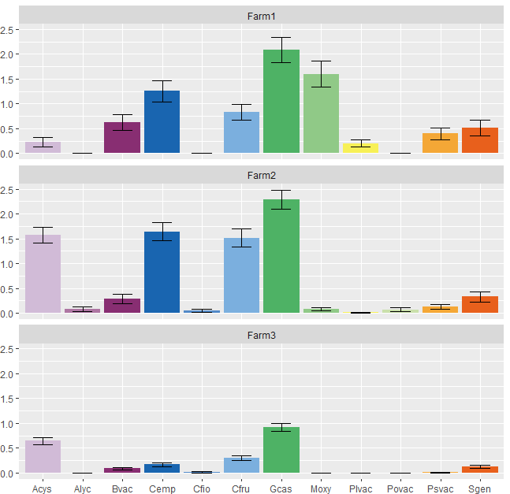
Impact of fungicides
Organic
Acys: Allantophomopsis cytisporea
Alyc: Allantophomopsis lycopodina
Bvac: Botryosphaeria vaccinii
Cemp: Coleophoma empetri
Cfio: Colletrotrichum fioriniae
Cfru: Colletotrichum fructivorum
Gcas: Godronia cassandrae
Moxy: Monilinia oxycocci
Plvac: Phyllosticta vaccinii
Povac: Phomopsis vaccinii
Psvac: Physalospora vaccinii
Sgen: Strasseria geniculata
Transition
Aboundance
Conventional
^{Conti et al., 2021}
Fungal pathogens

Slide 31
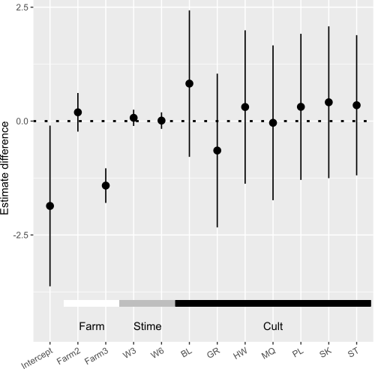
Large scale survey: RESULTS
Impact of fungicides
Notes:
On a évalué nos paramètres via un modele linéaire généralisé et le modele montre si on a des diff significatives ou pas
plus la barre est petite, moins il peut y avoir d’erreur (ex cultivar, bcp de variation/disparités entre champs et entre variétés)

Slide 32
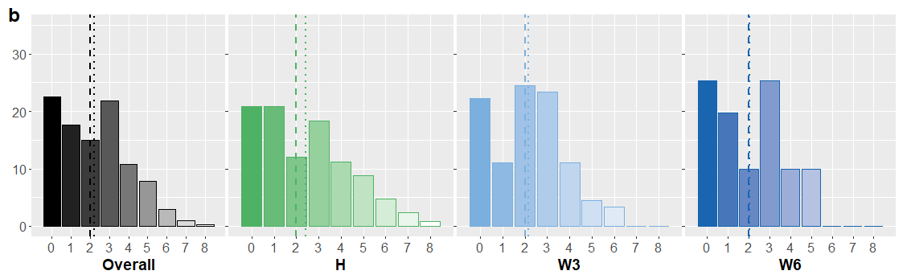
Large scale survey: RESULTS
Sampling time
H: harvest
W3: three weeks of storage
W6: six weeks of storage
% of fields
Species richness
^{Conti et al., 2021}

Slide 33
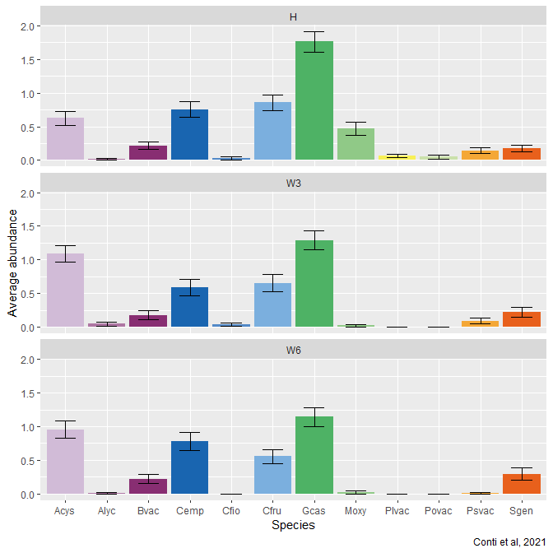
Large scale survey: RESULTS
Sampling time
H: harvest
W3: three weeks of storage
W6: six weeks of storage
Acys: Allantophomopsis cytisporea
Alyc: Allantophomopsis lycopodina
Bvac: Botryosphaeria vaccinii
Cemp: Coleophoma empetri
Cfio: Colletrotrichum fioriniae
Cfru: Colletotrichum fructivorum
Gcas: Godronia cassandrae
Moxy: Monilinia oxycocci
Plvac: Phyllosticta vaccinii
Povac: Phomopsis vaccinii
Psvac: Physalospora vaccinii
Sgen: Strasseria geniculata

Slide 34
Large scale survey: RESULTS
Sampling time
H: harvest
W3: three weeks of storage
W6: six weeks of storage
Notes:
Ce resultat contredit toute les connaissances d’avant qu’elle disaient que il y avait des differences entre récolte et entreposage

Slide 35
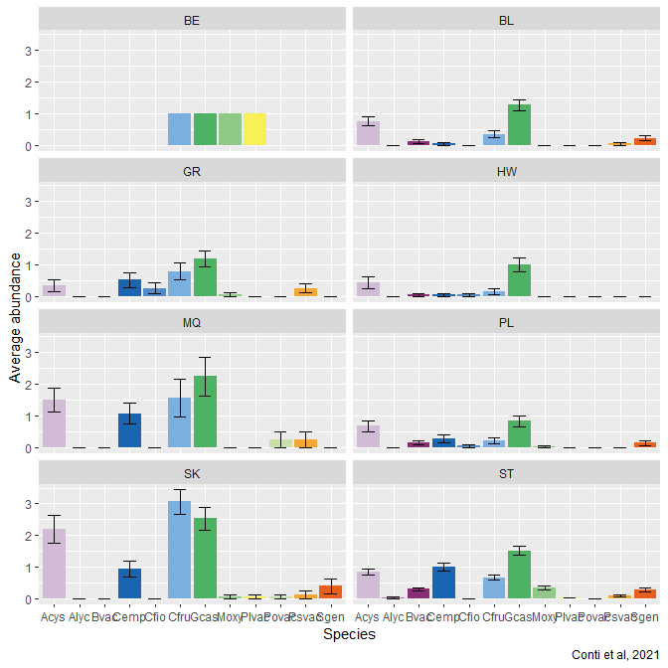
Large scale survey: RESULTS
Bergman
Ben Lear
Cultivar
BE: Bergman
BL: Ben Lear
GR: Gryglesky
HW: Howes
MQ: Mullica Queen
PL: Pilgrim
SK: Scarlett Knight
ST: Stevens
Grygelsky
Howes
Acys: Allantophomopsis cytisporea
Alyc: Allantophomopsis lycopodina
Bvac: Botryosphaeria vaccinii
Cemp: Coleophoma empetri
Cfio: Colletrotrichum fioriniae
Cfru: Colletotrichum fructivorum
Gcas: Godronia cassandrae
Moxy: Monilinia oxycocci
Plvac: Phyllosticta vaccinii
Povac: Phomopsis vaccinii
Psvac: Physalospora vaccinii
Sgen: Strasseria geniculata
Mullica Queen
Pilgrim
Scarlett Knight
Stevens
Cfio
Cfio
Cfru
Sgen
Cfru
Sgen
Acys
Bvac
Gcas
Acys
Bvac
Gcas
Alyc
Cemp
Plvac
Psvac
Alyc
Cemp
Plvac
Psvac
Moxy
Povac
Moxy
Povac
Notes:
Alyc

Slide 36
Large scale survey: RESULTS
Cultivar
BE: Bergman
BL: Ben Lear
GR: Gryglesky
HW: Howes
MQ: Mullica Queen
PL: Pilgrim
SK: Scarlett Knight
ST: Stevens

Slide 37

In summary…
All 12 fungal species were detected at some point
  -> Four main species involved in Quebec farms
On average, more than three fungi per field
  -> CFR = complex disease
Fungicides have a clear impact on species richness and abundance
  -> Higher risk of fungicide-resistance development
Absence of a de novo contamination in storage
  -> The fungal composition does not change between harvest and storage
No significant differences found among the eight different cultivars

Slide 38
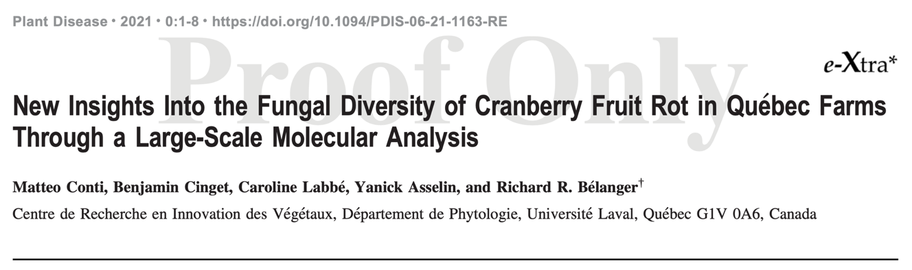

Slide 39
QUESTIONS

