Slide 1
Cranberry Research Farm Update: 2021 Results
Phenology (2020 to 2021)
Yield (2015 to 2021)
Fruit Quality (2019 to 2021)
Rutgers
  Released Varieties
  Numbered
    High Yield Numbered Varieties (2015 planting)
    Fruit Rot Resistance Varieties (2016 plantings)
Valley Corp
  Released Varieties

Slide 2
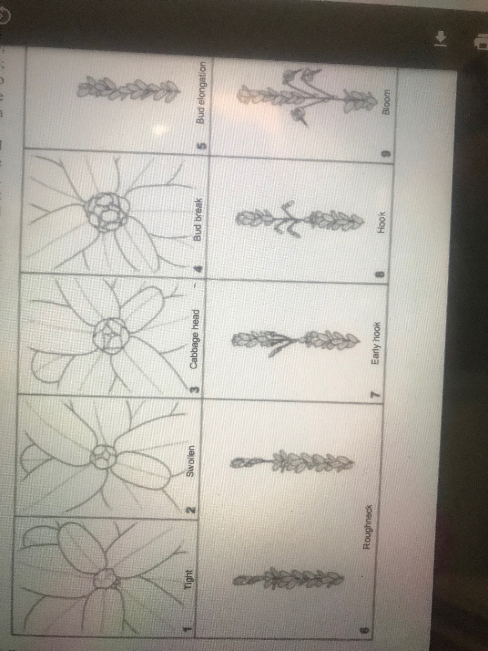

Slide 3
Frost protection
Stop Pre-Emergent Herbicide Applications
reduce phytotoxicity risk
Look for Fireworm
Fungicides for fruit ro

Slide 4
Upright Phenology 2020
Hook
Mullica Queen earliest to break dormancy
BG earliest to hit rough neck
Haines is relatively the slowest to break dormancy
Stays the slowest right through to hook
Early Hook
Rough Neck
Bud Elongation
Bud break
Cabbage Head

Slide 5
2021 Upright Phenology

Slide 6
2021 Upright Phenology

Slide 7
Bloom Phenology
2020
Haines continues to be the slowest to bloom
Demoranville and BG earliest to set fruit

Slide 8
2021 Bloom Phenology

Slide 9
Cranberry Research Farm Update: 2021 Results
Phenology (2020 to 2021)
Yield (2015 to 2021)
Fruit Quality (2019 to 2021)
Rutgers
  Released Varieties
  Numbered
    High Yield Numbered Varieties (2015 planting)
    Fruit Rot Resistance Varieties (2016 plantings)
Valley Corp
  Released Varieties

Slide 10
6 year average Rutgers released + RS 11 (2013 planting)
Vasanna has the highest 6 year average marketable yield (483 barrels/acre)
Demoranville lowest marketable yield (287.57 barrels/acre)
6 year average was over 300 barrels/acre for remaining varieties

Slide 11
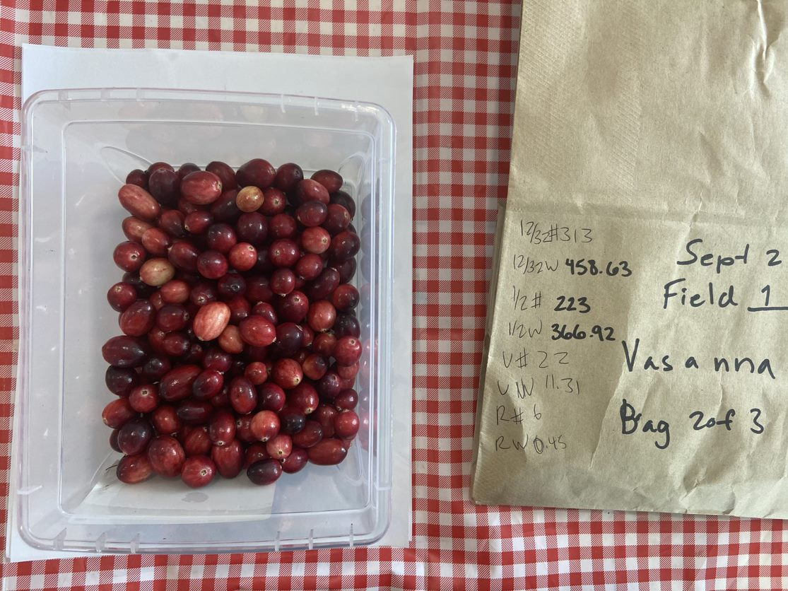
Vasanna (RS99-25)
Data are only from Field 1
7-year average 420.37 estimated barrels/acre
Vasanna

Slide 12
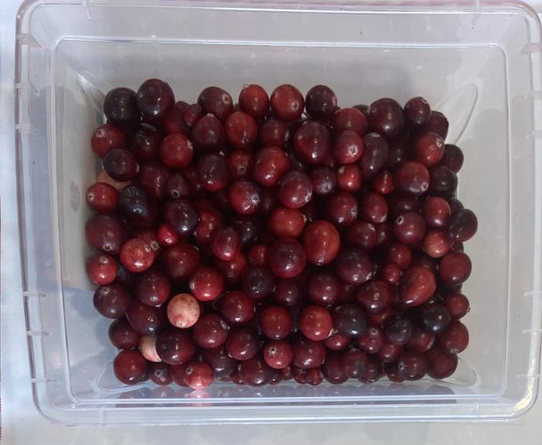
Crimson Queen
Data are only from Field 1
7-year average 378.29 estimated barrels/acre

Slide 13
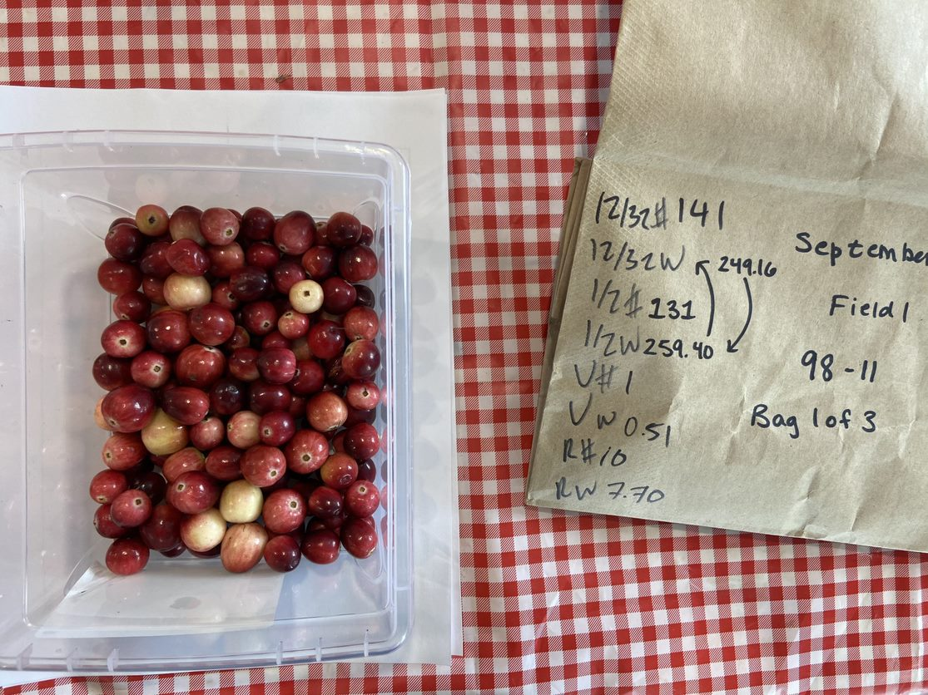
RS-11
Data are from Field 2
7-year average 376.77 estimated barrels/acre
Second highest yield in 2021
RS11

Slide 14
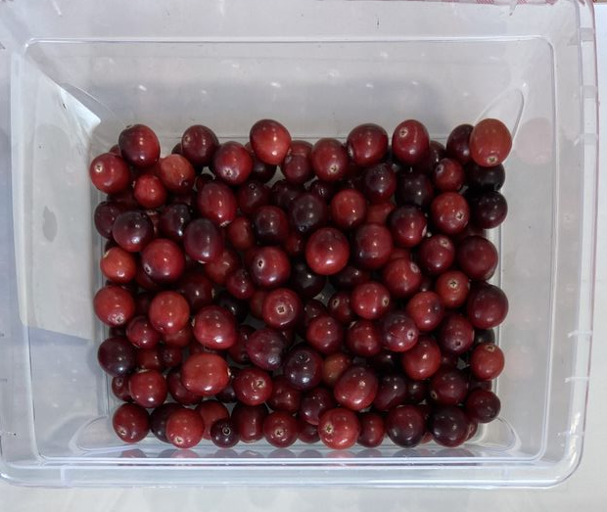
Haines
Data are only from Field 1
7-year average 333.58 estimated barrels/acre

Slide 15
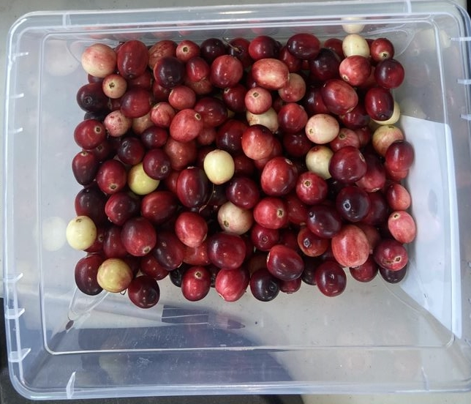
Mullica Queen
Data are only from Field 1
7-year average 326.26 estimated barrels/acre

Slide 16
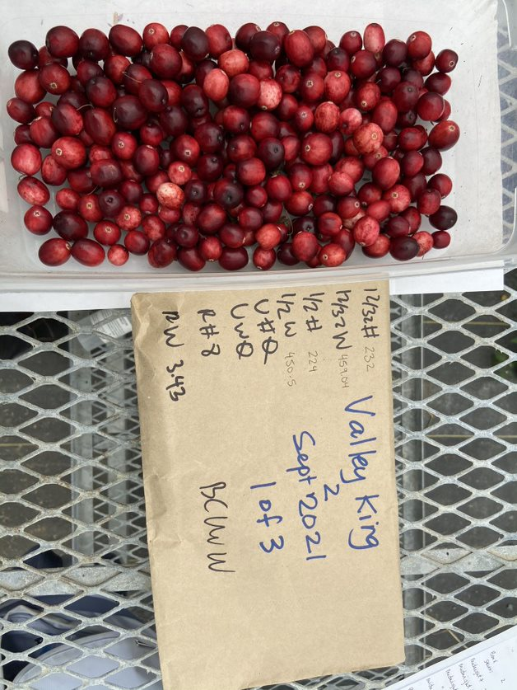
Valley King
Data are only from Field 2
7-year average 295.94 estimated barrels/acre
Highest yield in 2021

Slide 17
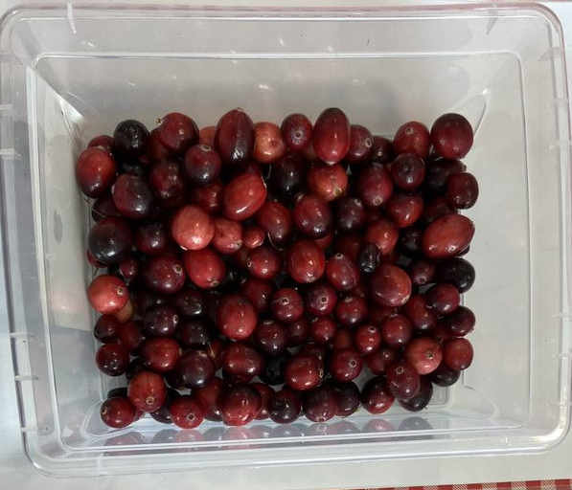
Demoranville
Data are only from Field 1
7-year average 288.51 estimated barrels/acre

Slide 18
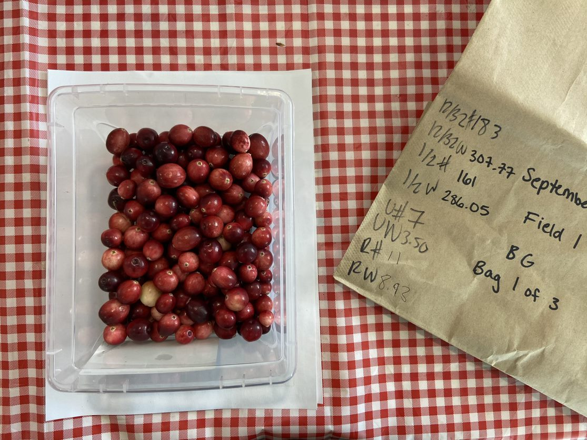
BG
Data are only from Field 2
7-year average 272.22 estimated barrels/acre
Third highest yield in 2021
BG

Slide 19
Cranberry Research Farm Update: 2021 Key Points
Yield is down in all varieties compared to 2020
All the new varieties are showing “biennialness”
Valley King, BG, RS-11, and Vasanna – all had 2021 estimated yields over 300 barrels/acre
Vasanna highest average yield over the 7 years

Slide 20
Valley King
Vasanna
BG
RS11

Slide 21
2015 Plantings: High Yield Varieties

Slide 22
Cranberry Research Farm Update: 2021 Results
Phenology (2020 to 2021)
Yield (2015 to 2021)
Fruit Quality (2019 to 2021)
Rutgers
  Released Varieties
  Numbered
    High Yield Numbered Varieties (2015 planting)
    Fruit Rot Resistance Varieties (2016 plantings)
Valley Corp
  Released Varieties

Slide 23
Fruit Quality: Firmness

Slide 24
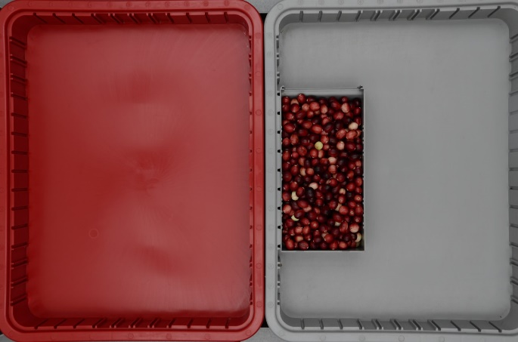
Fruit Quality: Colour
New method in 2020
All varieties were under the % allowed for Class 1 berries by
NB: Canopy growth impacts colour; BCCRF canopy is only 9 to 7 years old
Photo: M. Elsby

Slide 25
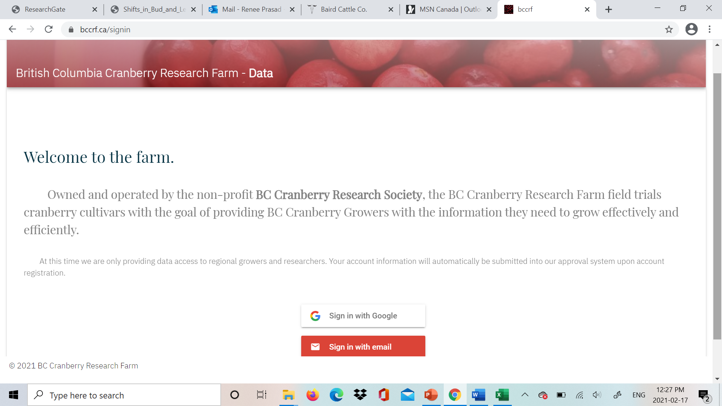
Growers can now download the data, for released varieties, themselves …

Slide 26




Acknowledgements
“This project was funded in part by Agriculture and Agri-Food Canada and the Government of British Columbia through programs delivered by the Investment Agriculture Foundation of B.C.”
Daniel Dufau – Website updates and maintenance
Field and lab crews: ES Cropconsult Ltd. (Heidi, Miriam and Elizabeth) UFV (Karli, Leah)
BC Cranberry Research Farm, especially Kyle Botkin (Operations Manager)
Ocean Spray of Canada – Miranda and the lab staff and Richmond station staff

